Slide 1
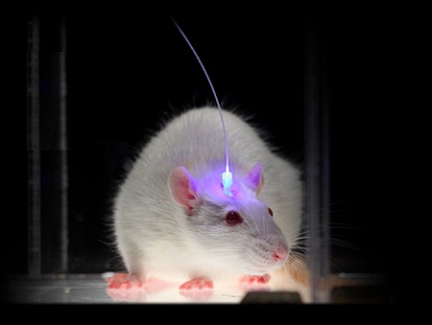
The optogenetic revolution

Slide 3
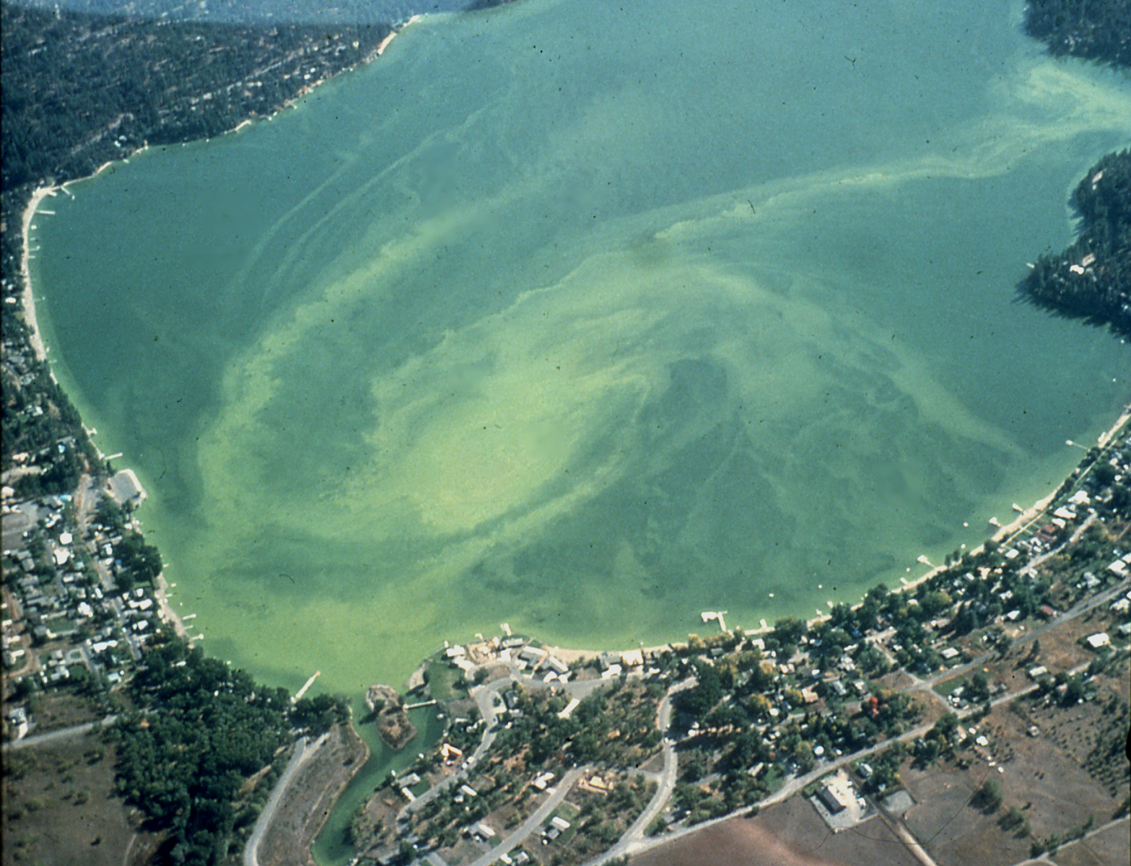
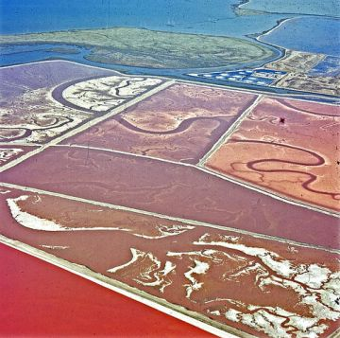
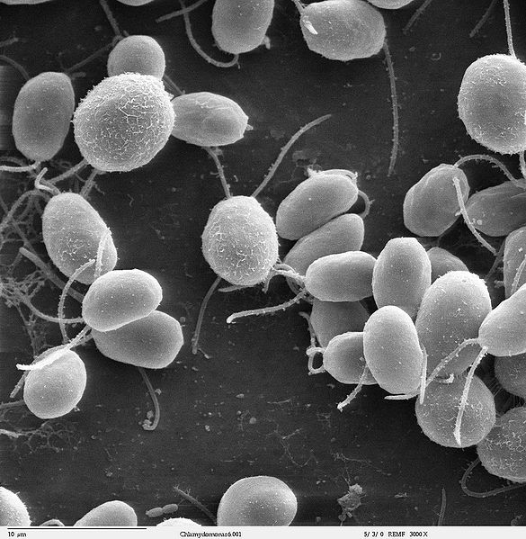
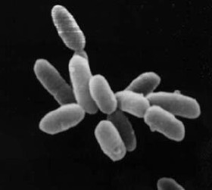
How algae changed neuroscience

Slide 4
https://www.youtube.com/watch?v=I64X7vHSHOE

Slide 5
Channelrhodopsin can activate neurons with millisecond resolution
Halorhodopsin can inactivate neurons at the same timescale

Slide 6
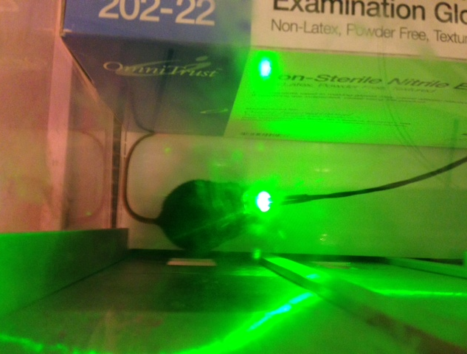
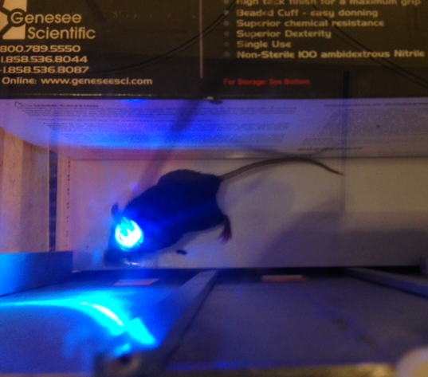
Channelrhodopsin can activate neurons at ~473nm (blue-ish)
Halorhodopsin can inactivate neurons at ~576nm (yellow-ish)

Slide 8
Mind control?
https://www.youtube.com/watch?v=FlGbznBmx8M
https://www.youtube.com/watch?v=v7uRFVR9BPU

Slide 9
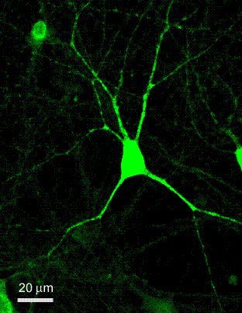
Optogenetics enables terminal-specific modulation of neural activity—an unprecedented technical achievement in neuroscience.

Slide 10
Targeting the targets of brain cells
Laser over cell bodies
Laser over axons
Optogenetics enables terminal-specific, cell-type specific, or spatially restricted modulation of neural activity.

Slide 11
A study in manipulating cell bodies

Slide 12
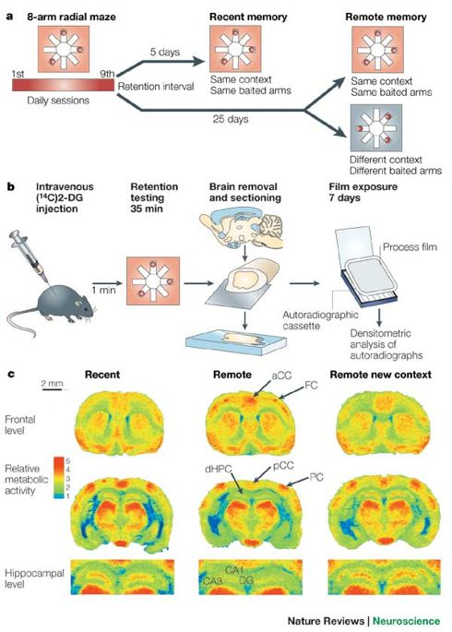
Systems Consolidation of Memory
Coronal sections of the rodent brain
The hippocampus is highly active when recalling a recent memory
The prefrontal cortex is highly active when recalling a remote memory

Slide 13
Goshen et al. Cell, 2011
Optogenetic inhibition of the hippocampus impaired acquisition and retrieval of recent memories (1 day old)
Optogenetic inhibition of the hippocampus impaired retrieval of remote memories (28 days old)
Why would optogenetic inhibition of hippocampus lead to a remote memory deficit?

Slide 14
Goshen et al. Cell, 2011
Prolonged inhibition of the hippocampus leads to *no* deficit, perhaps mimicking the timescale that drugs like anisomycin work on
Acute (optogenetic, “precise”) inhibition of the hippocampus leads to a deficit
Is the brain given enough time to compensate when the inhibition is long, e.g. drug inhibition?
During prolonged inhibition, the pfc now takes over and compensates and the animal freezes

Slide 15
Optogenetics enables terminal-specific modulation of neural activity—an unprecedented technical achievement in neuroscience.

Slide 16
A study in manipulating cell bodies or axons

Slide 17
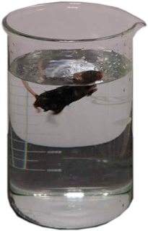
Measurements of depression-like behavior
The forced swim test has been routinely used as a measure of depression-like behavior
The PFC has been a key site linked in depression-like behaviors and gives us a target for optogenetic studies

Slide 18
A study in manipulating cell bodies or axons
Stimulating the mPFC with ChR2 does *not* change the amount of “struggling” a mouse displays in the forced swim test.
In these experiments, the researchers either stimulated cells that had ChR2 expressed in them and caused these cells to turn on, or they used a control virus in which the enhanced yellow fluorescent protein (eYFP) was expressed in cells that also received blue light, except eYFP does not respond to light so this is an important control to rule out the effects of simply shooting light into the brain.

Slide 19
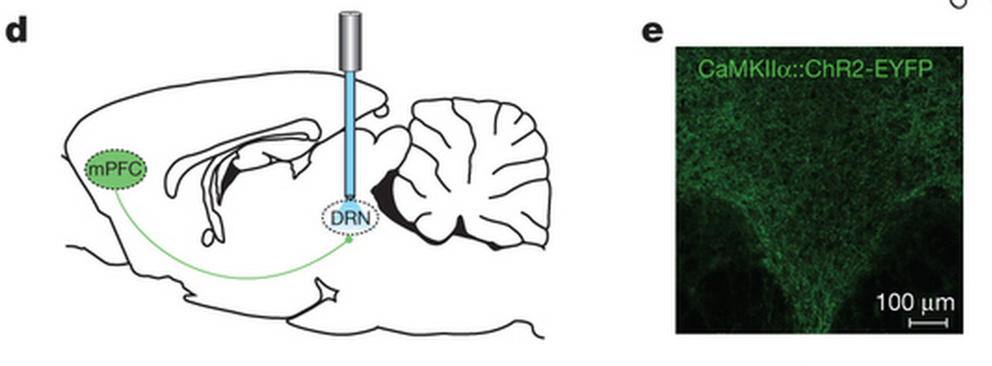
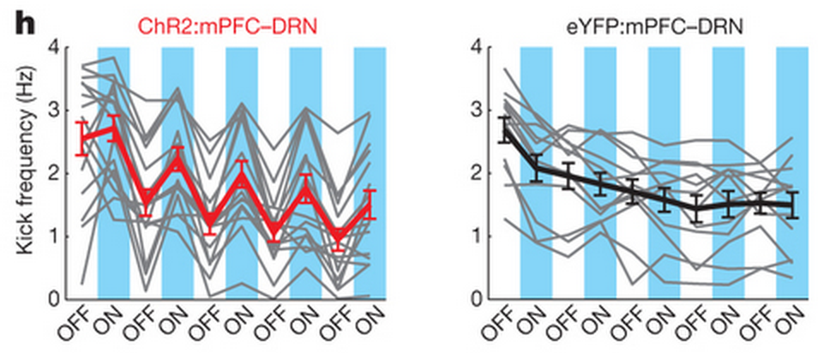
An example of terminal-specific control of behavior
Stimulating the mPFC axonal terminals in the dorsal raphe nucleus (which makes serotonin) with ChR2 increases the amount of “struggling” a mouse displays in the forced swim test.

Slide 20
An example of terminal-specific control of behavior
Stimulating the mPFC axonal terminals in the lateral habenula (which is involved in depression) with ChR2 decreases the amount of “struggling” a mouse displays in the forced swim test.

Slide 21
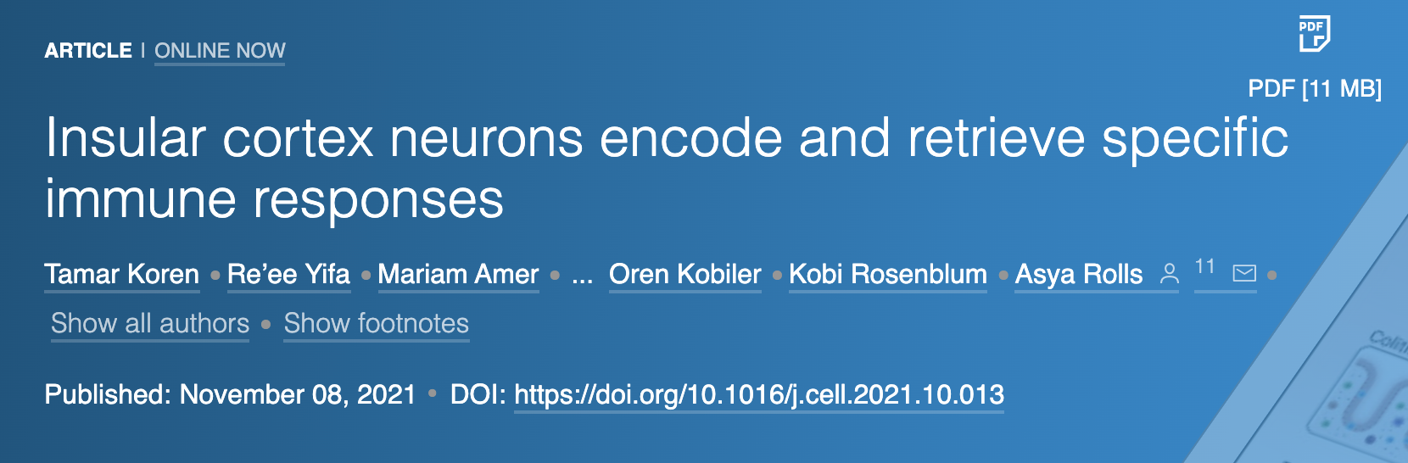
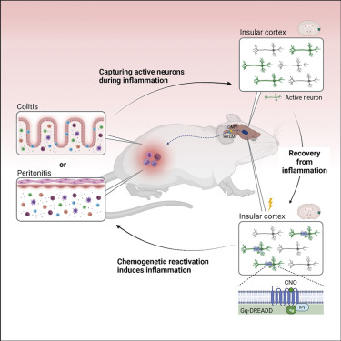

Slide 22
Summary of terminal-specific studies
ChR2-positive
cell bodies
Optogenetic manipulation
of terminals
Effect on behaviors
Axons to the lateral habenula (ChR2)
Pro-depression
PFC
Axons to the dorsal raphe nucleus (ChR2)
Anti-depression

Slide 23

Optogenetic
Reactivation
Axons to the hippocampus (ChR2)
HPC
BLA

Slide 24
The open field test can be used to measure anxiety-like behaviors in animals. ”Anxious” animals spend less time in the center of the arena
BLA inputs to the hippocampus can be turned on to increase anxiety or turned off to decrease anxiety.

Slide 25
The elevated plus maze test can be used to measure anxiety-like behaviors in animals. ”Anxious” animals spend less time in the open arms of the arena
BLA inputs to the hippocampus can be turned on to increase anxiety or turned off to decrease anxiety.

Slide 26
The resident intruder test can be used to measure social interactions between two animals.
BLA inputs to the hippocampus can be turned on to decrease social behaviors or turned off to increase social behaviors

Slide 27
The three-chamber test can be used to measure social interactions between two animals.
BLA inputs to the hippocampus can be turned on to decrease social behaviors or turned off to increase social behaviors
Collectively, BLA inputs to the hippocampus can be shown to be anxiety-inducing (”anxiogeneic”) when turned on, or anti-anxiety (“anxiolytic”) when turned off

Slide 28
Summary of terminal-specific studies
ChR2-positive
cell bodies
Optogenetic manipulation
of terminals
Effect on behaviors
Axons to the lateral habenula (ChR2)
Pro-depression
PFC
Axons to the dorsal raphe nucleus (ChR2)
Anti-depression
Axons to the hippocampus (ChR2)
Anxiogenic
BLA
Axons to the hippocampus (NpHR)
Anxiolytic

Slide 31
BNST = Bed Nucleus of the Stria Terminalis
Stress responses / anxiety

Slide 32
Activating terminals from the BNST to the lateral hypothalamus decreases anxiety in the open field, but does not change respiration or time in the stimulated side of an “RTPP” or real-time place preference chamber

Slide 33
Activating terminals from the BNST to the lateral hypothalamus decreases anxiety in the open field
Activating terminals from the BNST to the parabrachial nucleus decreases respiration, but does not change time in the center of the open field or RTPP

Slide 34
Activating terminals from the BNST to the lateral hypothalamus decreases anxiety in the open field
Activating terminals from the BNST to the parabrachial nucleus decreases respiration
Activating terminals from the BNST to the ventral tegmental area increases place preference only

Slide 35
Summary of terminal-specific studies
ChR2-positive
cell bodies
Optogenetic manipulation
of terminals
Effect on behaviors
Axons to the lateral habenula (ChR2)
Pro-depression
PFC
Axons to the dorsal raphe nucleus (ChR2)
Anti-depression
Axons to the hippocampus (ChR2)
Anxiogenic
BLA
Axons to the hippocampus (NpHR)
Anxiolytic
Axons to the lateral hypothalamus (ChR2)
Anxiolytic
BNST
Decreased respiration
Axons to the parabrachial nucleus (ChR2)
Axons to the ventral tegmental area (ChR2)
Increased place pref.

Slide 36
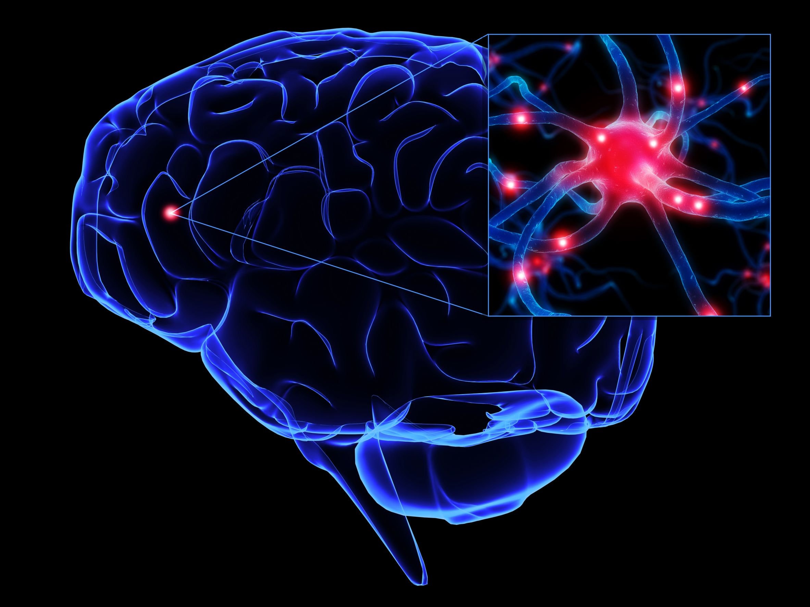
Memory Engrams in the Brain
How is memory stored in the brain?
Engrams are a hypothetical means by which memory traces are stored as biophysical or biochemical change in the brain (and other neural tissue) in response to external stimuli.
Wikipedia
“In our view, the final test of any hypothesis concerning
memory encoding and storage must be a mimicry experiment, in which apparent memory is generated artificially without the usual requirement for sensory experience…”
(Martin and Morris, 2002)

Slide 37
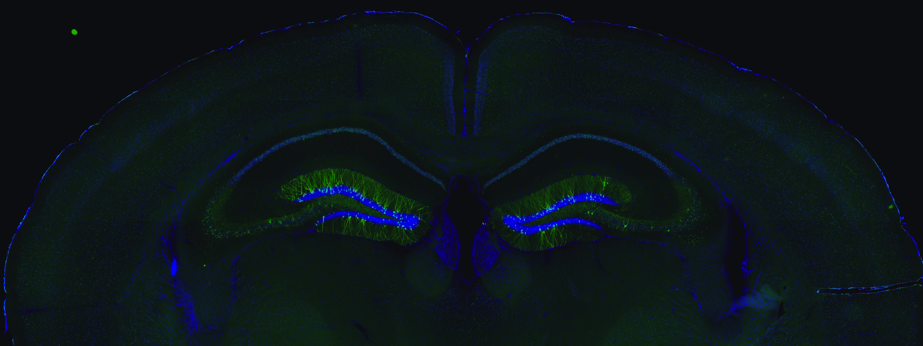

Slide 38


Slide 39
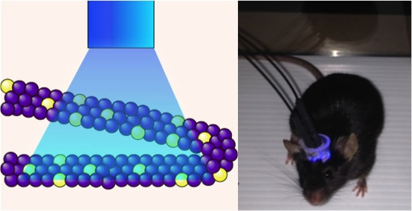
Notes:
A memory in the brain

Slide 40
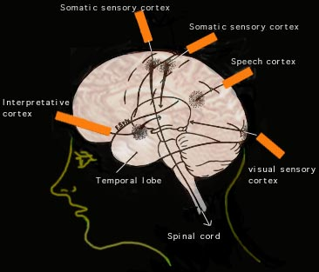
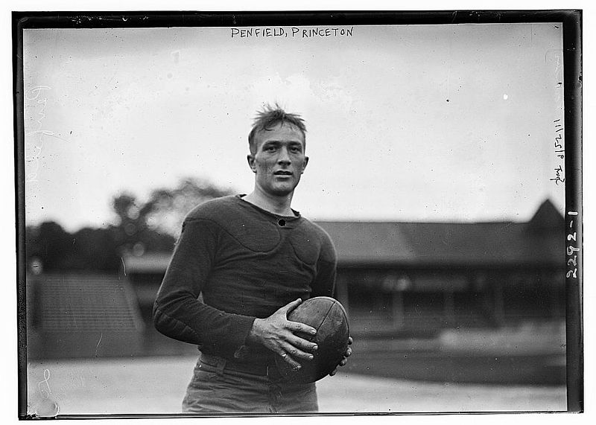
Penfield: The Neural Cartographer
~5-8% of patients reported vivid recall of memories, recent and distant, and sometimes even hallucinations after temporal lobe stimulation
Wilder Penfield

Slide 41

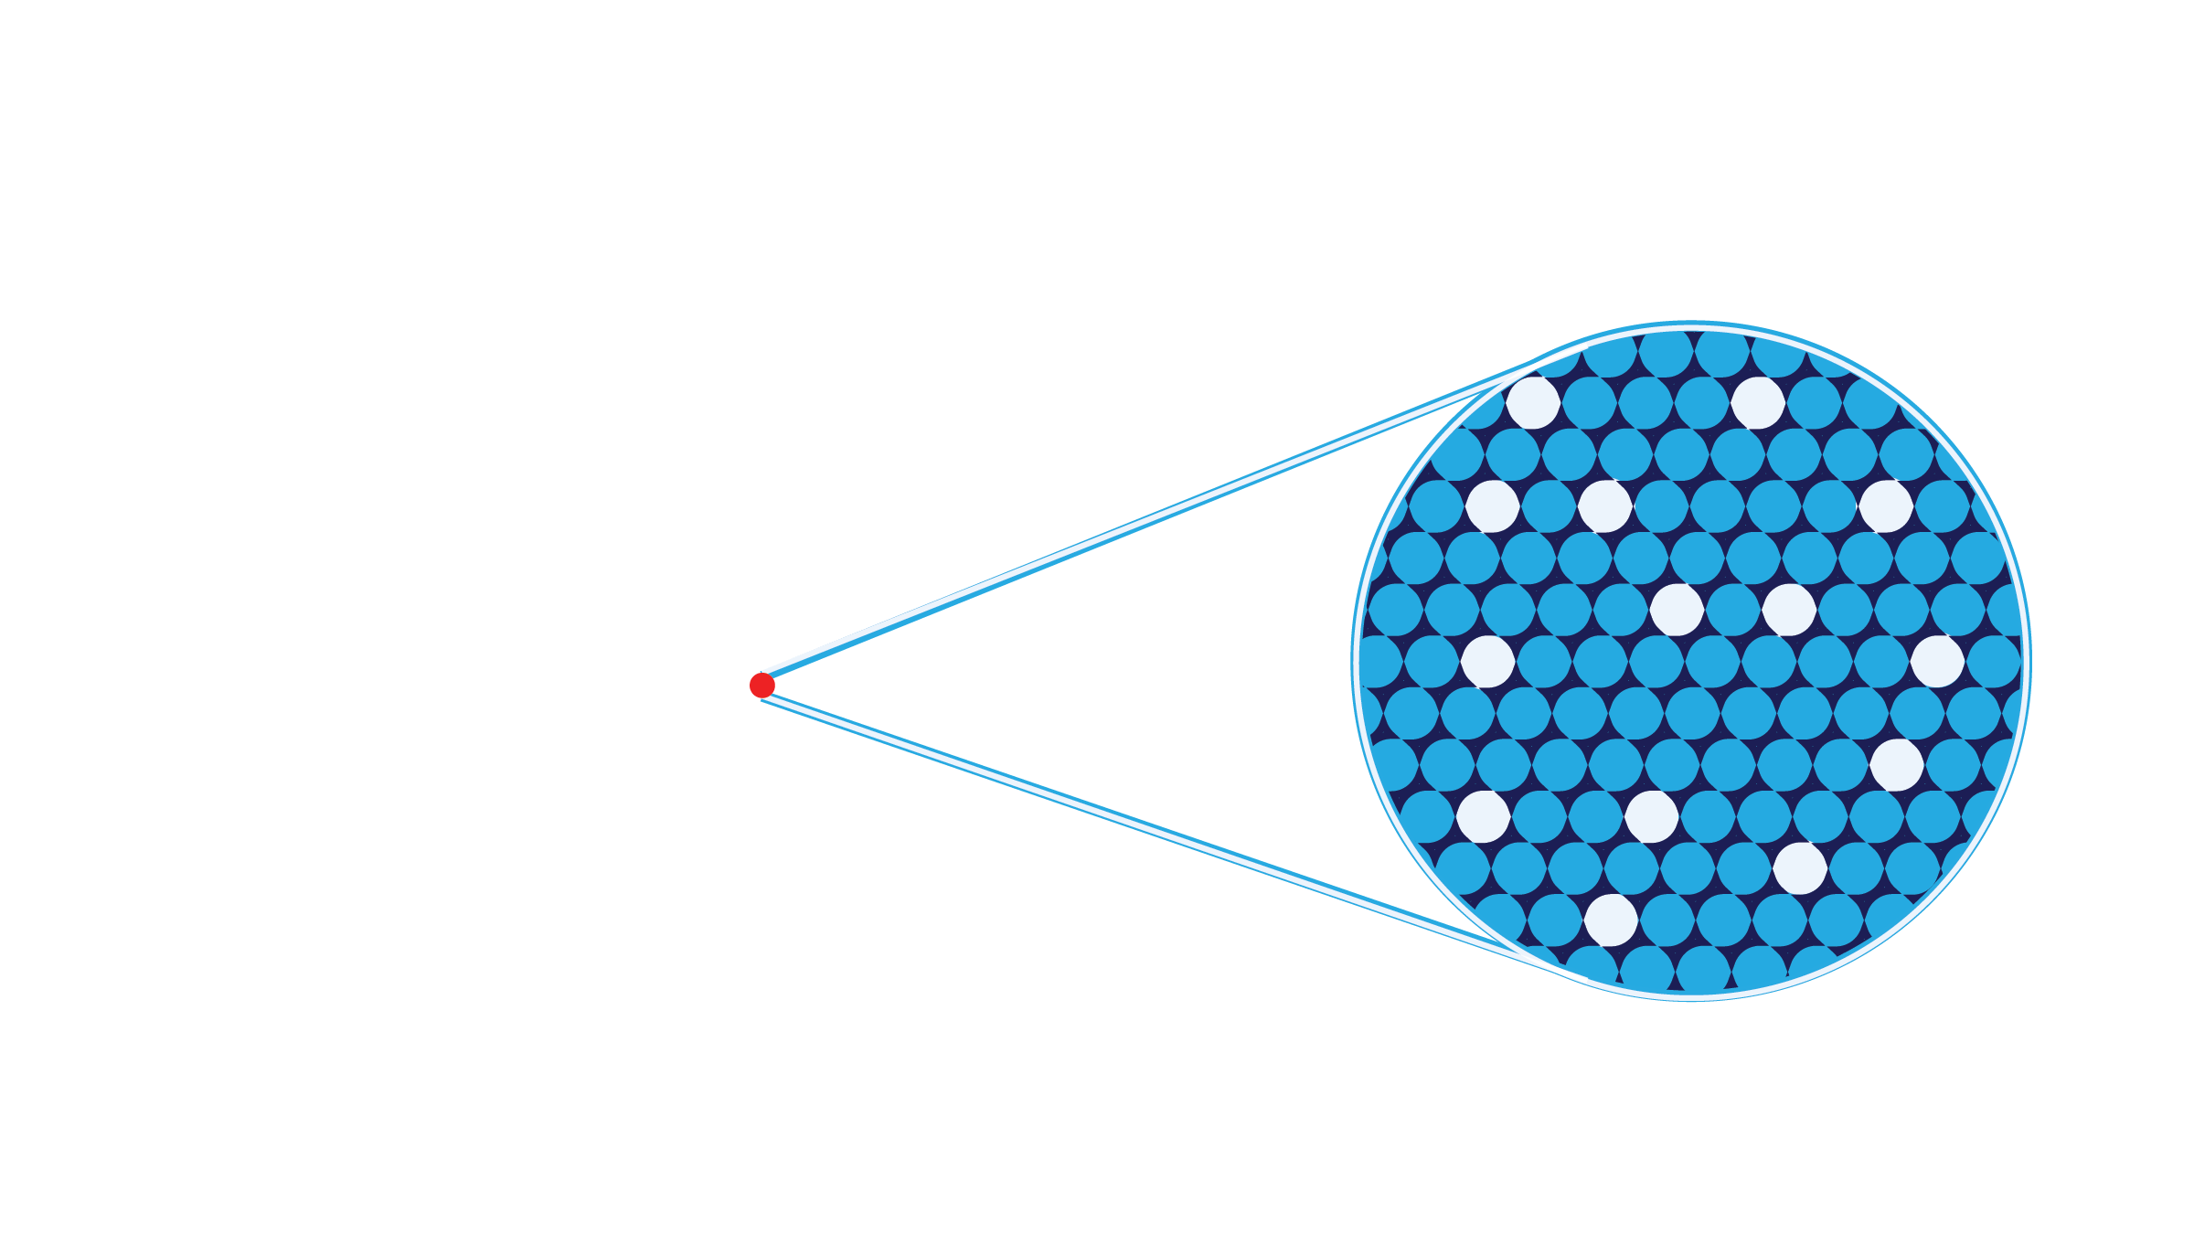
Hypothesis
Hippocampus cells active during the formation of a fear memory are sufficient to drive the expression of fear memory

Slide 42
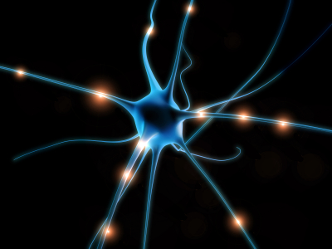
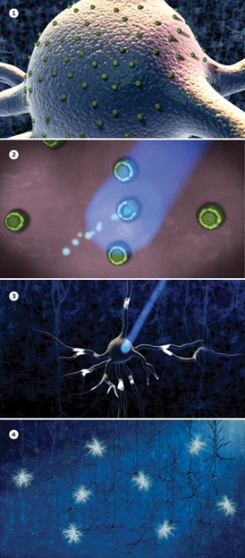
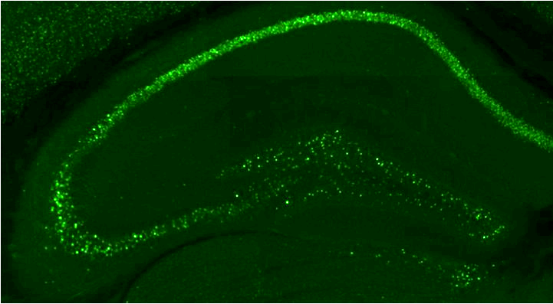
Activity-dependent and inducible optogenetics
Tta = tetracycline transactivator
TRE = tetracycline response element
DOX = Doxycycline
ChR2
tTA
c-fos promoter
tTA
c-fos
DOX
tTA
TRE
Gene Of Interest
Protein
ChR2 makes cells
responsive to light
c-Fos is only expressed in active neurons
Dox can open and close windows for expressing a given gene
Notes:
HOW do we control cells at the millisecond timescale with light?
HOW DO WE KNOW which cells are active during learning?
We COULD JUST DO c-foS CHR2 but we can’t control when it’s expressed and if the animal sneezes it’ll express c-fos
ttA = ACTIVATOR

Slide 43
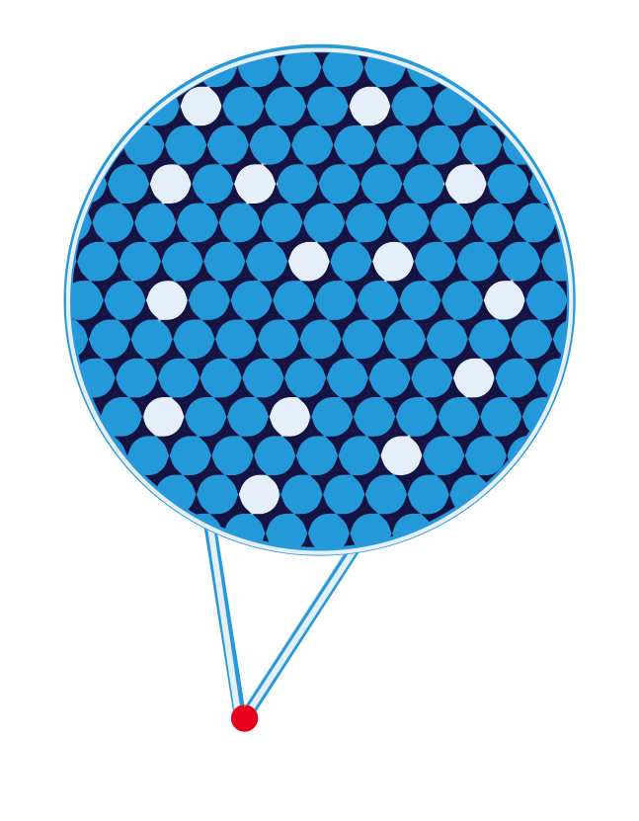

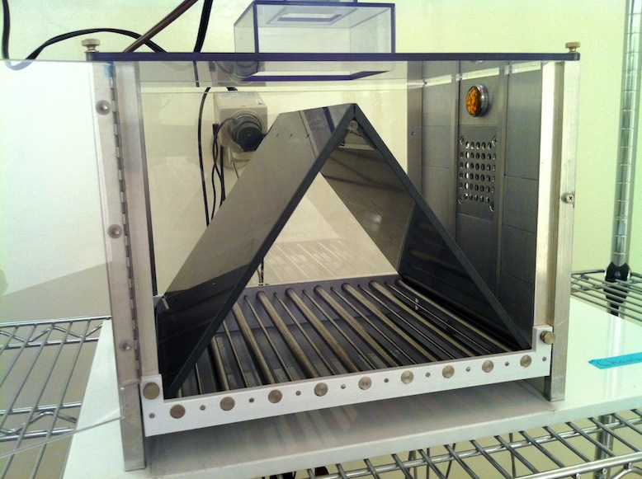
Context A

Slide 44

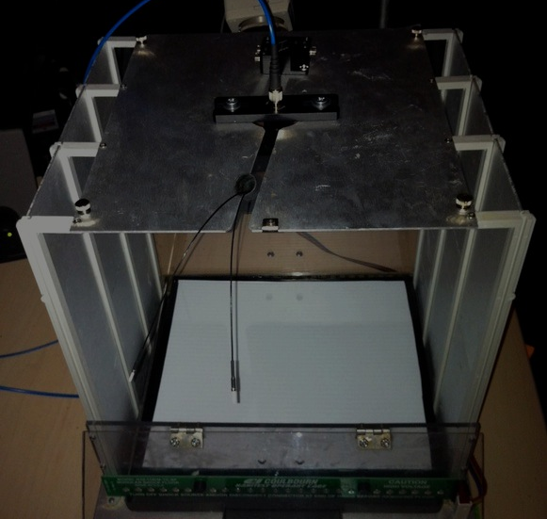
Context A
Context B

Slide 45
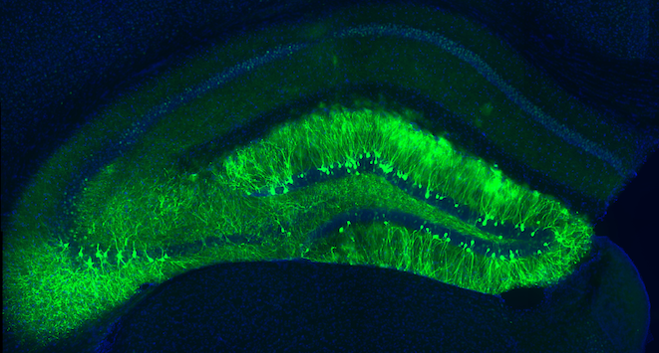
Notes:
A memory in the brain

Slide 46
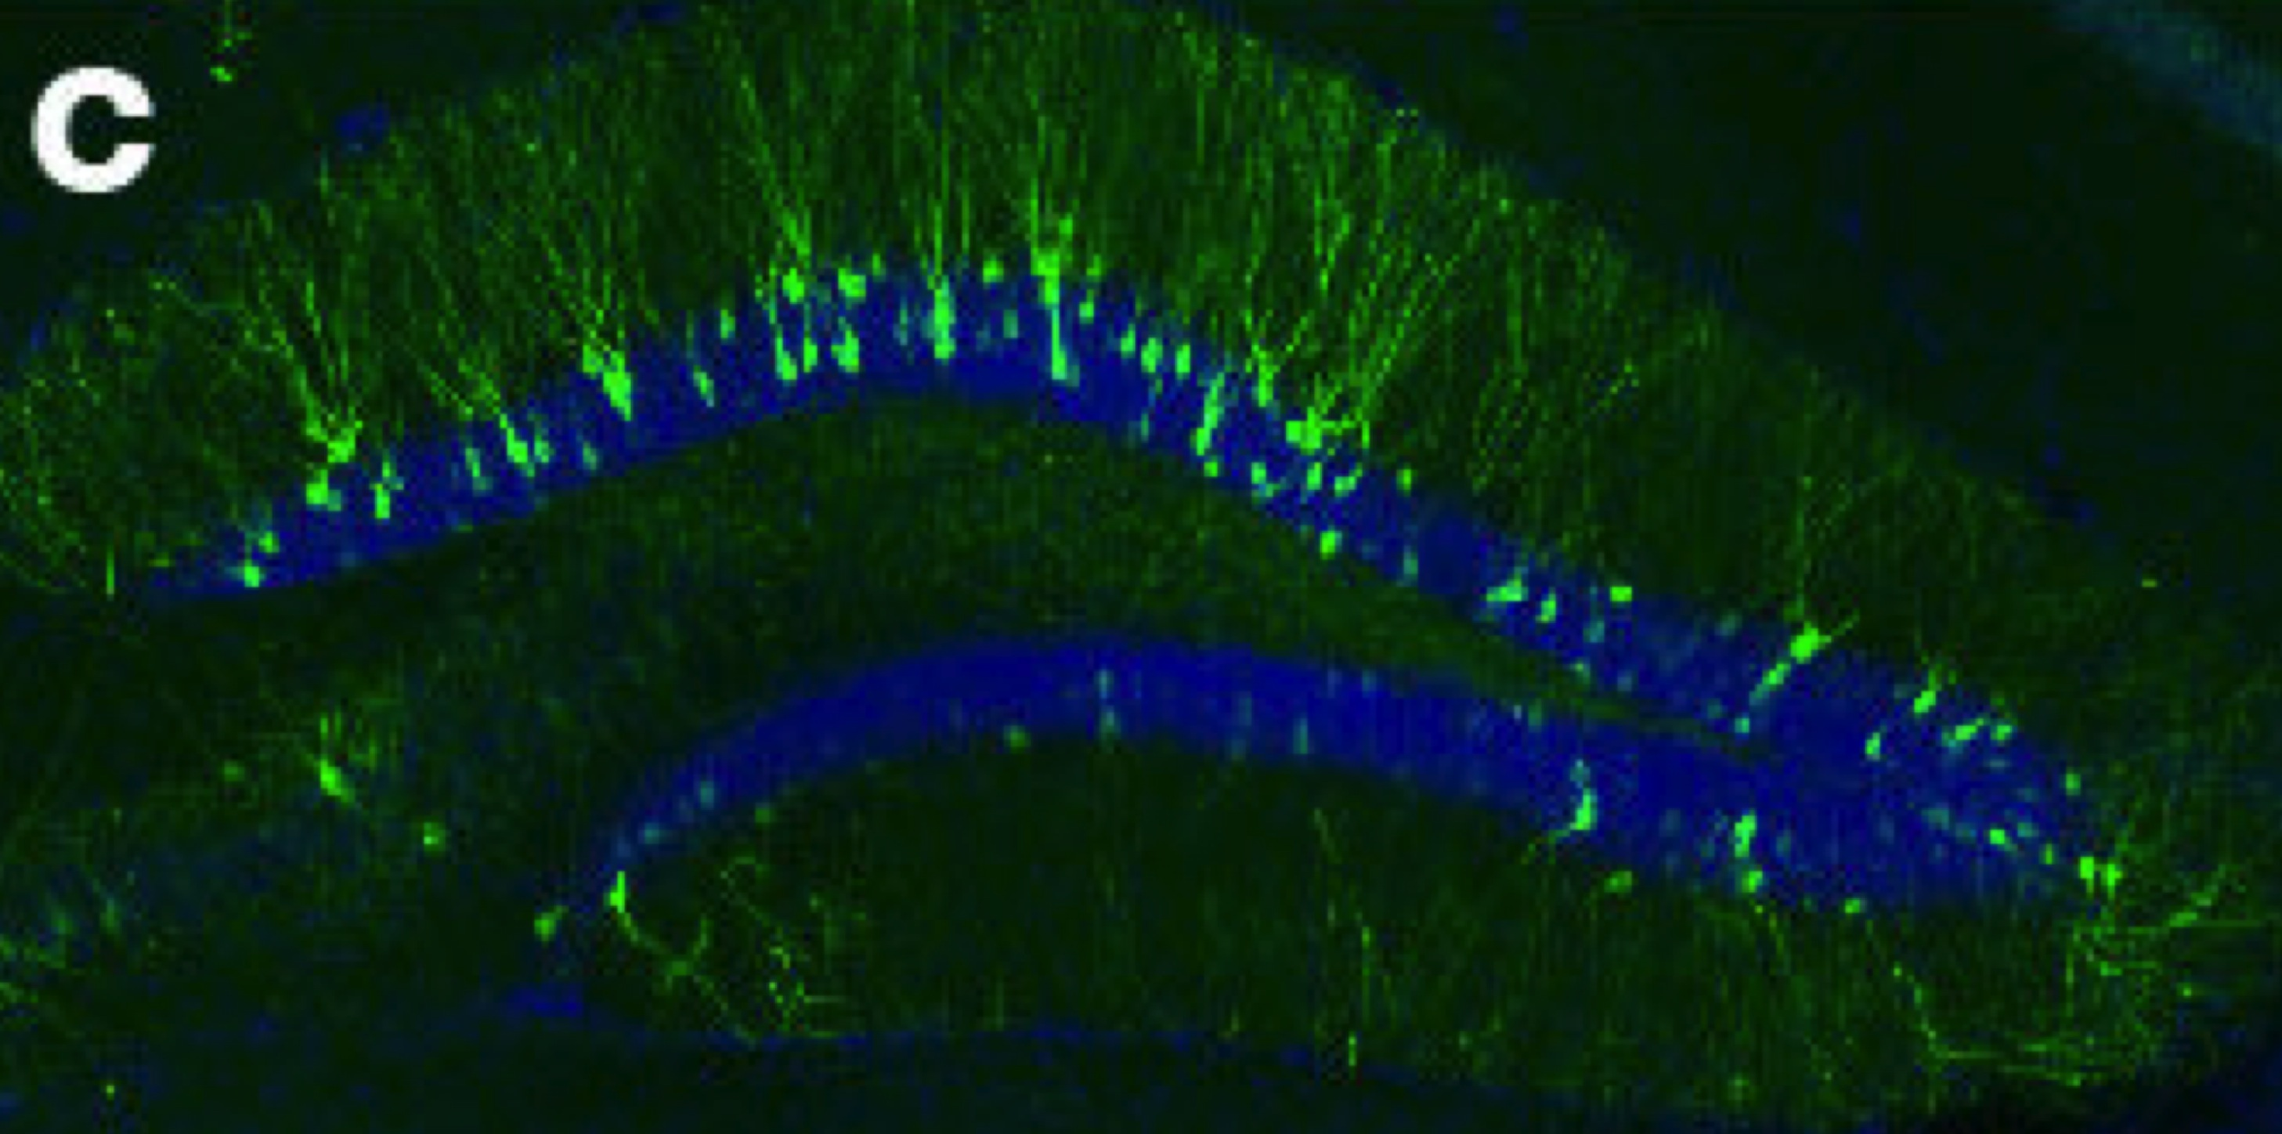
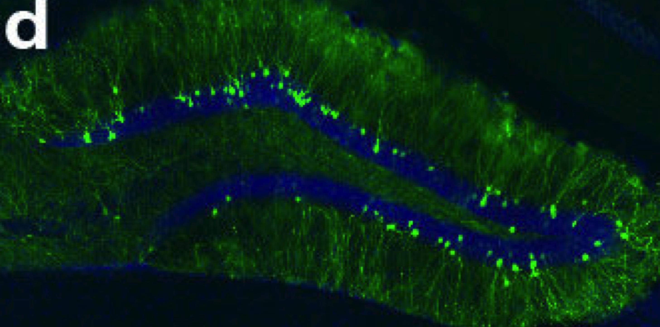
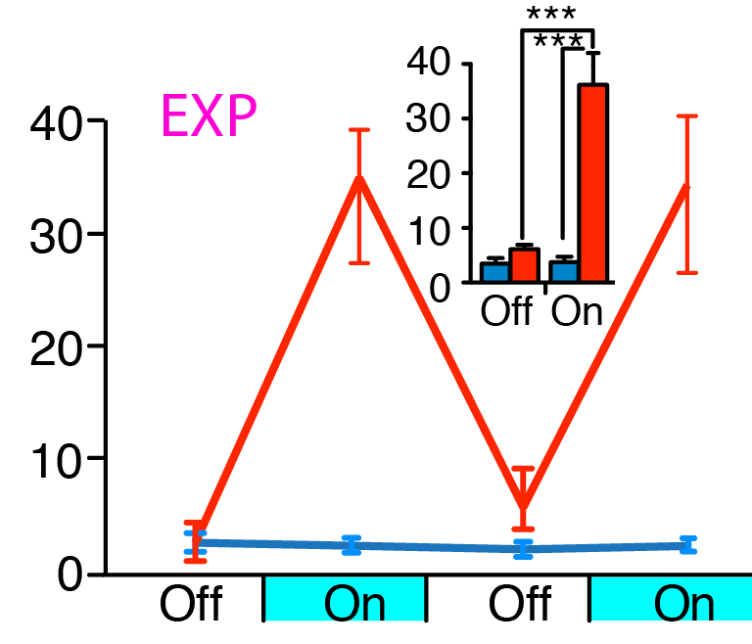
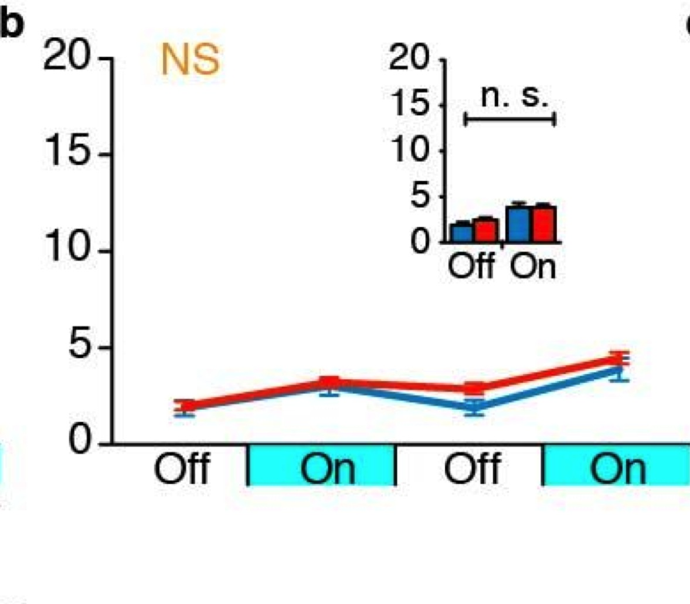
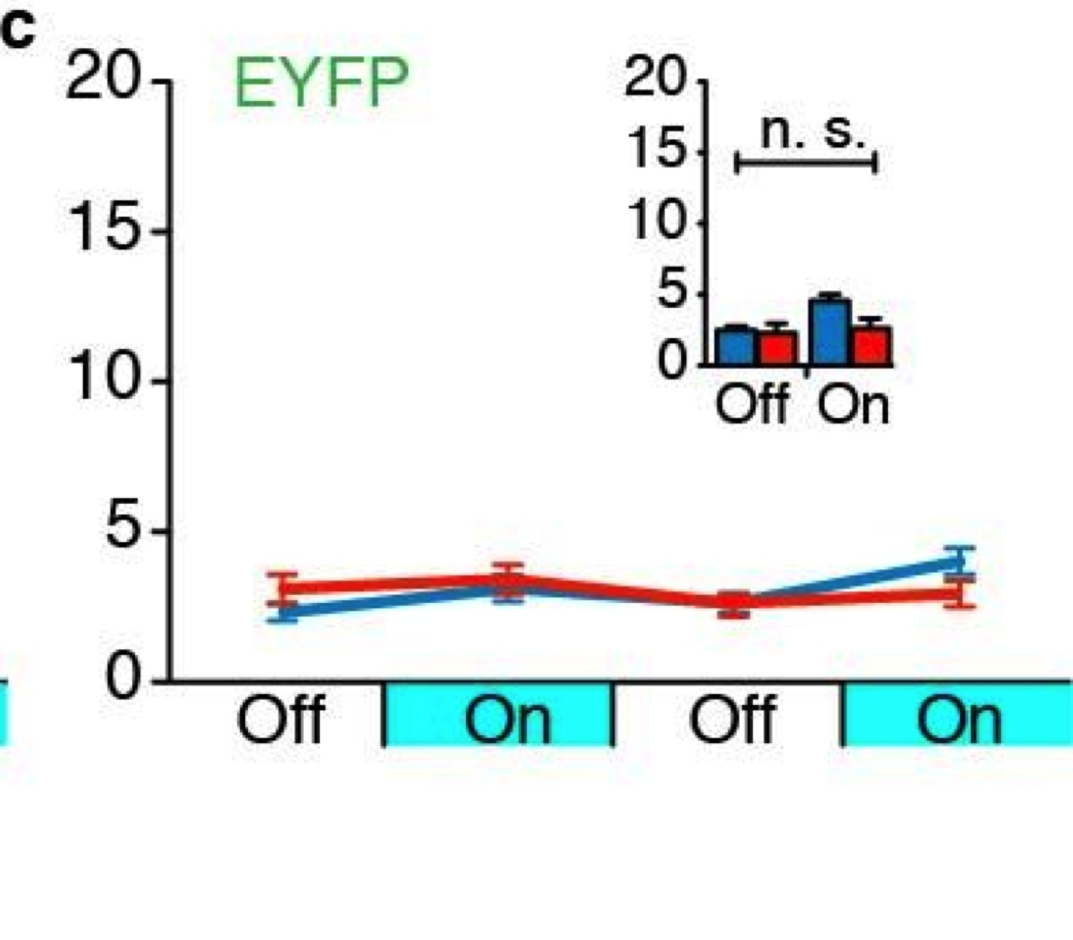
Fear memory
ChR2 label
Light-induced freezing
Fear memory
ChR2 label
Light-induced freezing
Fear memory
ChR2 label
Light-induced freezing
☑
☑
✔
☒
☑
✖
☑
☒
✖
Conclusion: Reactivating hippocampus cells that were active during the formation of a fear memory led the expression of the fear memory.
(Liu & Ramirez et al., Nature, 2012)
Notes:
What could explain this finding besides reactivating a fear memory?

Slide 47
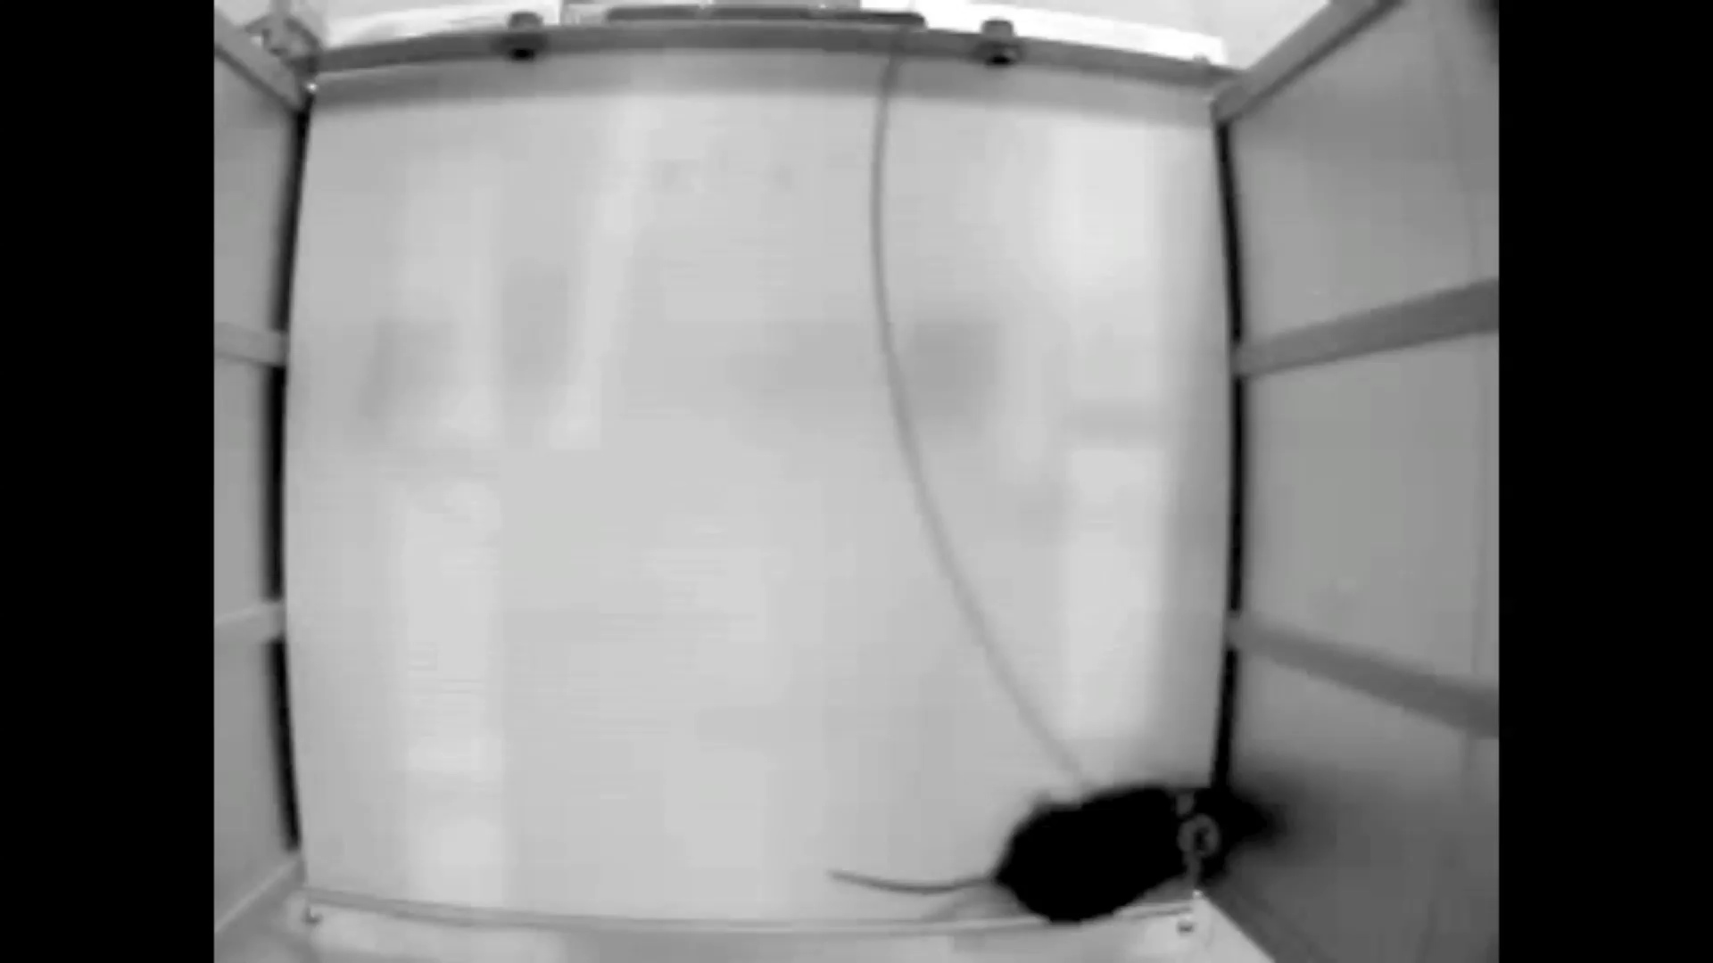
Behavior Videos

Slide 48
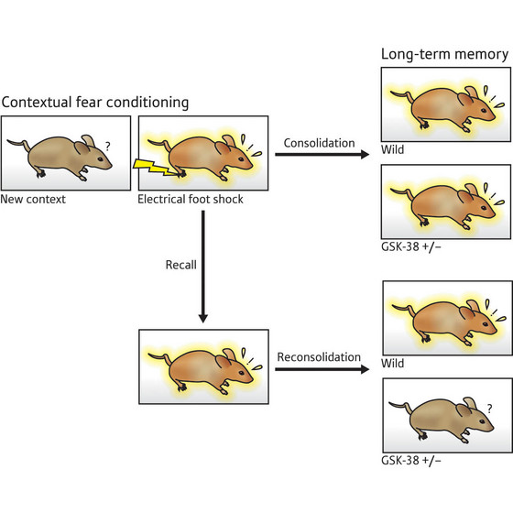

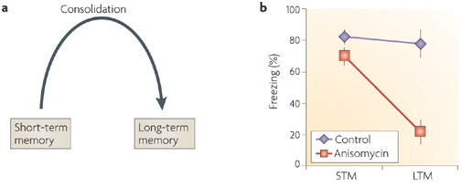
Memory consolidation requires protein synthesis…. OR DOES IT?
Memory consolidation requires the brain to make new proteins. They act as a sort of “glue” to stabilize memories in the brain
Protein synthesis inhibitors, like anisomycin, induce deficits in memory when given during consolidation
No
Give anisomycin
No Freezing

Slide 49
Anisomycin induces amnesia, i.e. it blocks consolidation of a memory
And yet, activating hippocampus cells that processed the fear memory *still* leads to freezing behavior
The conclusion is that anisomycin actually blocks the machinery necessary to *retrieve* (and not store) a memory.

Slide 50
https://www.tedmed.com/talks/show?id=624548

Slide 51
(Roy et al. Nature, 2016)

Slide 52
Alzheimer’s induces amnesia, i.e. it blocks consolidation of a memory and so animals show a freezing deficit
And yet, activating hippocampus cells that processed the fear memory *still* leads to freezing behavior
The conclusion is that Alzheiner’s actually blocks the machinery necessary to *retrieve* (and not store) a memory.

Slide 53
Memory Extinction
Extinction is the process by which an organism learns to suppress (not erase!) a memory. It is another form of learning.
Extinction, like consolidation, requires protein synthesis
Repeated exposure
*without* shock
Extinction Learning
No Fear

Slide 54
In these experiments, cells active during extinction training were tagged with NpHR for optical inhibition
Blocking cells processing an extinction memory now forced the animals to freeze in the extinguished context, suggesting that the extinction cells were actively suppressing the dear memory
The conclusion is that extinction cells are needed for the successful expression of an extinction memory; blocking these now lets fear memories dominate
Notes:
A memory in the brain

Slide 55
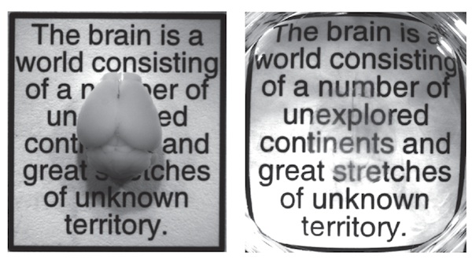
CLARITY and Takashi

Slide 56

https://www.youtube.com/watch?v=c-NMfp13Uug
Notes:
A memory in the brain

Slide 57
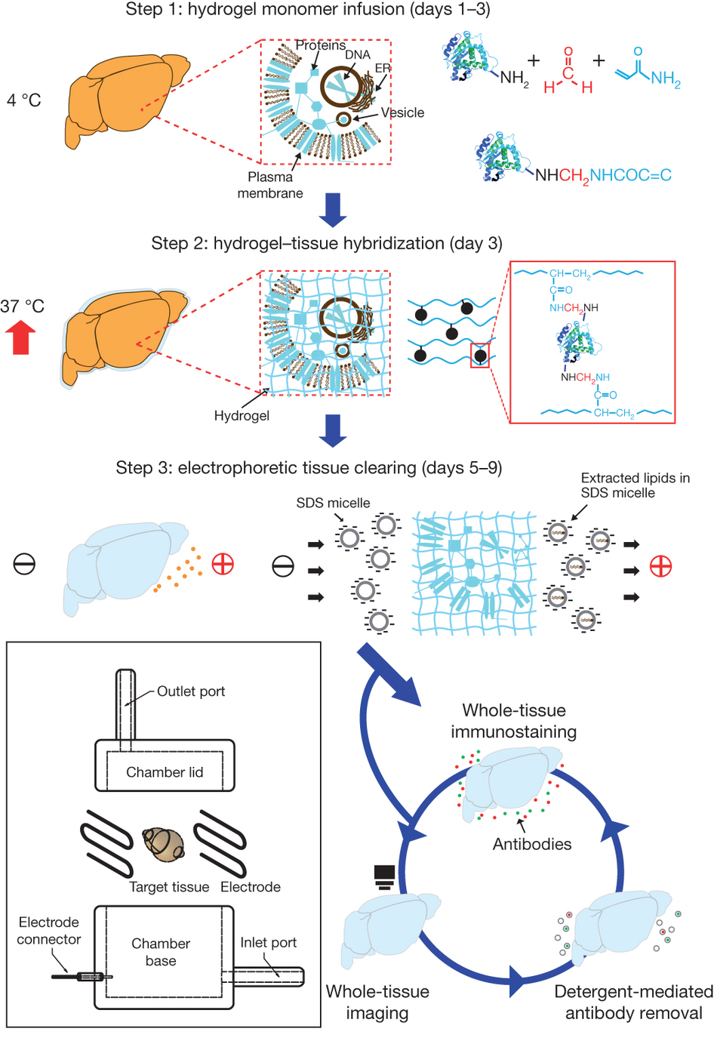
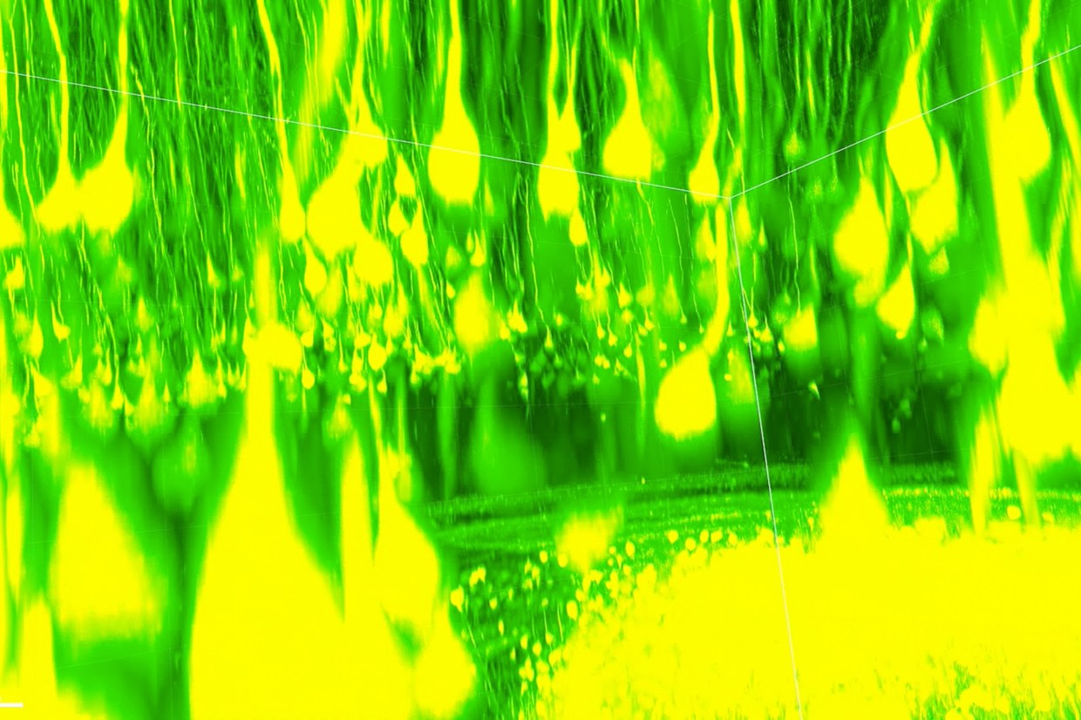
1) “Fix” the brain in a hydrogel matrix
2) Use clearing techniques to get rid of brain tissue (fatty cell membranes, which give the brain its color, etc)
3) Place your brain somewhere easy to find

Slide 58
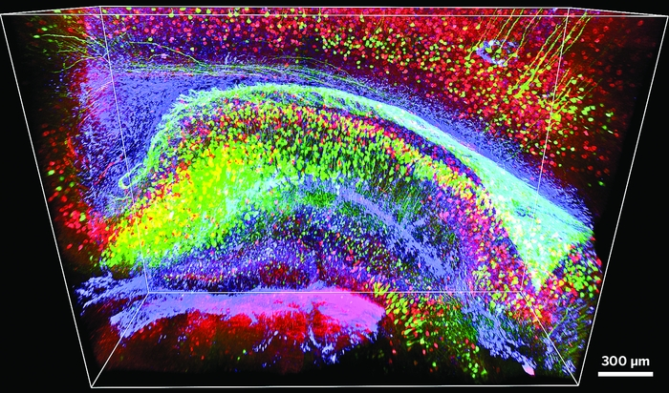
Applications for viewing a whole brain at once?

