Slide 1

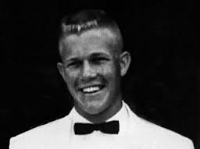
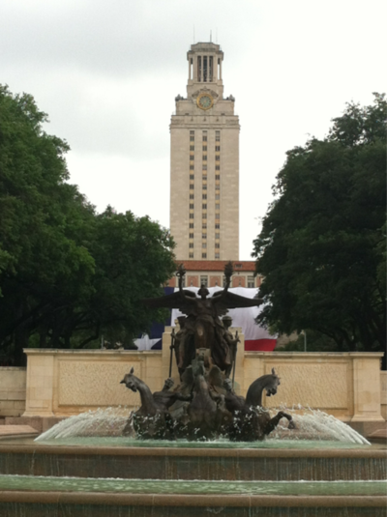
The case of Charles Whitman
“I don’t really understand myself these days. I am supposed to be an average reasonable and intelligent young man. However, lately (I can’t recall when it started) I have been a victim of many unusual and irrational thoughts.
It was after much thought that I decided to kill my wife, Kathy, tonight … I love her dearly, and she has been as fine a wife to me as any man could ever hope to have. I cannot rationally pinpoint any specific reason for doing this …
I talked with a Doctor once for about two hours and tried to convey to him my fears that I felt [overcome by] overwhelming violent impulses. After one session I never saw the Doctor again, and since then I have been fighting my mental turmoil alone, and seemingly to no avail.”
Notes:
1966, University of Texas Tower and killed more than a dozen people

Slide 2
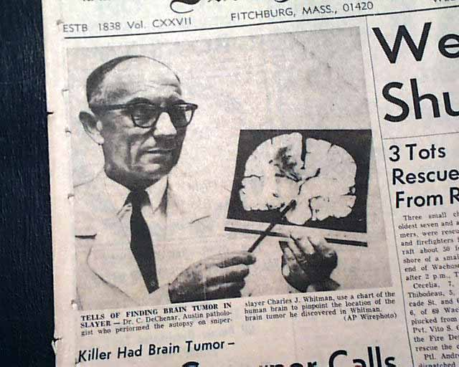
Does a tumor exonerate an evil act?
“This tumor had blossomed from beneath a structure the thalamus, impinged on the hypothalamus, and compressed a third region called the amygdala”
Was Charles Whitman responsible?
https://www.theatlantic.com/magazine/archive/2011/07/the-brain-on-trial/308520/
(Eagleman, The Brain on Trial)
Notes:
Hypothalamus: 4 F’s

Slide 3
p.314
Lecture 8: Motor memory
How we learn without knowing

Slide 4
Place vs. Response; Hippocampus vs. Striatum
Early in learning, i.e. 7 days or less, rats use hippocampal place strategy.
If we train them long enough, i.e. 14 days or more, the memory “goes from episodic to motor” and becomes overlearned and rats switch to striatal response strategy.
Notes:
EARLY, rats use HIPPOCAMPAL STRATEGY. If we run it long enough, it becomes overlearned and they switch to STRIATAL strategy.

Slide 5
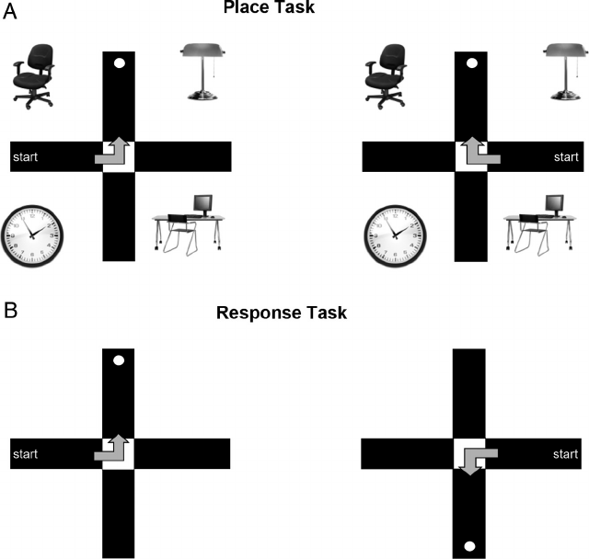

Slide 6
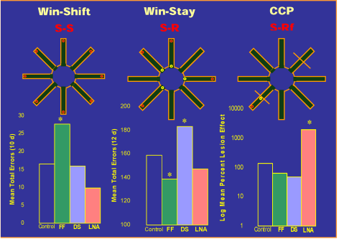
The Win-Stay task is a stimulus-response task: the animal will see 4 lights at the beginning of each arm and it can go to any one of them to get a food, and then it stays put. On the next trial, 4 different arms will have lights now to act as cues to let animal respond to them. It is a kind of motor memory task.
Notes:
correct performance of the win-shift task requires rats to obtain the food pellet at the end of each arm without reentering arms. This requires spatial (or S-S) information processing. Performance of this task was impaired by lesions of fimbria-fornix (FF), but not by caudate nucleus (CN) or amygdala (AM) lesions. The win-stay task requires a simple association between a cue light and the arm entry response, reinforced by eating the food at the end of the lit arms. A different set of four arms is lit and baited on each daily trial. This is an instance of S-R information processing. Performance on this task was impaired by lesions of the caudate nucleus but not by lesions of fimbria-fornix or amygdala. The improved performance on this task produced by fimbria-fornix lesions is explained in Figure 5. In the conditioned cue preference (CCP) task, the rats acquire an S-Rf association between the light and the food reinforcer, causing the light to acquire conditioned stimulus properties. This results in a preference for the food-paired arm even when no food is present on the test trial. Performance on this task was impaired by lesions of the amygdala, but not by lesions of fimbria-fornix or caudate nucleus.

Slide 7
The Win-Shift task is a stimulus-stimulus task: the animal has to go to an arm to get food, and then “remember” which arm that was so that on the next trial it “shifts” and goes to the neighboring arm for food. It is a kind of cognitive spatial memory.
Notes:
correct performance of the win-shift task requires rats to obtain the food pellet at the end of each arm without reentering arms. This requires spatial (or S-S) information processing. Performance of this task was impaired by lesions of fimbria-fornix (FF), but not by caudate nucleus (CN) or amygdala (AM) lesions. The win-stay task requires a simple association between a cue light and the arm entry response, reinforced by eating the food at the end of the lit arms. A different set of four arms is lit and baited on each daily trial. This is an instance of S-R information processing. Performance on this task was impaired by lesions of the caudate nucleus but not by lesions of fimbria-fornix or amygdala. The improved performance on this task produced by fimbria-fornix lesions is explained in Figure 5. In the conditioned cue preference (CCP) task, the rats acquire an S-Rf association between the light and the food reinforcer, causing the light to acquire conditioned stimulus properties. This results in a preference for the food-paired arm even when no food is present on the test trial. Performance on this task was impaired by lesions of the amygdala, but not by lesions of fimbria-fornix or caudate nucleus.

Slide 8
The CCP task (Conditioned Cue Preference) is a Stimulus-food-Reinforced task: it has a single arm with a light that cues the animal to go to it and, over time, the animal learns that cue itself now has “emotional” value since it signals food always in the same arm.
Notes:
correct performance of the win-shift task requires rats to obtain the food pellet at the end of each arm without reentering arms. This requires spatial (or S-S) information processing. Performance of this task was impaired by lesions of fimbria-fornix (FF), but not by caudate nucleus (CN) or amygdala (AM) lesions. The win-stay task requires a simple association between a cue light and the arm entry response, reinforced by eating the food at the end of the lit arms. A different set of four arms is lit and baited on each daily trial. This is an instance of S-R information processing. Performance on this task was impaired by lesions of the caudate nucleus but not by lesions of fimbria-fornix or amygdala. The improved performance on this task produced by fimbria-fornix lesions is explained in Figure 5. In the conditioned cue preference (CCP) task, the rats acquire an S-Rf association between the light and the food reinforcer, causing the light to acquire conditioned stimulus properties. This results in a preference for the food-paired arm even when no food is present on the test trial. Performance on this task was impaired by lesions of the amygdala, but not by lesions of fimbria-fornix or caudate nucleus.

Slide 9
The Win-Shift task is a stimulus-stimulus task: the animal has to go to an arm to get food, and then “remember” which arm that was so that on the next trial it “shifts” and goes to the neighboring arm for food. It is a kind of cognitive spatial memory.
The Win-Stay task is a stimulus-response task: the animal will see 4 lights at the beginning of each arm and it can go to any one of them to get a food, and then it stays put. On the next trial, 4 different arms will have lights now to act as cues to let animal respond to them. It is a kind of motor memory task.
The CCP task (Conditioned Cue Preference) is a Stimulus-food-Reinforced task: it has a single arm with a light that cues the animal to go to it and, over time, the animal learns that cue itself now has “emotional” value since it signals food always in the same arm.
Notes:
correct performance of the win-shift task requires rats to obtain the food pellet at the end of each arm without reentering arms. This requires spatial (or S-S) information processing. Performance of this task was impaired by lesions of fimbria-fornix (FF), but not by caudate nucleus (CN) or amygdala (AM) lesions. The win-stay task requires a simple association between a cue light and the arm entry response, reinforced by eating the food at the end of the lit arms. A different set of four arms is lit and baited on each daily trial. This is an instance of S-R information processing. Performance on this task was impaired by lesions of the caudate nucleus but not by lesions of fimbria-fornix or amygdala. The improved performance on this task produced by fimbria-fornix lesions is explained in Figure 5. In the conditioned cue preference (CCP) task, the rats acquire an S-Rf association between the light and the food reinforcer, causing the light to acquire conditioned stimulus properties. This results in a preference for the food-paired arm even when no food is present on the test trial. Performance on this task was impaired by lesions of the amygdala, but not by lesions of fimbria-fornix or caudate nucleus.

Slide 10
Ctrl |HPC | Str | Amg
Ctrl |HPC | Str | Amg
Ctrl |HPC | Str | Amg
Notes:
correct performance of the win-shift task requires rats to obtain the food pellet at the end of each arm without reentering arms. This requires spatial (or S-S) information processing. Performance of this task was impaired by lesions of fimbria-fornix (FF), but not by caudate nucleus (CN) or amygdala (AM) lesions. The win-stay task requires a simple association between a cue light and the arm entry response, reinforced by eating the food at the end of the lit arms. A different set of four arms is lit and baited on each daily trial. This is an instance of S-R information processing. Performance on this task was impaired by lesions of the caudate nucleus but not by lesions of fimbria-fornix or amygdala. The improved performance on this task produced by fimbria-fornix lesions is explained in Figure 5. In the conditioned cue preference (CCP) task, the rats acquire an S-Rf association between the light and the food reinforcer, causing the light to acquire conditioned stimulus properties. This results in a preference for the food-paired arm even when no food is present on the test trial. Performance on this task was impaired by lesions of the amygdala, but not by lesions of fimbria-fornix or caudate nucleus.

Slide 11
Procedural Memory
The Striatum is important for the acquisition of specific Stimulus-Response associations.
This is on contrast to the Hippocampus system, which is important for the acquisition of stimulus-stimulus associations.
The speed of learning differs across systems:
(Hippocampus fast; Striatal system slow)
Episodic and motor learning have different flexibilities: (Hippocampus flexible; Striatal system not flexible)

Slide 12
Motor Memory and Expectations: https://www.youtube.com/watch?v=Xnk4seEHmgw

Slide 13
An fMRI Study of the role of the
medial temporal lobe
in implicit and explicit
sequence learning
Schendan, Searl, Melrose, Stern, Neuron, 2003

Slide 14
SRT Task
msec
1000
2500
Notes:
To examine learning, participants performed a serial reaction time (SRT) task, pressing the key at the same location as on the screen.
For example, during the next slide, try moving your fingers in response to the locations on the screen

Slide 15
Motor vs. Memory Accounts:
  If SRT task is purely a “Motor” or “Procedural” learning task then the “motor” account predicts the striatum will be active but NOT the hippocampus
  Amnesic patients with hippocampus damage CAN do the SRT task
  Parkinson’s patients with striatal damage are IMPAIRED on the SRT task

Slide 16
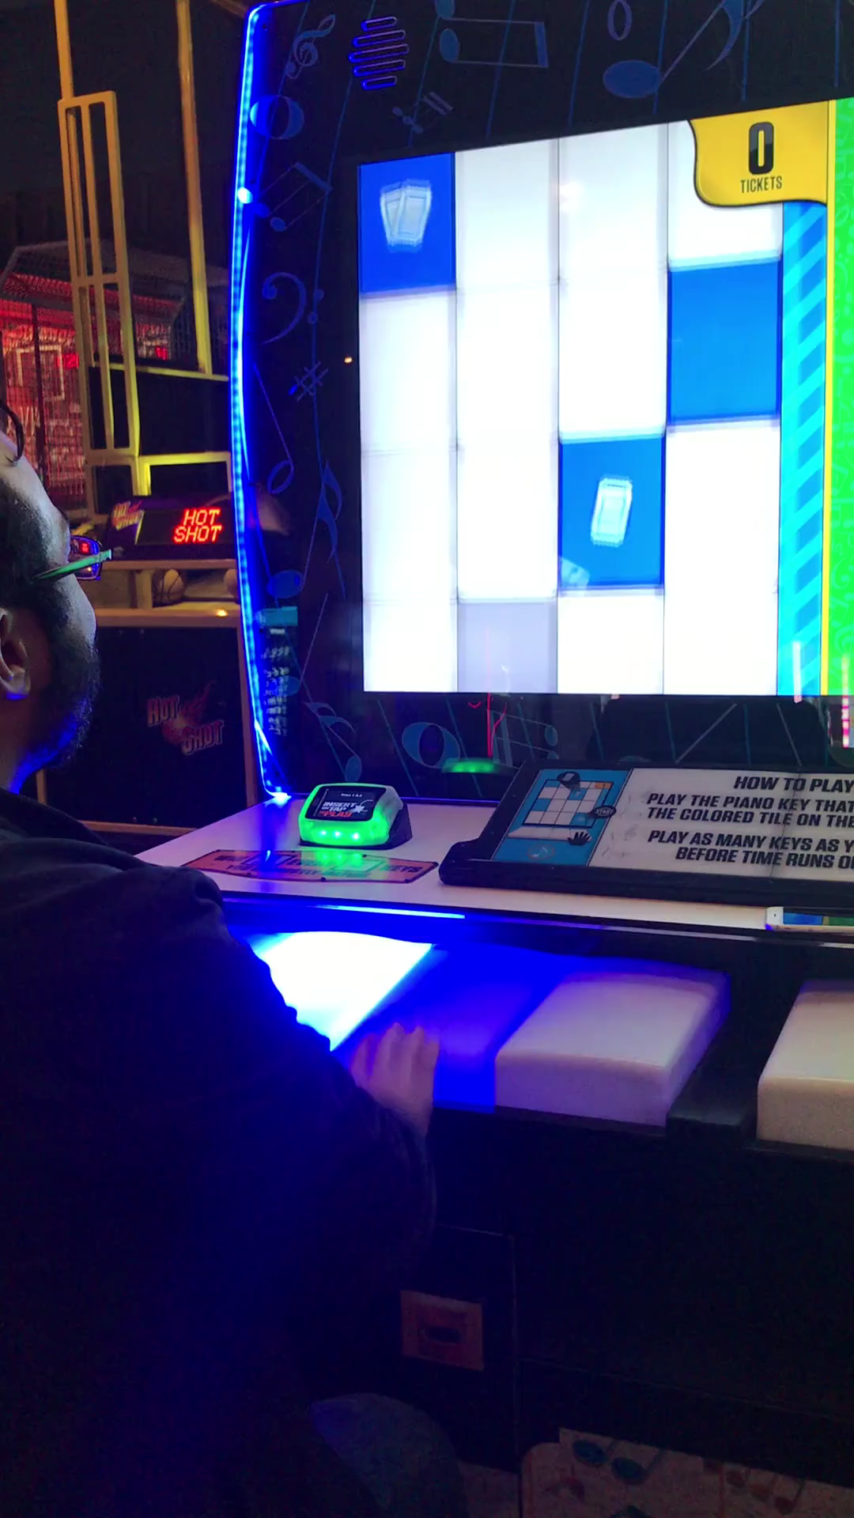
12-02

Slide 17
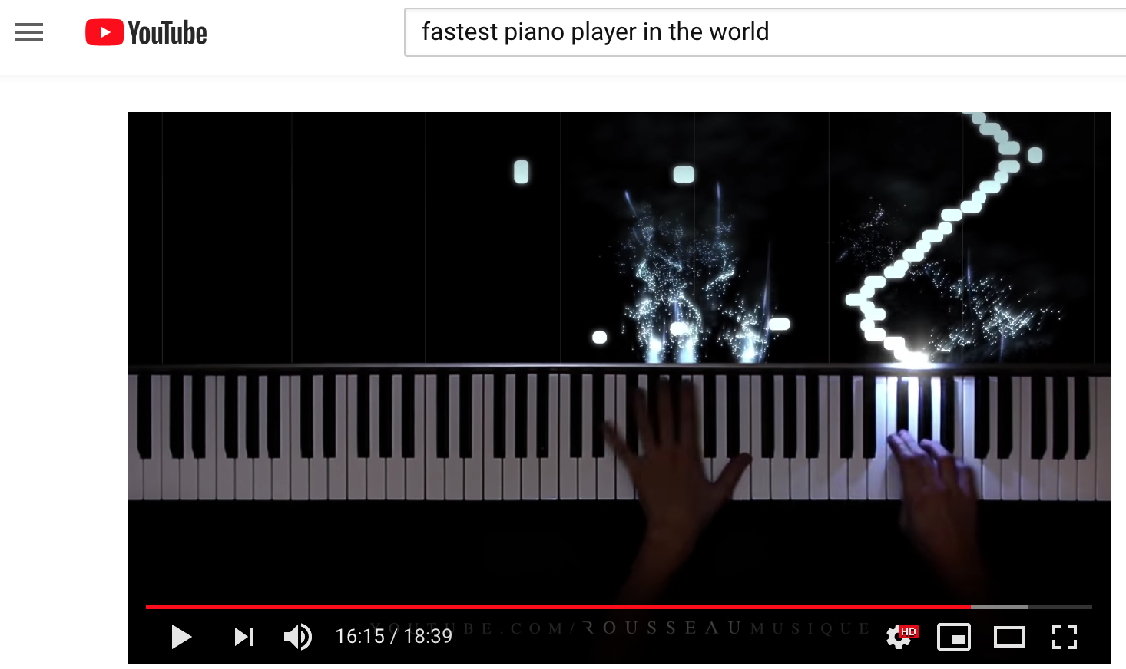
https://www.youtube.com/watch?v=AEMgNMNeBr4

Slide 18
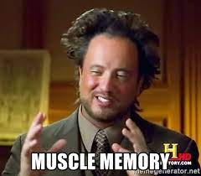
https://www.youtube.com/watch?v=6Y4vbS6c4p4

Slide 20
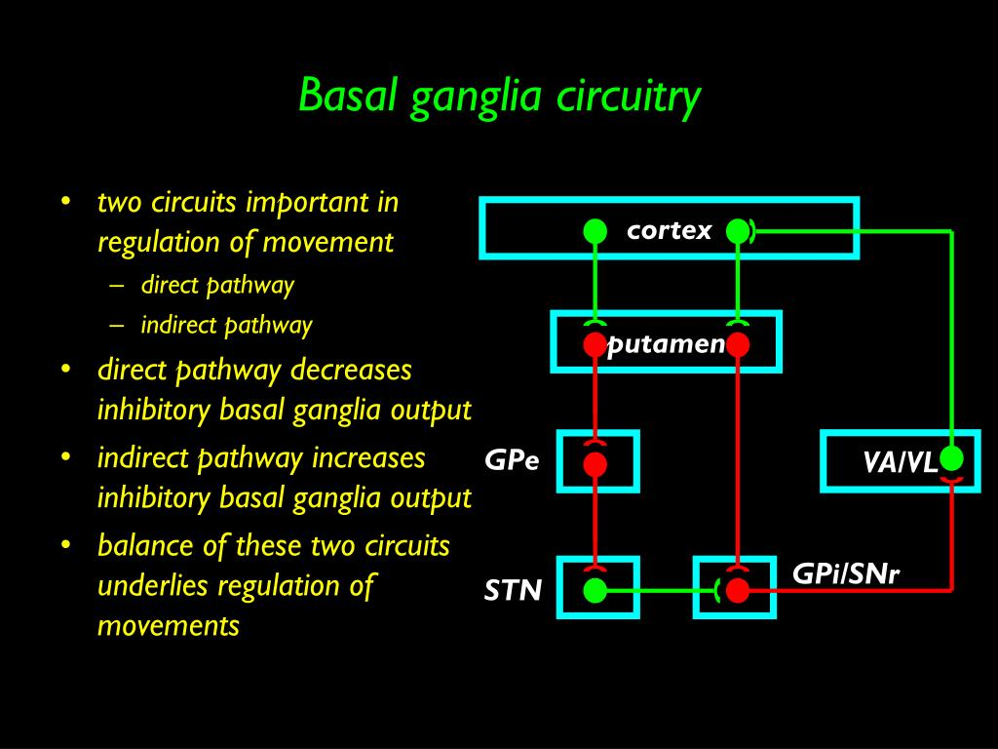

Slide 21
The direct pathway helps promote
movements.
The indirect pathways counteracts movements to fine-tune them.
Both involve an interplay of dopamine, glutamate, and GABA.

Slide 22
When the direct pathway wins out:
https://www.youtube.com/watch?v=_fyEarGbpXM

Slide 23
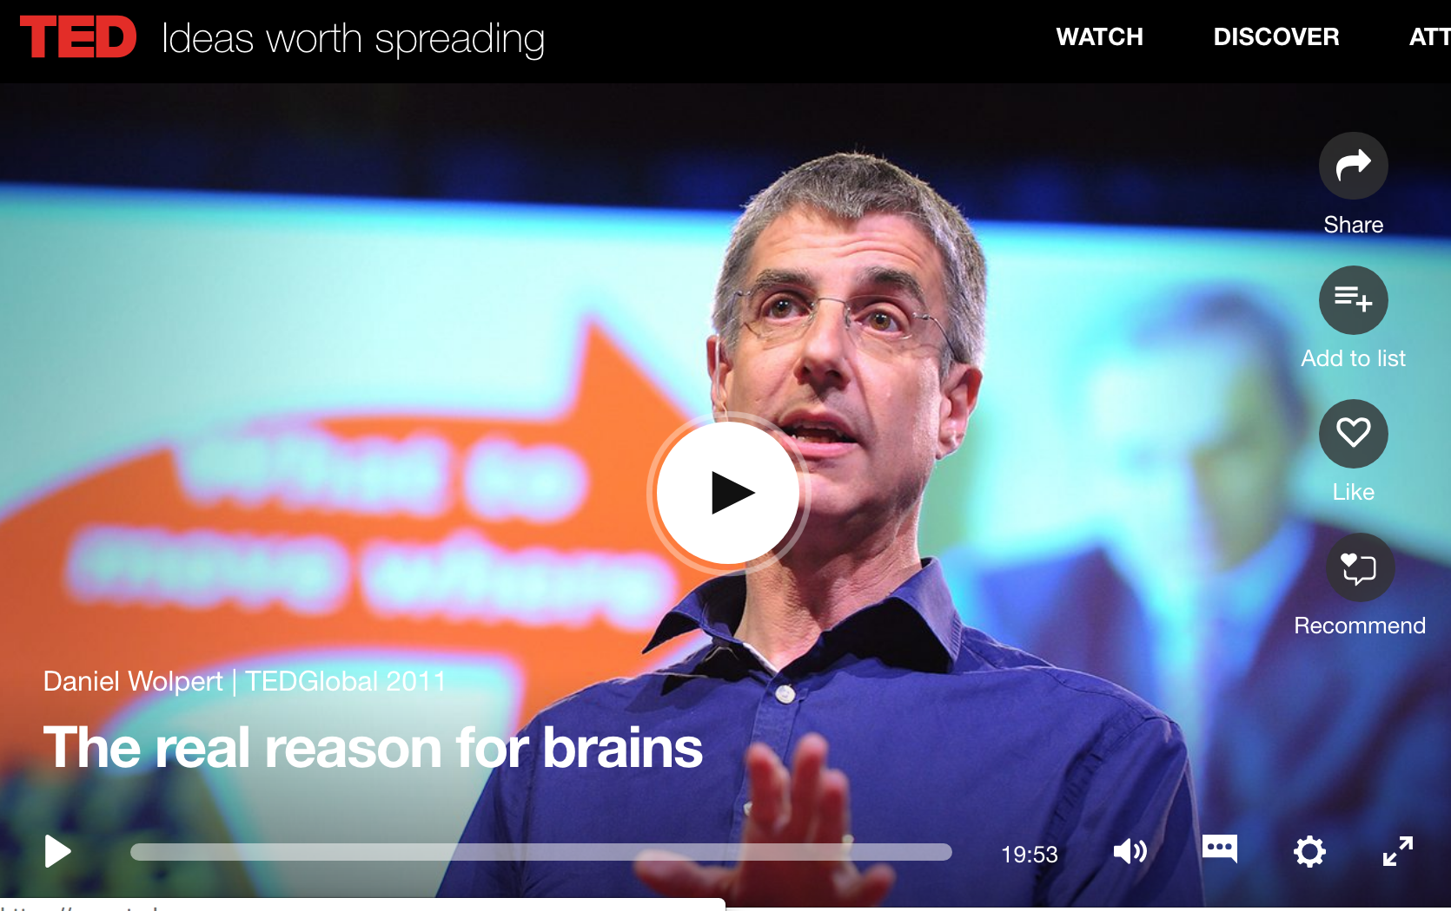
https://www.ted.com/talks/daniel_wolpert_the_real_reason_for_brains?language=enYouTube

Slide 24
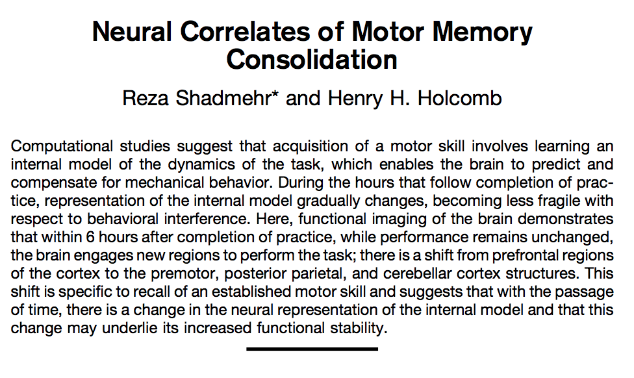
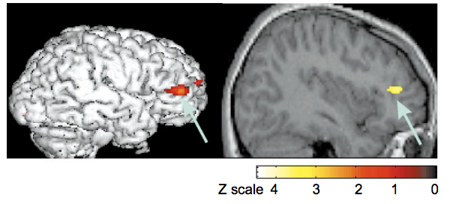
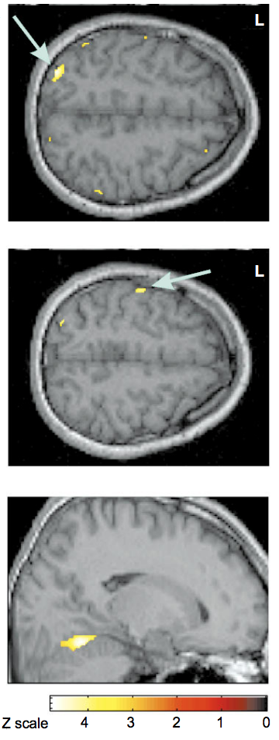
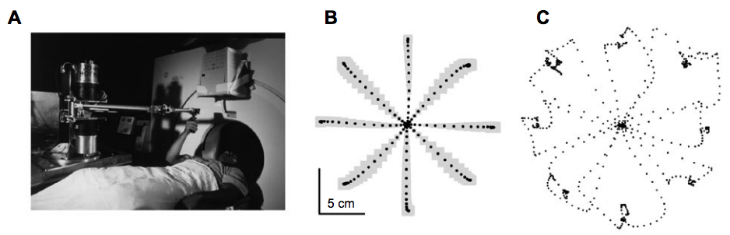
Early on in learning, the prefrontal cortex is active, presumably processing us “thinking” of how to learn to move the arm
When the motor memory was fully formed, motor cortex and cerebellum became activated

Slide 25
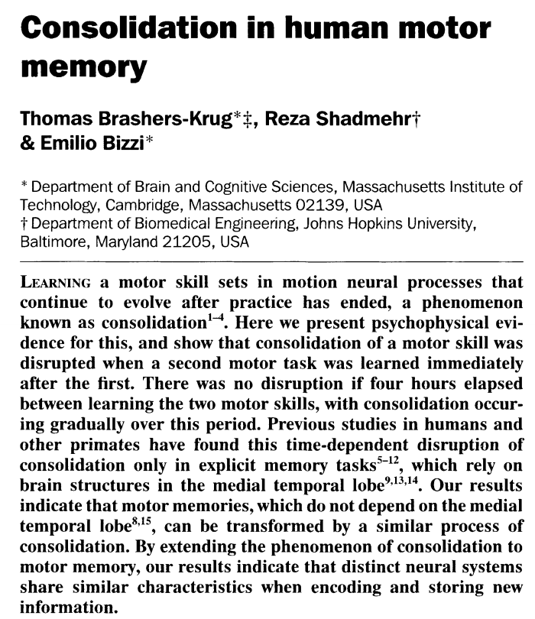
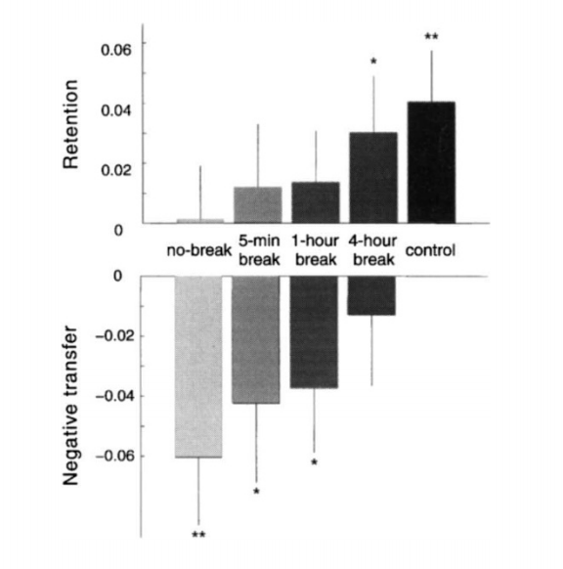
Performance
Learning one motor task, followed by a second immediately after impaired later performance on the first task the next day.
Learning one motor task, followed by a second one 4 hours later, did not impair performance on the first task the next day.

Slide 27
The cerebellum can “shape” hippocampus activity
Inhibiting the cerebellum when animals are in the dark (and therefore need to use self-motion cues) impairs place cell activity

Slide 29
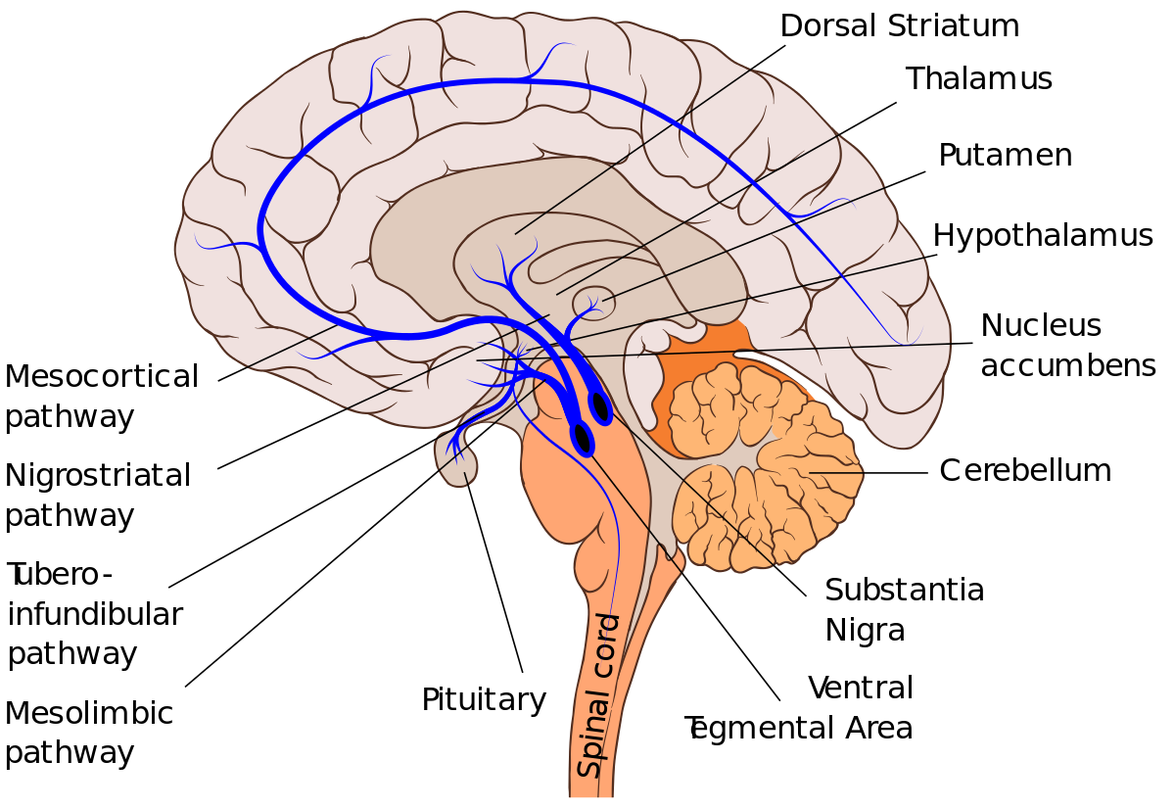
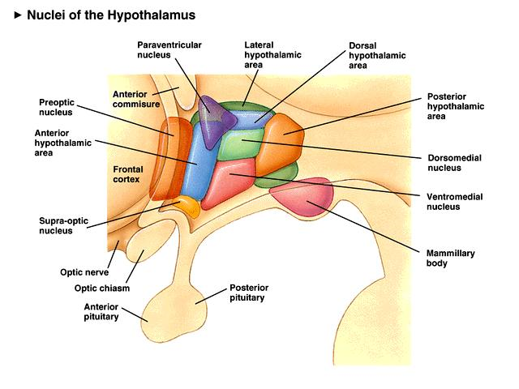
Circuits for motivational drive: the lateral hypothalamus (LHA)

Slide 30
Manipulation of LHA alters motivational drive
  Stimulation
Experiments done on rodents and cats in the 1960’s
Self stimulation
Heightened responsiveness to stimuli
General activation of movement patterns and consumption including feeding and drinking
  Ablation
Suppress feeding
Suppress drinking
Decreased goal-directed drive

Slide 31
https://www.youtube.com/watch?v=aNXhyPj-RsM

Slide 32
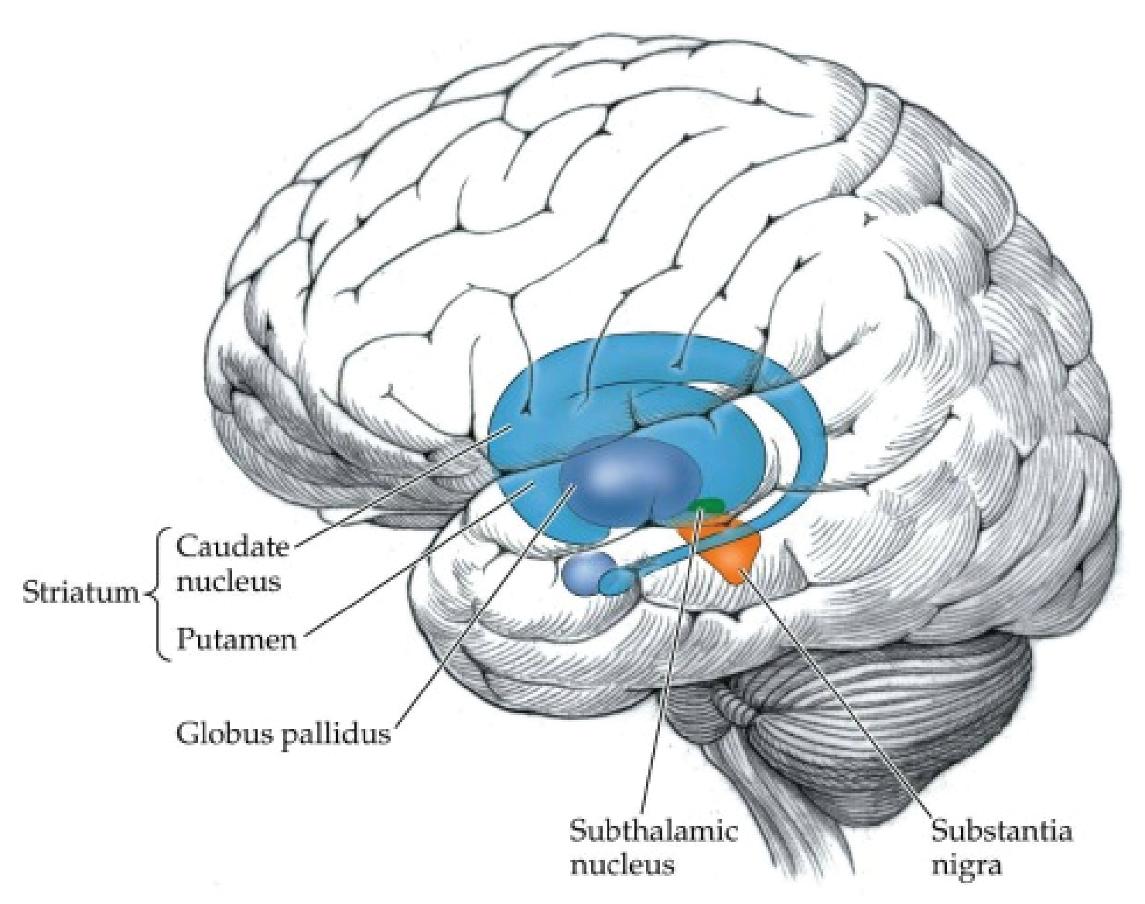
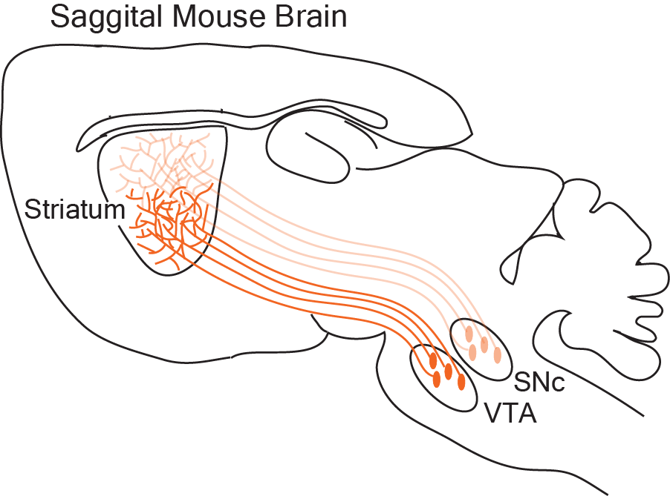
Parkinson’s Disease
Movement intent
Initiation
Basal
Ganglia
Movement Maintenance impaired (slow, jerky movements)
Spared basic motor function
Progressive loss of dopamine in the striatum
https://www.youtube.com/watch?v=Ztwkwqgvoso

Slide 33
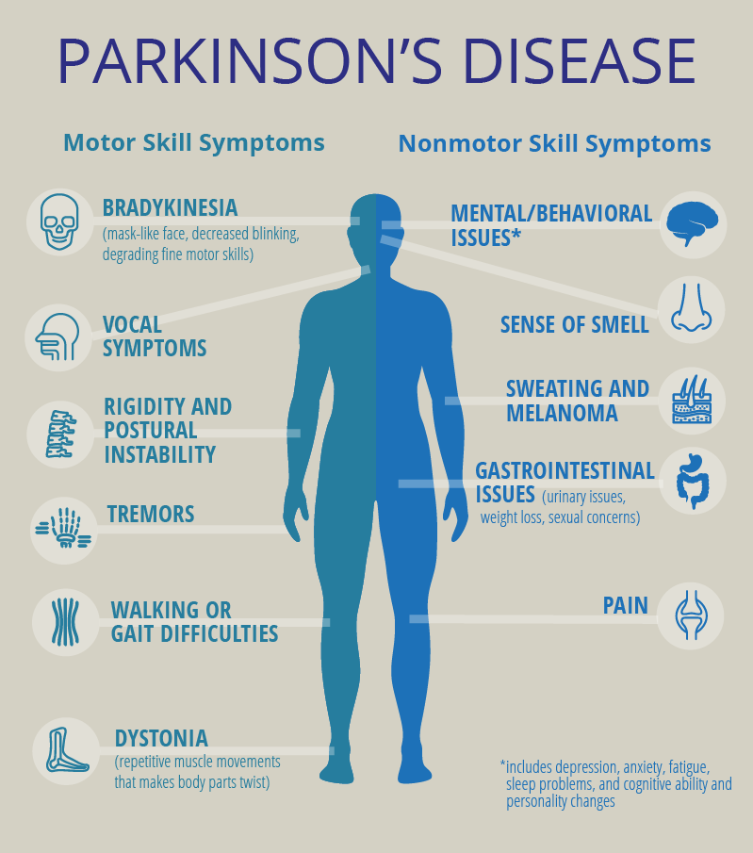

Slide 34
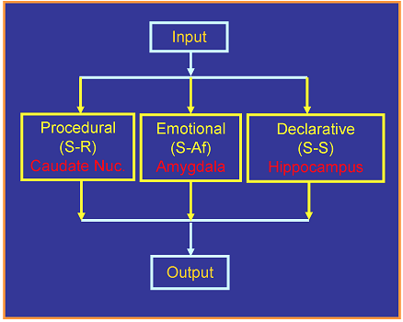
Striatum

Slide 35
Not so top 10 plays
https://www.youtube.com/watch?v=973ayUGfs7A

Slide 36
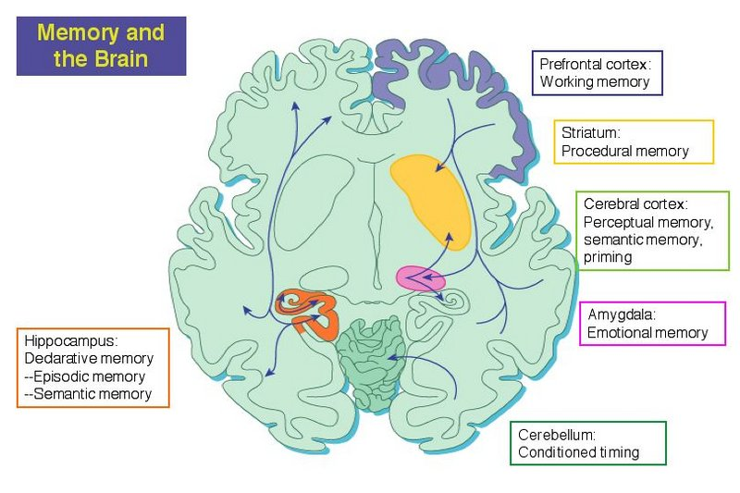
Summary

