Slide 1

Notes:
Reviews from 2 years ago

Slide 2
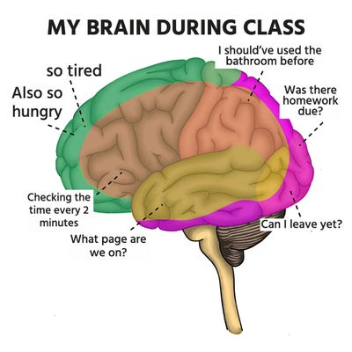
Week 1 Lecture 2:
Anatomy of the brain

Slide 3
Class Structure
Each class begins with ~45mins of neuroscience background, with questions always encouraged throughout
Spread throughout the class are ~15 min TED / YouTube / Netflix breaks
And enough time for ~ 15 minutes of discussion throughout
Discussion will be heavily encouraged from the beginning to end of each class—the more opinions and questions we generate the more insight we can uncover

Slide 4
Grading
Presentations (0%): summary of the meaning of life
Reflection papers (0%): write a lot
Quizzes (0%): multiple choice
Final Paper or presentation (0%): 1,000,000 words
Participation (0 +/-1% for rounding a grade)
Tests (100%; 2 mid-terms and 1 final; final is cumulative but with “redemption” sections)

Slide 5
The Brain in 45 Minutes

Slide 6
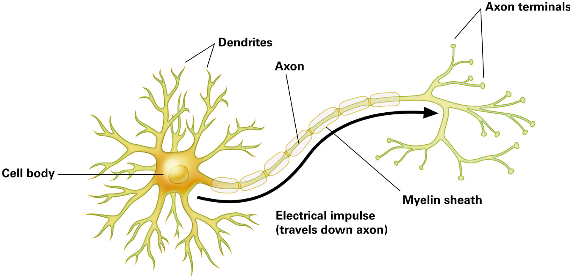
Building blocks
Neurons: Responsible for information transmission throughout the nervous system
Cell body: contains nucleus and other biologic essentials to keep cell alive
Dendrites: receive info from neurons
Axon: transmits signals to neurons
Axon terminals: end of the axon; release messages to a different neuron

Slide 7
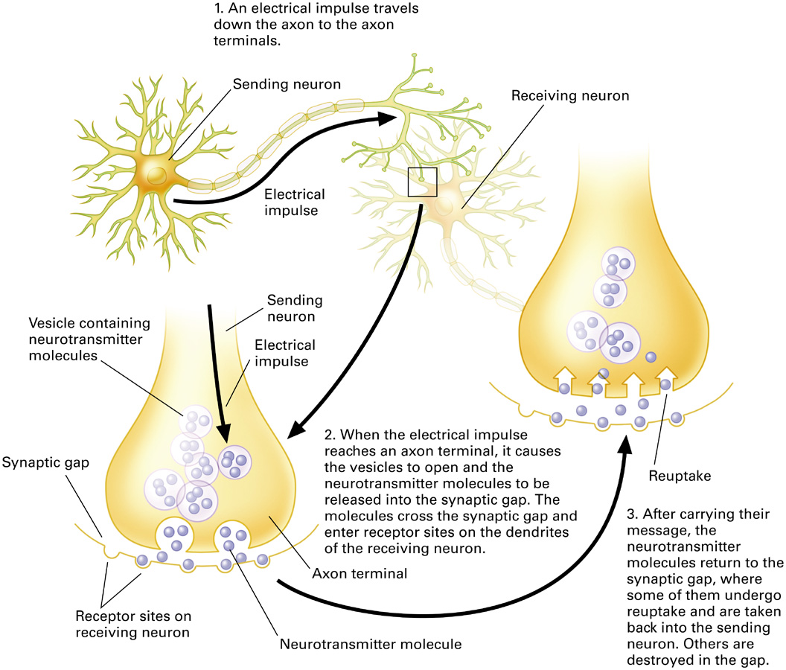
Building blocks
Communication within a neuron is electrical
  Axons transmit electrical impulses in the form of action potentials
  Communication between neurons is chemical
  Neurotransmitters
    Agonists: drugs that increase the activity of neurotransmitters
    Antagonists: drugs that decrease the activity of neurotransmitters

Slide 8
Navigating the brain

Slide 9
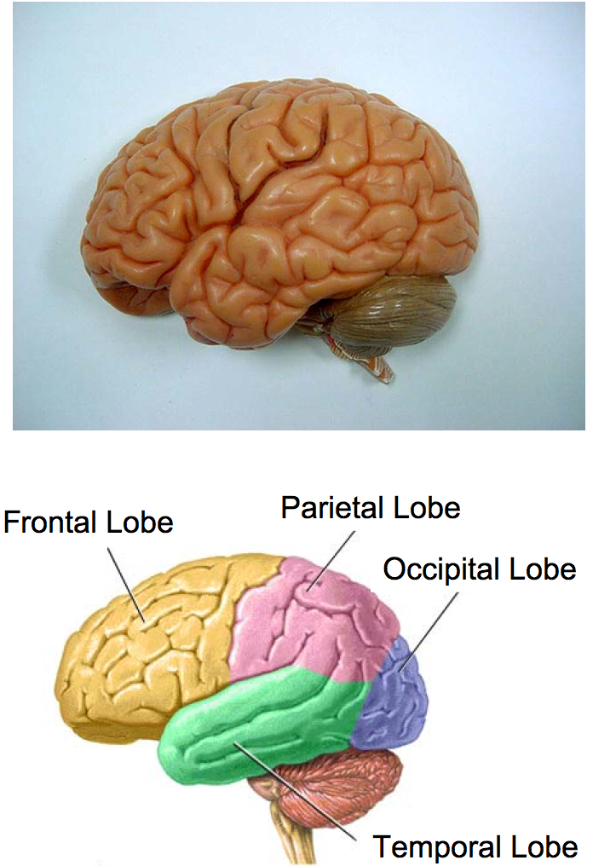
The Brain can be divided into 4 lobes

Slide 10
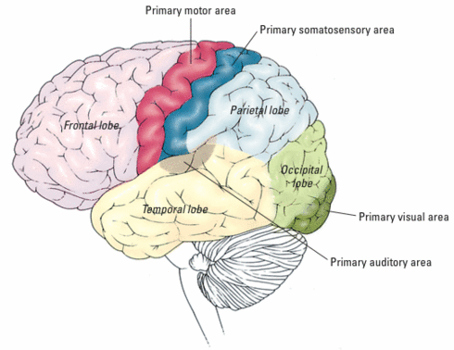
Functions of The Brain: The Cortex
Movement
Bodily Sensation
Planning
Vision
Memory

Slide 11
Vision is processed in the
Occipital Lobe

Slide 12

Vision is processed in the
Occipital Lobe
https://www.youtube.com/watch?v=y_AHzle_d2s
https://www.youtube.com/watch?v=DVz0tIIwyhM
https://www.youtube.com/watch?v=prlIhY3e04k
Notes:
It took one week to animate just one second of footage.

Slide 13
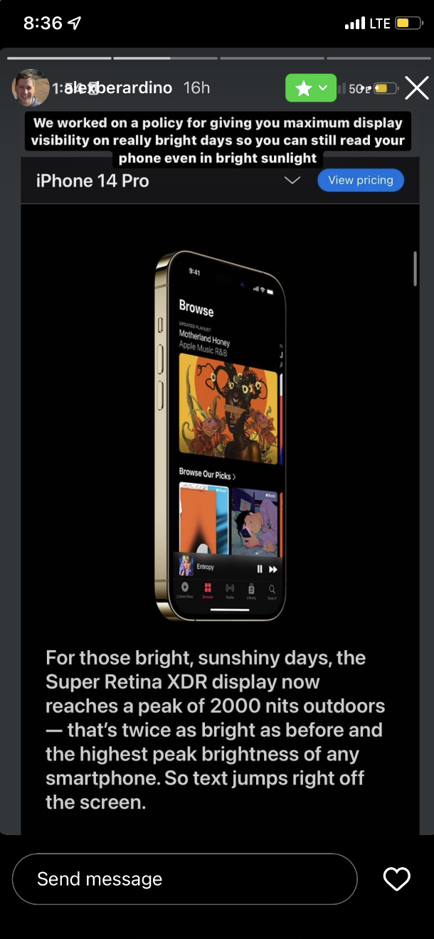
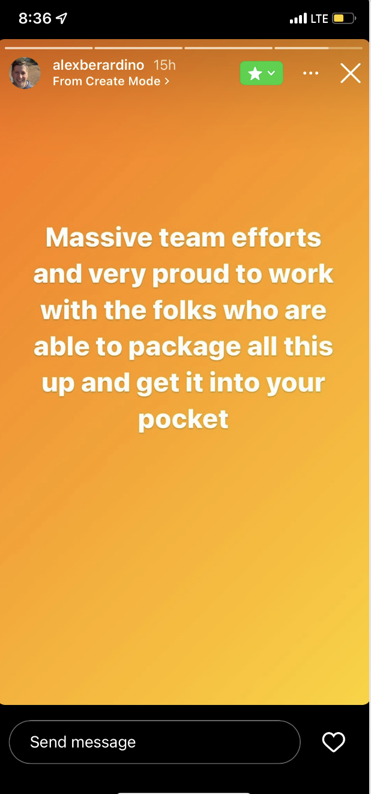
Vision is processed in the
Occipital Lobe

Slide 14
Hearing (and memory) are processed in part of the Temporal Lobe

Slide 15
Hearing (and memory) are processed in part of the Temporal Lobe
https://www.youtube.com/watch?v=WnozP8OWeik
https://www.youtube.com/watch?v=WnozP8OWeik
Notes:
Just think of a dentist’s drill to notice how important hearing is

Slide 16
Touch is processed in part of the Somatosensory Cortex

Slide 17
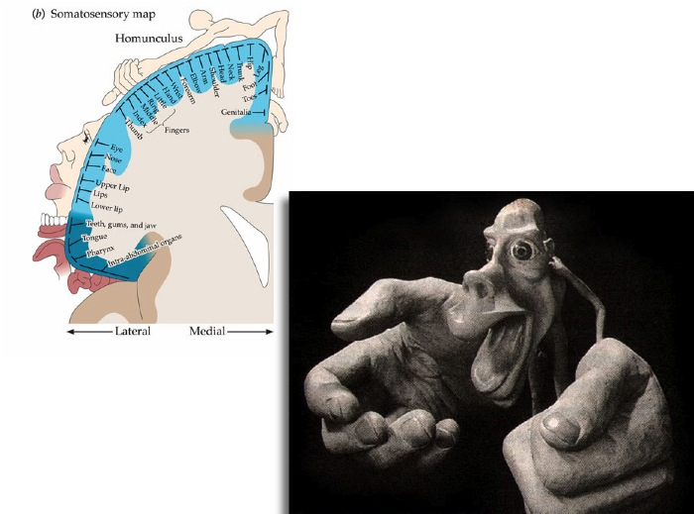
The Somatosensory Cortex contains a map of your Body

Slide 18
The Motor Cortex enables the ability to move the body
https://www.youtube.com/watch?v=Qcr_6__wuoo
https://twitter.com/sahilbloom/status/1567578180680032257?s=21&t=Zo71DgZBmFbEkxnNmoPSXg

Slide 19
The Frontal Lobe enables higher-order cognition, such as planning

Slide 20
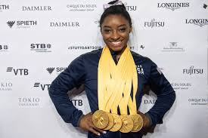

The Frontal Lobe enables higher-order cognition, such as planning
https://www.youtube.com/watch?v=NIKtsOuWosg
https://www.youtube.com/watch?v=gVo6SbcpClc

Slide 22
The Thalamus process nearly all sensory input to the brain

Slide 23
The Cerebellum processes fine-motor movements
https://www.youtube.com/watch?v=kMKdD18Nw3g

Slide 24
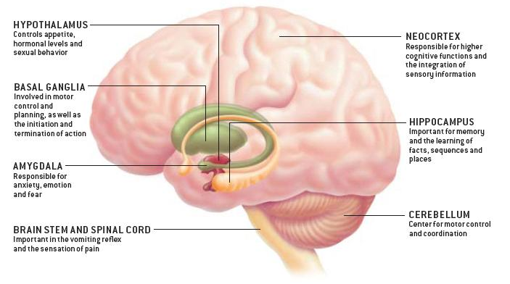
Subcortical areas

Slide 25




The Cortex and Hollywood
Movement
Bodily Sensation
Planning
Vision
Memory

Slide 26




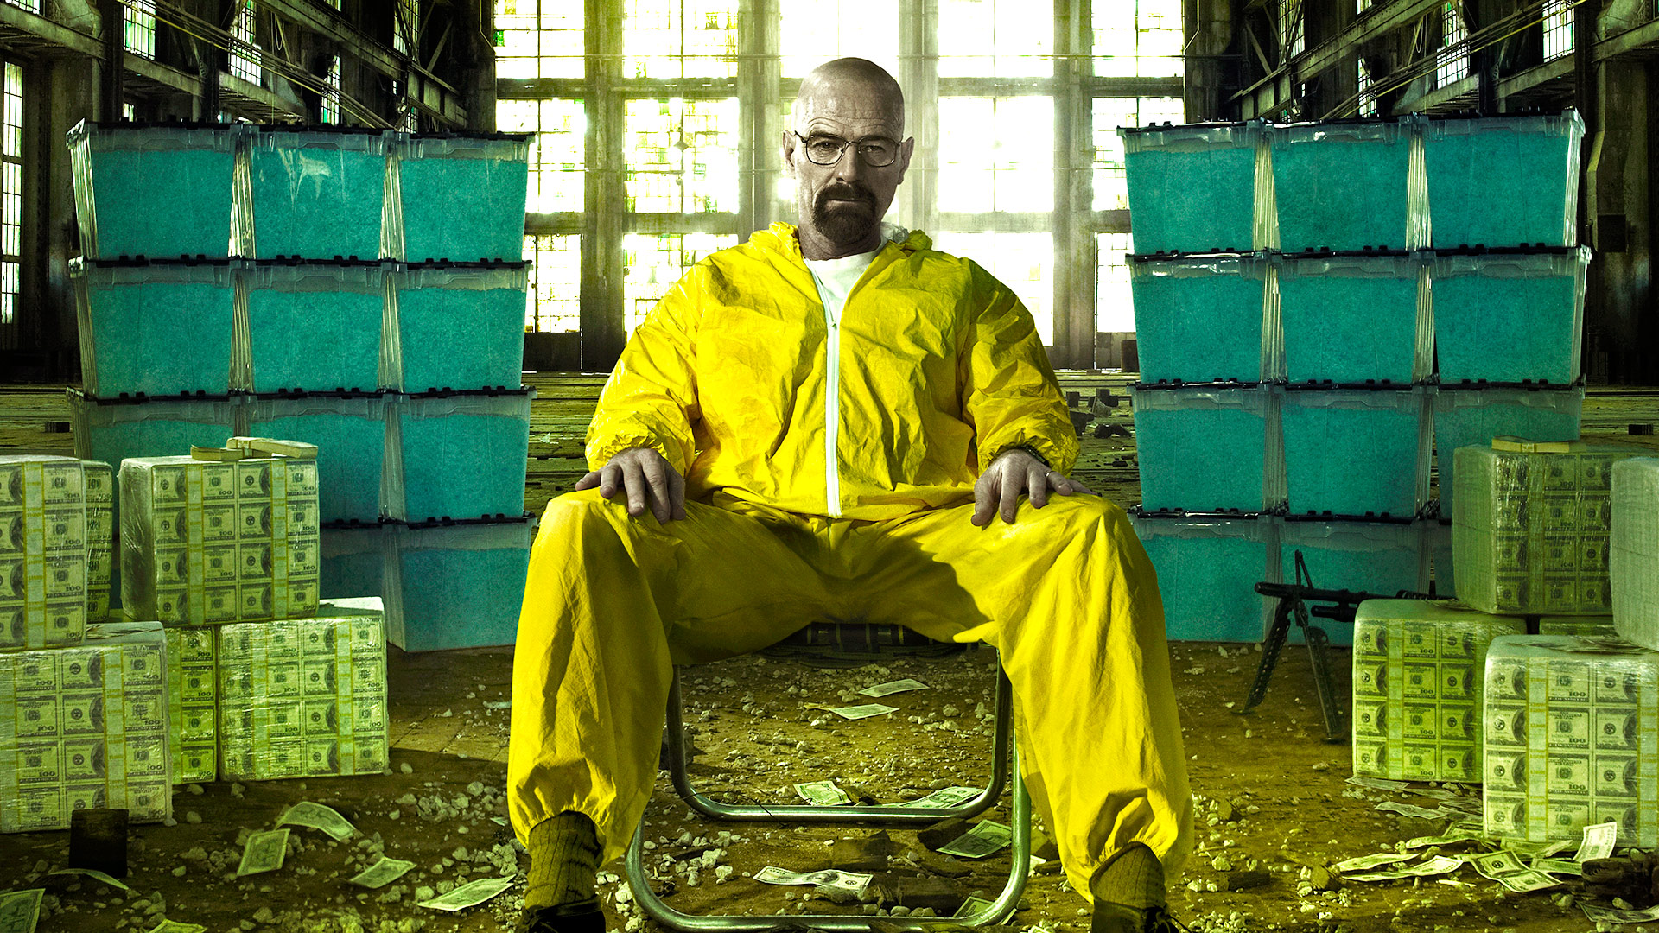

Subcortical areas and Hollywood

Slide 27
What Jason Bourne can teach us about Neuroscience
What Bourne Knows
http://www.youtube.com/watch?v=IjrWOZby8s8

Slide 28
Questions
What are the 4 lobes of the brain?
What brain region processes our emotional responses to situations?
What brain region processes memories of personally experienced events?
Leonard Shelby (Memento’s protagonist) cannot form new personal memories, and yet he can remember how to drive. What brain region do you predict is damaged? What brain area should be intact?

Slide 29
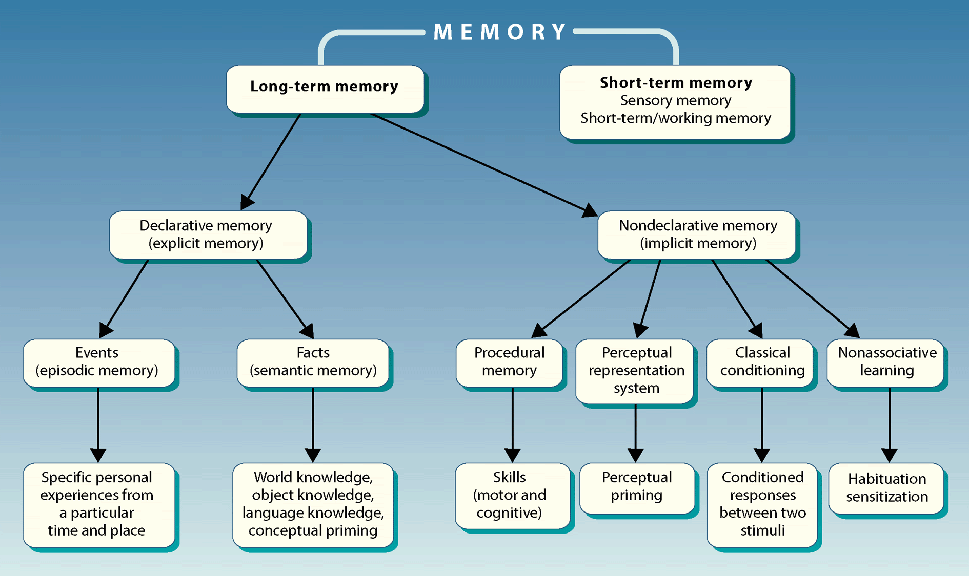
p.314
W. W. Norton

Slide 30



Memory bends the arrow of time
Episodic memory – recollecting events with spatial (where), temporal (when), and informational (what) dimensions

Slide 31
https://www.ted.com/talks/joshua_foer_feats_of_memory_anyone_can_do?language=en

