Slide 1
Emotional memory systems

Slide 3
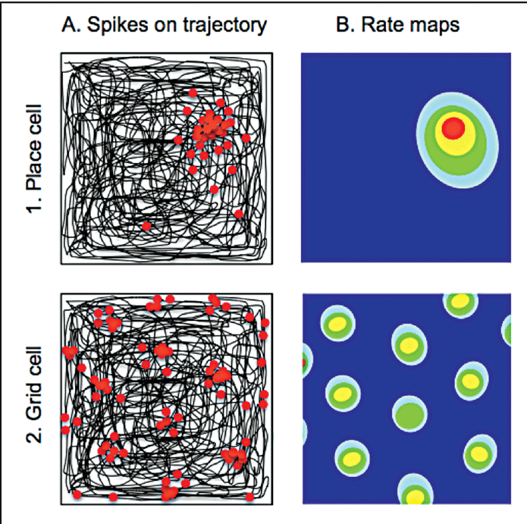
The entorhinal cortex contains grid cells
The hippocampus contains place cells
All the cells:
https://www.youtube.com/watch?v=GmFspbHHZ_w

Slide 4
Place Cells in Humans (2003)

Slide 5
Grid Cells in Humans (2010)

Slide 6
It’s not just space:
The hippocampus contains “time cells”
The hippocampus contains cells that keep track of time
Say we have a task where the animal has to wait 10 seconds before making a choice:
Cell A will fire in the first few seconds (represented by the “ticks” on the right)
Cell B will fire in the following seconds
Cell C will fire in the next few second
Cell D will fire in the last few seconds
The seconds they spend firing are called their “time fields”

Slide 7

Time Cells in Humans as of last year

Slide 8
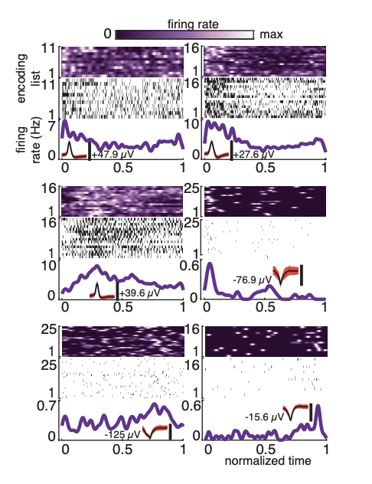
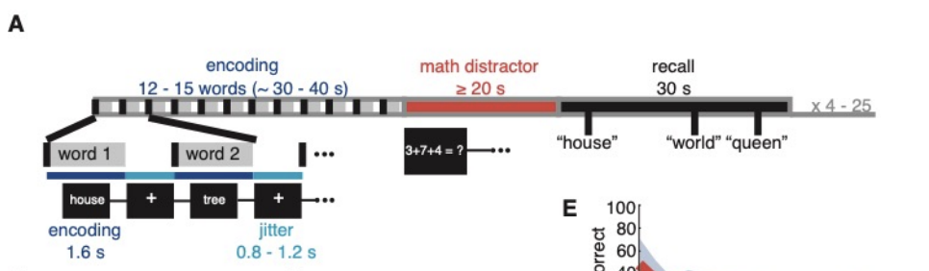
Time Cells in Humans

Slide 9
BREAKING:
The hippocampus processes past, present, and future
in mice and humans

Slide 10
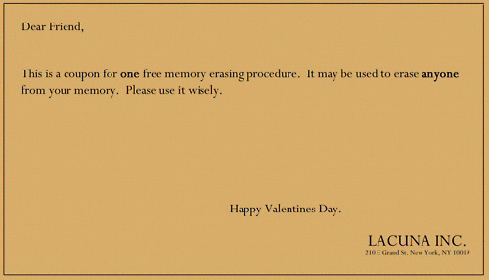
Lacuna Commercial
http://www.youtube.com/watch?v=UAlZ0SJzCcw

Slide 11
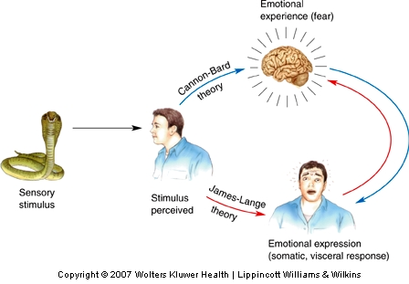
What Is Emotion?
Theories of Emotion
  The James-Lange Theory: Emotion = Response to physiological changes in the body
  The Cannon-Bard Theory: Emotions independent of emotional expression
https://www.youtube.com/watch?v=pecha-7QOVo

Slide 12
Amygdala

Slide 13
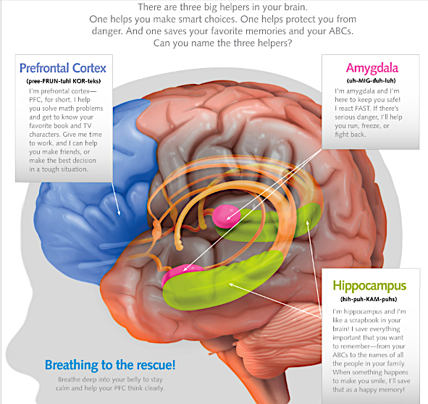

Slide 14
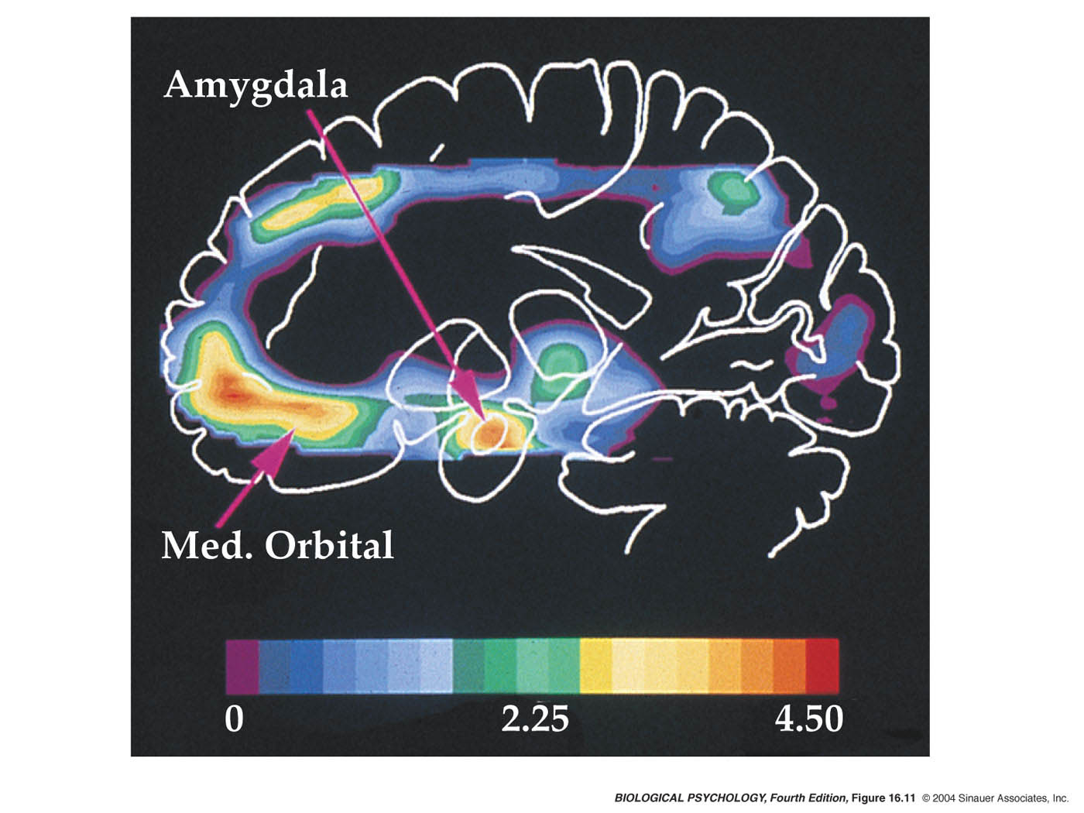

Slide 15
Amygdala
What a hyperactive amygdala looks like
https://www.youtube.com/watch?v=gO8N3L_aERg

Slide 16
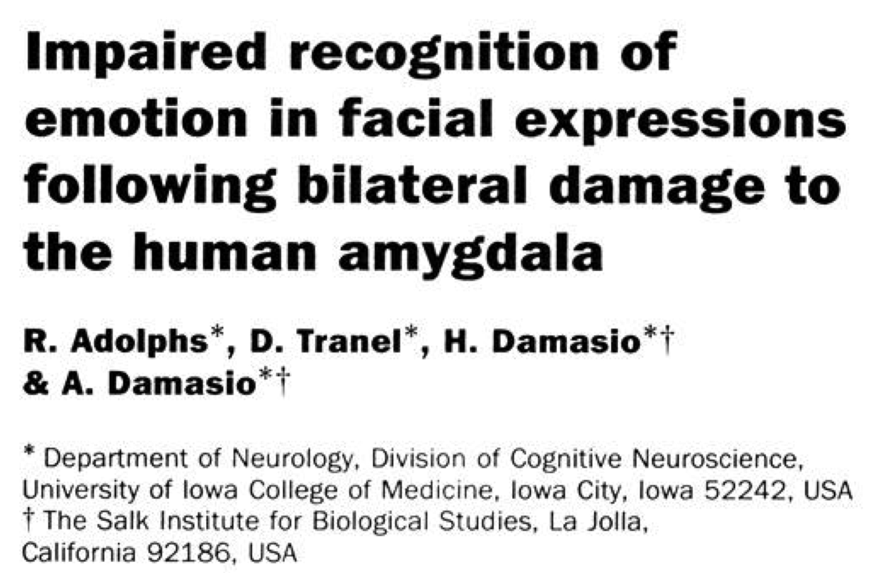
Damage to the amygdala and fear
Often called Kluver-Bucy Syndrome

Slide 17
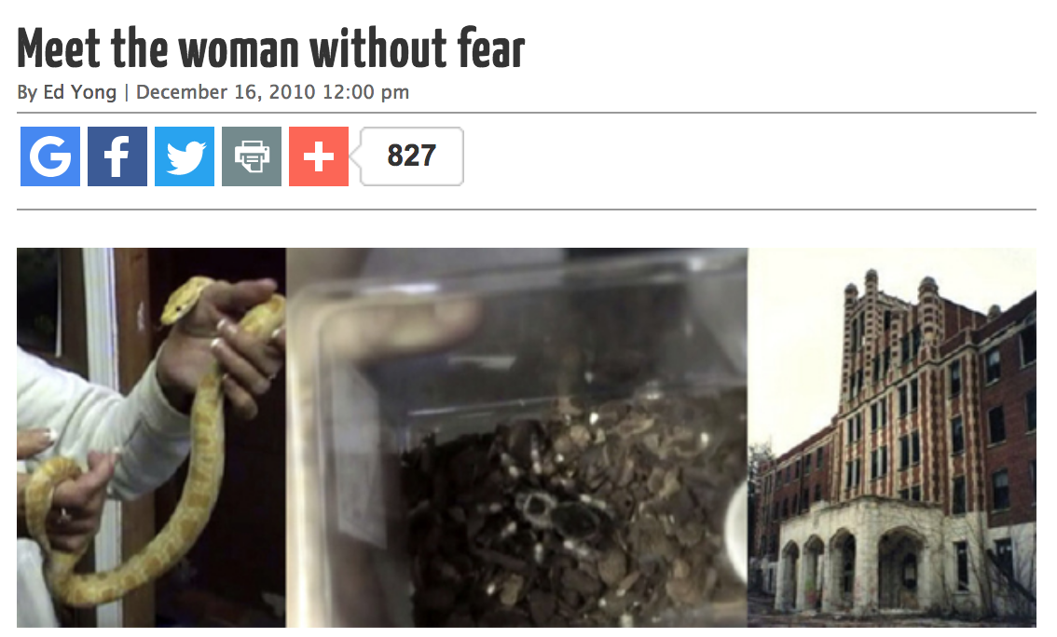
Patient S.M.
Can perceive faces and recognize faces, but couldn’t characterize the emotion of fear.
Inability to appreciate emotional expression.
Reponses to pain impaired
H.M had partial amygdala damage: Responses to pain were impaired and he did not identify stimuli as “painful”
OPTIONAL: http://blogs.discovermagazine.com/notrocketscience/2010/12/16/meet-the-woman-without-fear/#.XD4wVc9KjL8

Slide 18
Klüver-Bucy Syndrome
  Amygdala damage even in rhesus monkeys results in:
    Decreased fear and aggression
  The same damage in humans results in:
    A blunting (“dampening”) of emotions
https://www.youtube.com/watch?v=2Hi3JO1rqYw

Slide 19
Amygdala lesions in mice
https://www.youtube.com/watch?v=9AStzt21ZdE

Slide 20
Sample test question
Patient HM had hippocampus and amygdala damage, while patient SM only had amygdala damage. One of their overlapping symptoms is:
An inability to recall memories they formed yesterday
An inability to perceive snakes
An impairment in responding to pain
1 and 3
None of the above

Slide 21
How to measure distinct emotional states in rodents

Slide 22
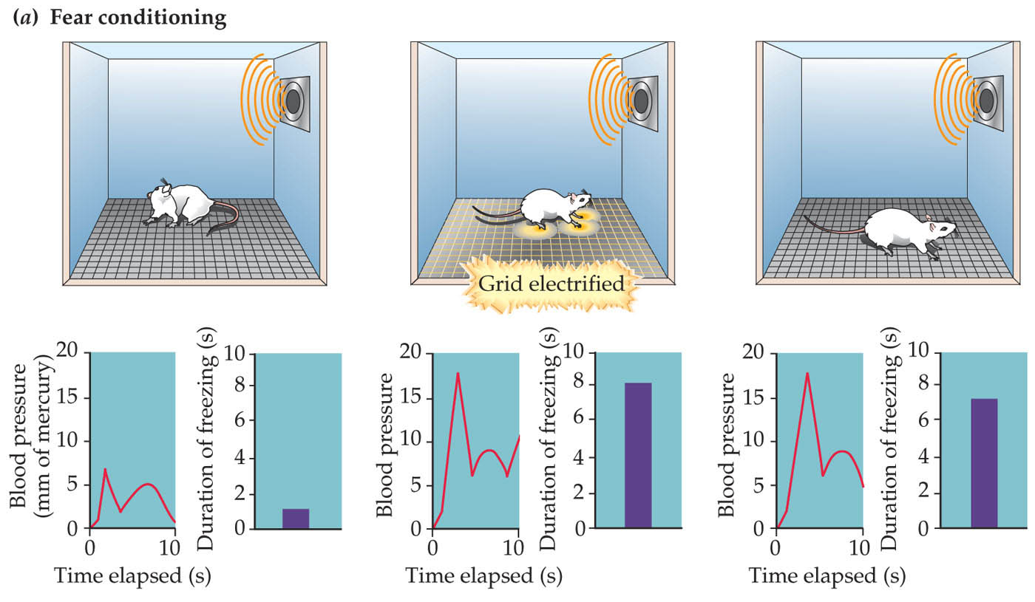
Pairing tones and shocks to induce learning
This is dependent on the amygdala!

Slide 23
Using genes to detect a memory
1) Cells are active during learning have genes (”gene 1”) that also become active for a few hours. However, this gene can be tricked to make a cell glow green permanently and thus “tag” a set of cells permanently.
2) To identify the same cells active during learning, consolidation, and retrieval, we now trick a new gene (”gene 2”) to make a cell glow red, so wherever we see yellow (green + red) we see which cells were involved in all phases of memory.

Slide 24
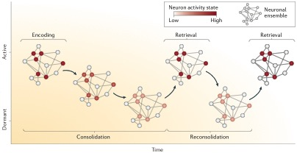
Using genes to detect a memory
Neural ”Ensembles” are sets of cells active at the same time during a given task

Slide 25
Using activity-dependent genes to detect a memory
Active
Learning
A subset of amygdala neurons that were active during learning also have genes in them (e.g. c-fos) that are “turned on” due to the neuron’s activity, i.e. it firing action potentials
These genes can trick the cells they’re in to glow any color so that we can visualize them under a microscope
This same subset of neurons that were active during learning were also preferentially activated during retrieval.
Reactivated
Retrieval

Slide 26
Using genes to detect a memory
Cells that have increased levels of a protein called “CREB” are more likely to fire action potentials than controls (CON)
Each ”blip” on the right represents an action potential
Please do NOT MEMORIZE the CREB pathway that would be and should be against the law

Slide 27
How to erase memories
CREB
Active
Learning
Memories can be artificially forced into to a subset of neurons:
Cells that have heightened levels of CREB are more likely to be active in general
Researchers can force cells to have heightened levels of CREB, and then have an animal learn to fear a tone
Since the cells with CREB are more likely to be activated in general, they now preferentially become active during tone fear conditioning
This version of CREB has been modified so that researchers can inject an animal with a molecular “key” that fits into a type of “lock” that CREB has on it which, when bound, causes cell death
This erases an animal’s fear memory by killing these neurons
Cell death induces memory erasure
Fear memory

Slide 28
Eternal Sunshine
https://www.youtube.com/watch?v=2ke2HjqVXfc

Slide 29
The greatest climb in history
Read:
http://nautil.us/issue/39/sport/the-strange-brain-of-the-worlds-greatest-solo-climber
https://www.youtube.com/watch?v=tnRoda7Ke2w
TED: https://www.youtube.com/watch?v=6iM6M_7wBMc

Slide 30
Alex
Control
The blue is Alex Honnold’s brain on the left, with the crosshairs on his amygdala responding to fearful stimuli
The red is a control subject’s brain on the right responding to the same stimuli

Slide 31
Emotional Memory (Cont):
A neural basis for positive and negative emotions

Slide 32
https://www.youtube.com/watch?v=1S0RKRRyqhQ
Emotions can oscillate between positive and negative
(and everything in between)

Slide 33
Pairing tones and shocks to induce learning
This is dependent on the amygdala!
The office again bc duh: https://vimeo.com/35754924

Slide 34
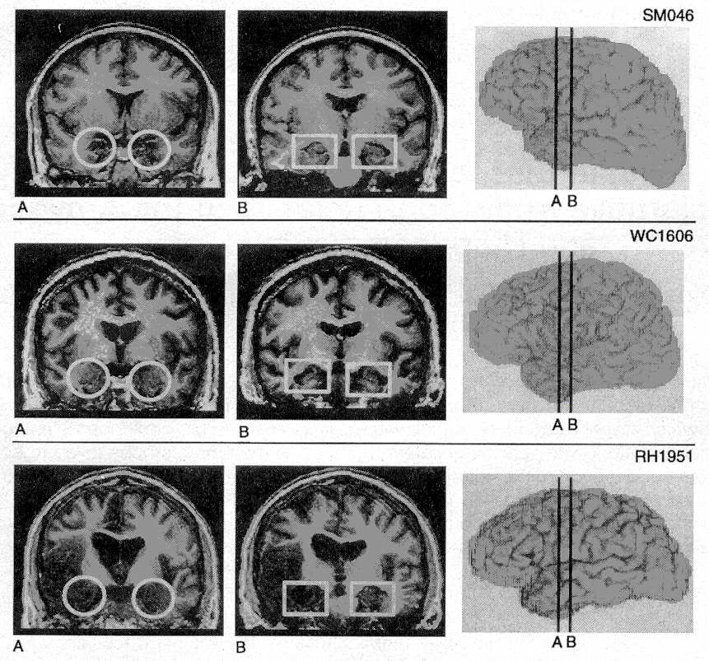
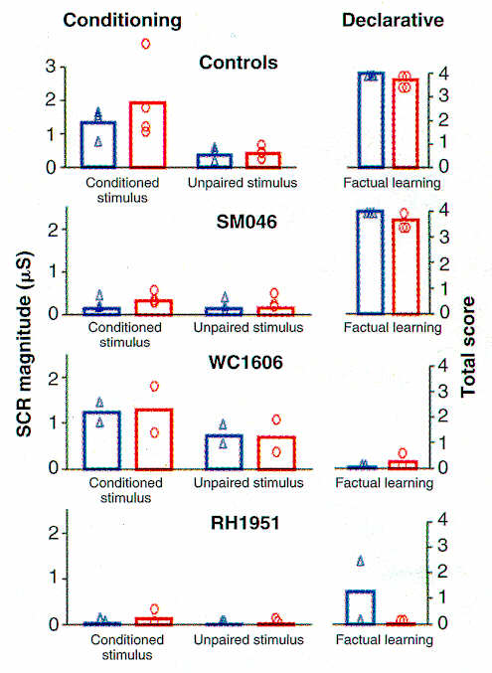
Emotional conditioning is dependent on amygdala, declarative learning on the hippocampus
Amygdala damage prevented tone-shock conditioning but left declarative memory intact
Hippocampus damage prevented declarative memory but left tone-shock conditioning intact
Damage to both areas prevented declarative memory and tone-shock conditioning
SCR = Skin Conductance Response
Amygdala
Hippocampus
Both

Slide 35
The amygdala is remarkably conserved across evolution
Janak and Tye 2015

Slide 36
The amygdala processes both fear and reward
In humans, non-human primates, and rodents, the amygdala is active for both positive and negative experiences.
How could the same region do both?
(BLA here = amygdala, just a subregion of it called the “baso-lateral” amygdala”)
Janak and Tye 2015
Notes:
Janak and Tye 2015

Slide 37
The amygdala sends axons to many areas of the brain, including the central amygdala and nucleus accumbens
BLA = Amygdala
In humans, non-human primates, and rodents, the amygdala is active for both positive and negative experiences.
How could the same region do both?
NAc = Nucleus Accumbens
CeM = Central Amygdala
Reward
Fear

Slide 38
The amygdala sends axons to many areas of the brain, including the central amygdala and nucleus accumbens
Anterior (front) of brain
Posterior (back) of brain
NAc
CeA
BLA
NAc = Nucleus Accumbens
BLA = Amygdala
CeM = Central Amygdala

Slide 39
Researchers identified two different sets of cells in the amygdala that communicated to two different regions of the brain.
The amygdala sends direct axons to the central amygdala, which is thought to mediate fear
The amygdala also sends direct axons to the nucleus accumbens—a brain area strongly implicated in processing rewards
Fear
Reward

Slide 40
BLA to NAc, i.e. amygdala to nucleus accumbens, which processes reward
BLA to CeM, i.e. amygdala to central amygdala, which processes fear
Animals will nose poke a lot, which is a measure of reward since they “want” more of that stimuli, when the BLA to NAc cells are turned on
Animals will show avoidance or run away from an environment when BLA to CeM cells are turned on, which is a measure of fear

Slide 41
Switching from reward to aversion instantly
https://www.youtube.com/watch?v=qfNReBBUk_w

Slide 42
WOULDN’T THIS BE A GREAT TEST QUESTION THO?
The amygdala projects to many brain areas, including the nucleus accumbens and central amygdala. If you managed to stimulate the projections from the amygdala to the accumbens, you would expect ________ whereas from the amygdala to the central amygdala you would expect ___________?
Fear, Reward
Fear, Fear
Reward, reward
1 and 2
None of the above

Slide 43
That was based on “who” neurons talked to;
What about WHERE they’re located?
Anterior (front) of brain
Posterior (back) of brain
NAc
CeA
BLA

Slide 44
Researchers identified two areas of the amygdala: one in the anterior (or “front” of the brain) that processes fear
And another in the posterior (or “back” of the brain) that processes reward
The genetic “markers” were:
Rspo2, which processed fear.
PPP1r1B, which processes reward.
Anterior (front) of brain
Posterior (back) of brain
Reward
Fear
BLA

Slide 45
Cells responsive to fear or reward cues
Anterior of the amygdala to posterior of the amygdala
Distance from the front the front to back of the brain
Cells with Rspo2, which process fear, are near the front of the brain
Cells with PPP1r1B, which process reward, is near the back of the brain

Slide 46
Please be mindful that each paper uses the *opposite* color for fear and reward because no one can agree on anything ever

Slide 47
”Where” neurons are located and “who” they talk to can dictate their function with memory and emotion
Anterior (front) of brain
Posterior (back) of brain
Reward
NAc
CeA
Fear
BLA
Anterior (front) of brain
Posterior (back) of brain
Fear
Reward
BLA

Slide 48
Philippe Petit: The greatest walk in history
https://www.youtube.com/watch?v=hkAmU6N98mo
https://www.youtube.com/watch?v=0GKuUhqxwLU

Slide 49
Anxiety Disorders I
Phobias: Specific fears, often learned.
Panic attacks: Severe sympathetic nervous system reactions to uncomfortable situations. Usually treated with GABA-ergic drugs and psychotherapy; target amygdala but affect the whole brain
Post-traumatic stress: Fear disorder brought on by specific trauma, e.g., violence or accident.
Generalized anxiety: Persistent excessive worries even in the absence of an immediate threat. Treated with SSRIs or tranquillizers that target the amygdala

Slide 50
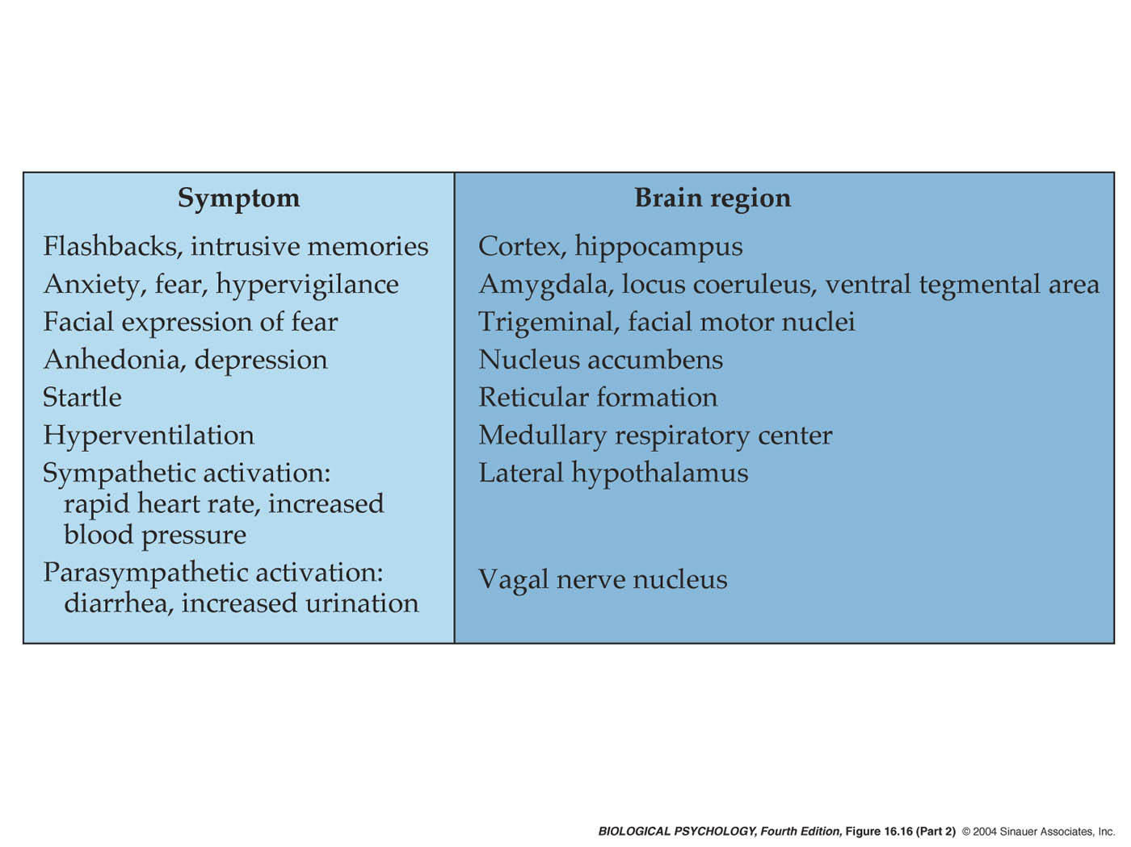
Posttraumatic Stress Disorder

Slide 51
Iron man and Anxiety
https://www.youtube.com/watch?v=zaozzBszc4w

Slide 52
Inactivating the PL impaired fear expression but not extinction memory
Inactivating the IL impaired extinction learning and extinction memory

Slide 53
Inactivating the BLA impaired fear expression and extinction memory
Inactivating the HPC impaired fear expression and extinction memory

Slide 54

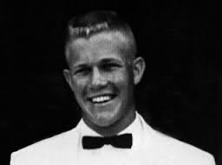
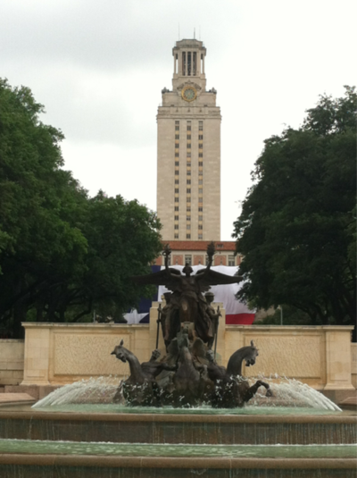
The case of Charles Whitman
“I don’t really understand myself these days. I am supposed to be an average reasonable and intelligent young man. However, lately (I can’t recall when it started) I have been a victim of many unusual and irrational thoughts.
It was after much thought that I decided to kill my wife, Kathy, tonight … I love her dearly, and she has been as fine a wife to me as any man could ever hope to have. I cannot rationally pinpoint any specific reason for doing this …
I talked with a Doctor once for about two hours and tried to convey to him my fears that I felt [overcome by] overwhelming violent impulses. After one session I never saw the Doctor again, and since then I have been fighting my mental turmoil alone, and seemingly to no avail.”
Notes:
1966, University of Texas Tower and killed more than a dozen people

Slide 55
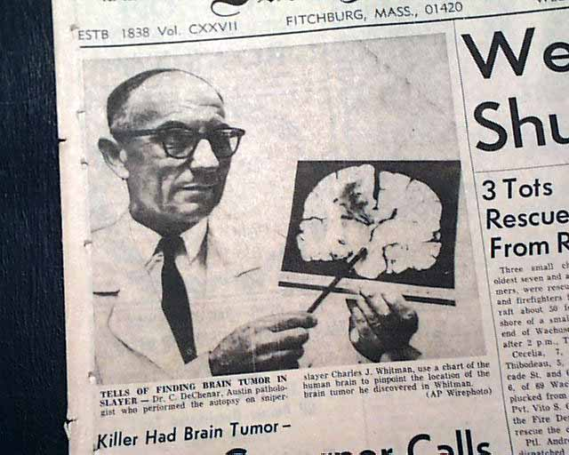
Does a tumor exonerate an evil act?
“This tumor had blossomed from beneath a structure the thalamus, impinged on the hypothalamus, and compressed a third region called the amygdala”
Was Charles Whitman responsible?
https://www.theatlantic.com/magazine/archive/2011/07/the-brain-on-trial/308520/
(Eagleman, The Brain on Trial)
Notes:
Hypothalamus: 4 F’s

Slide 56
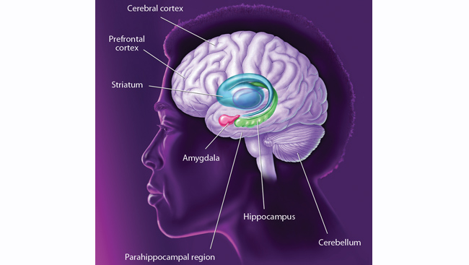
Name that brain area!

