Slide 2
Artificially modulating neurons and behavior:
from memories to psychiatric disease-like states

Slide 3



Notes:
Graduating BU

Slide 4


Slide 5

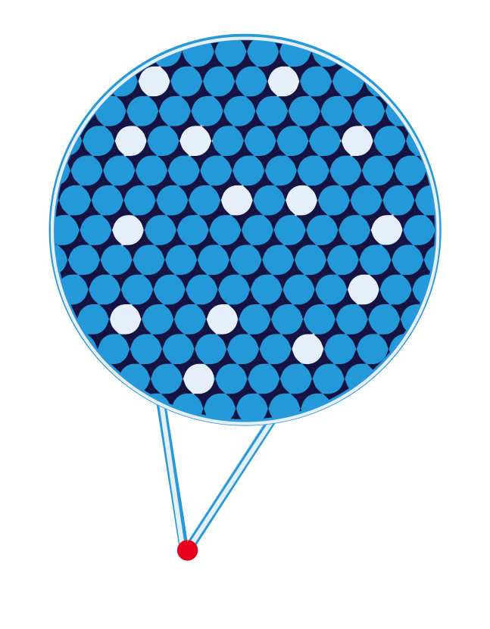
Criteria for identifying a putative neural correlate of memory
Observe
Learning => Neural Activity
Correlation
(Eichenbaum, 2016)
(Hasselmo et al. 2002)
(Reijmers et al. 2007)
Perturb
Block neurons => Block memory
Necessity
(Han et al, 2009)
(Denny et al. 2014)
(Tanaka et al. 2014)
Mimic
Activate neurons => Activate memory
Sufficiency
(Ramirez et al. 2013)
(Cowansage al. 2014)
(Josselyn et al. 2015)
(Martin and Morris, 2000)

Slide 6

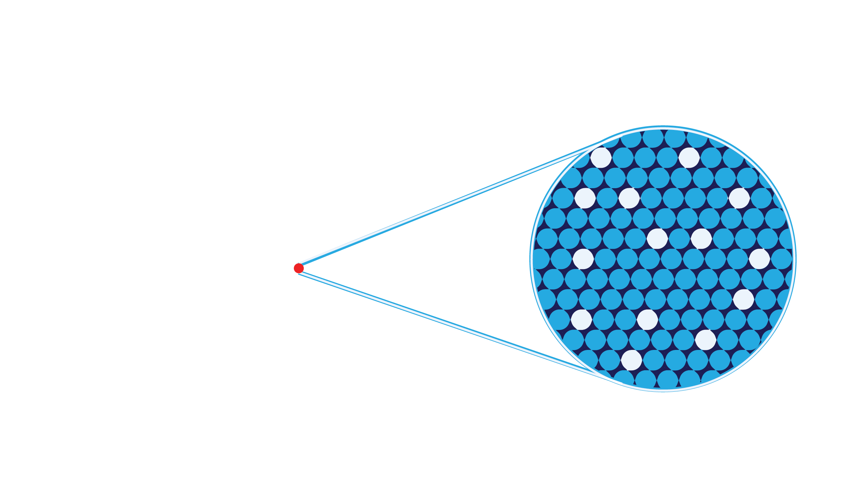
Hypothesis
Hippocampus cells active during the formation of a memory are sufficient to drive the behavioral expression of that memory

Slide 7
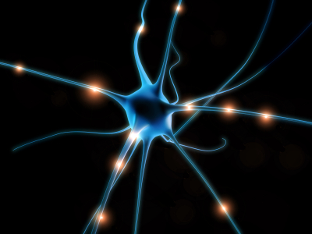
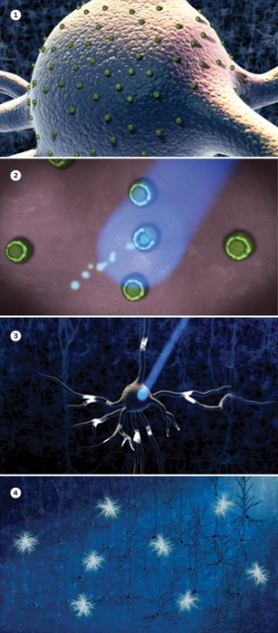
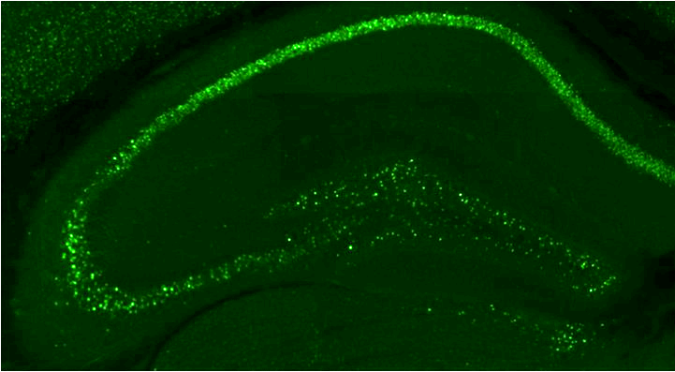
Activity-dependent and inducible optogenetics
ChR2
tTA
c-fos promoter
tTA
c-fos
Dox
tTA
TRE
ChR2
ChR2
ChR2 makes cells
responsive to light
c-Fos is expressed in active neurons
Dox can open and close windows for expressing a given gene

Slide 8
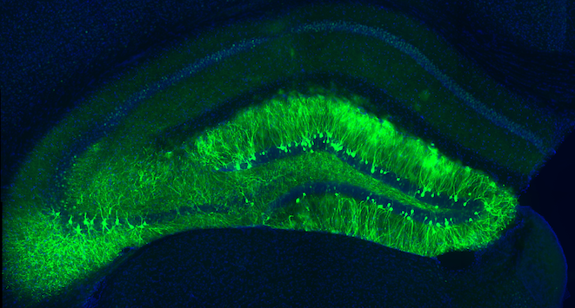

Slide 9
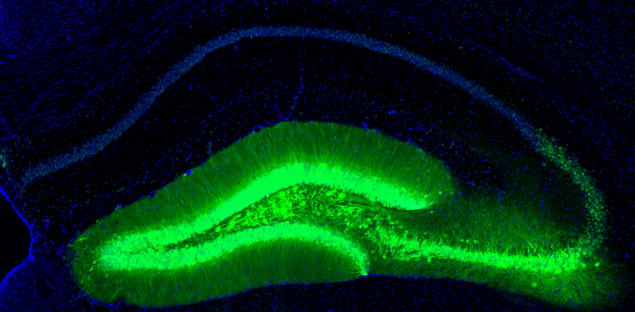

Slide 10

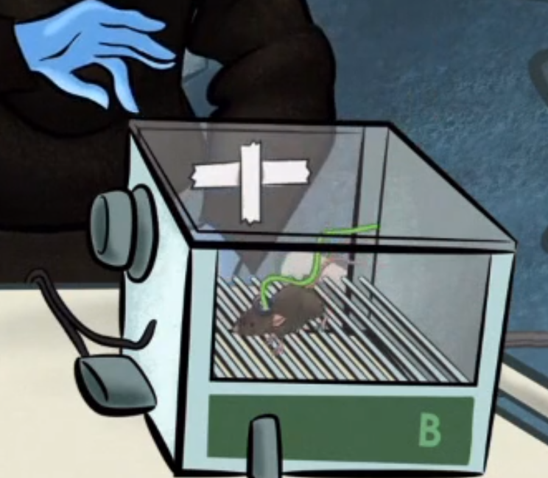
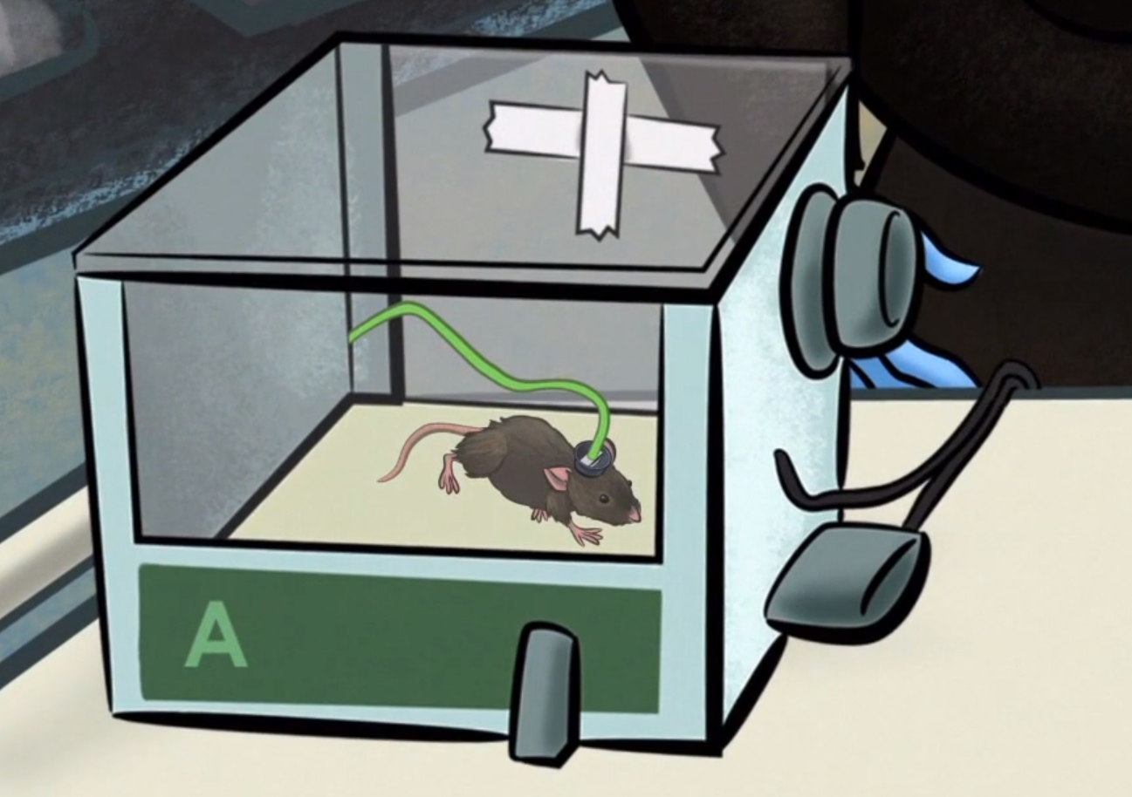

Slide 11
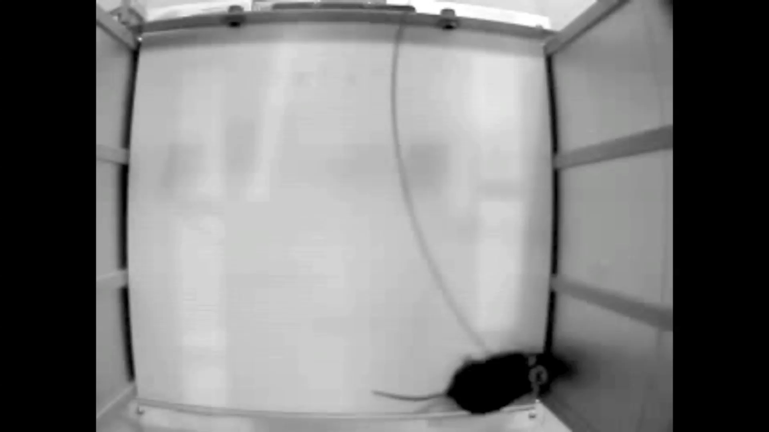

Slide 12

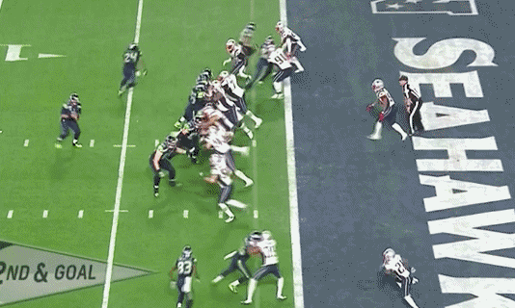
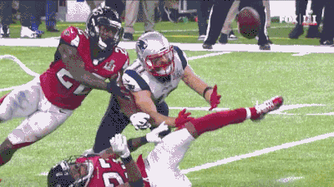
From negative to positive

Slide 13
Activating hippocampus cells associated with a
positive experience
Conclusion: hippocampus cells that were active during reward experiences can drive place preference.
Notes:
To gain access to a positive experience in mice, Roger and Josh in our lab started by exposing male mice to female mice

Slide 14
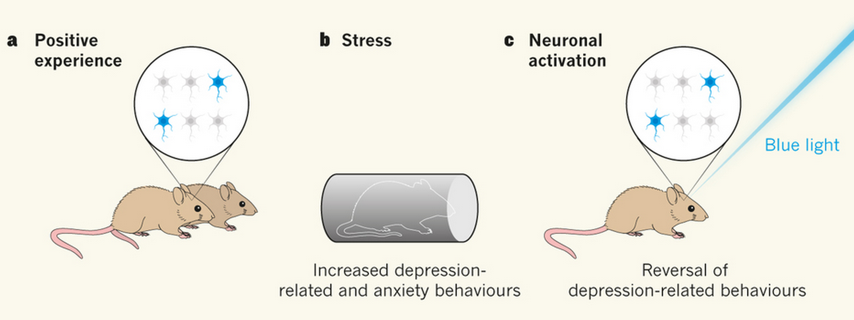
Hypothesis
Hippocampus cells active during a positive experience are sufficient to bi-directionally modulate maladaptive states when reactivated

Slide 15
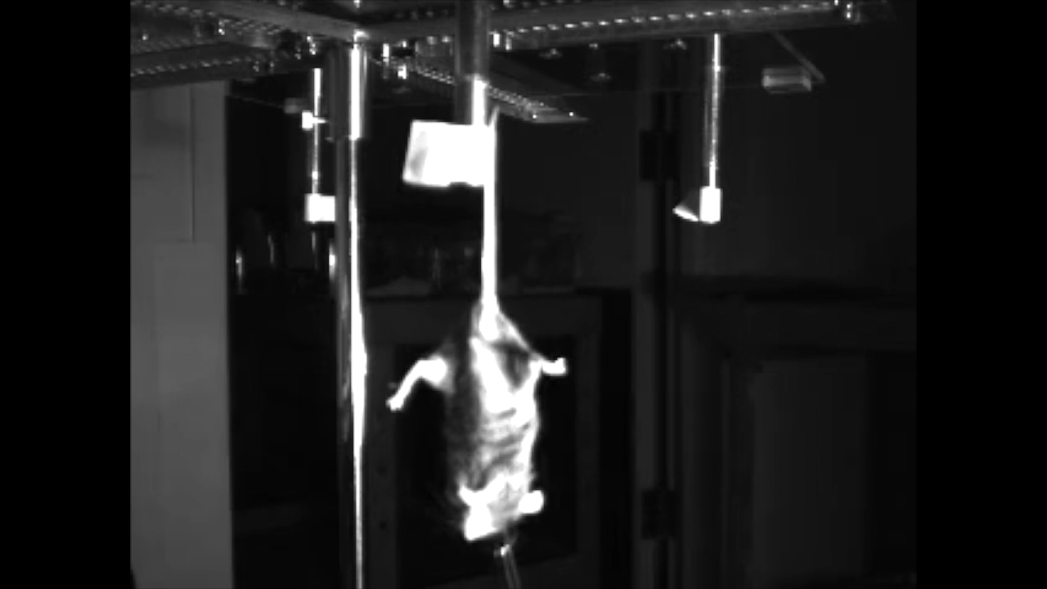
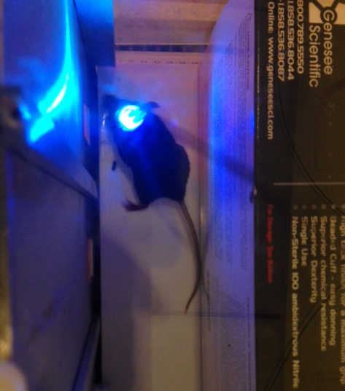
Unstressed
Positive
Neutral
Negative
*
Significance: hippocampus cells that were active during a positive experience are sufficient to reverse the effects of stress in a battery of behavioral assays

Slide 16
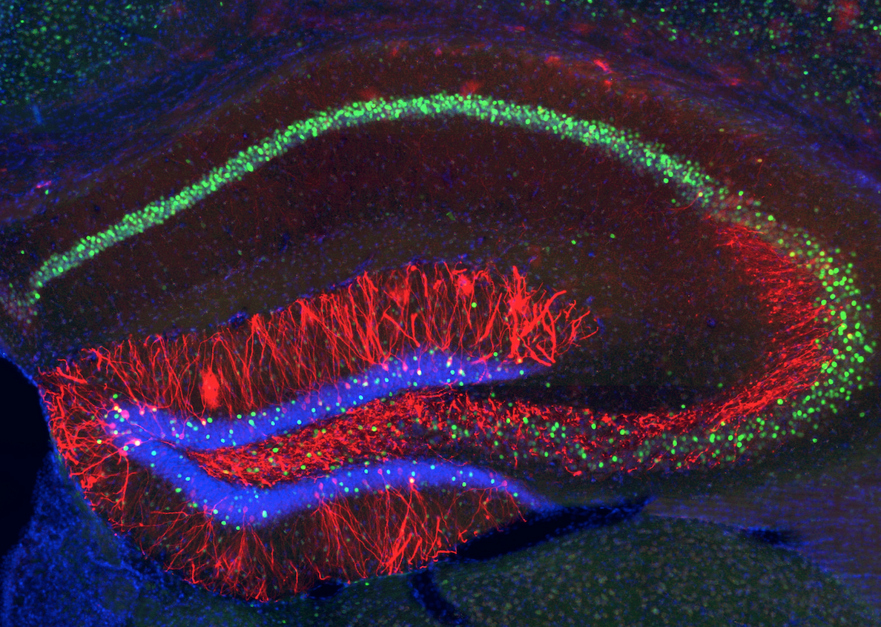
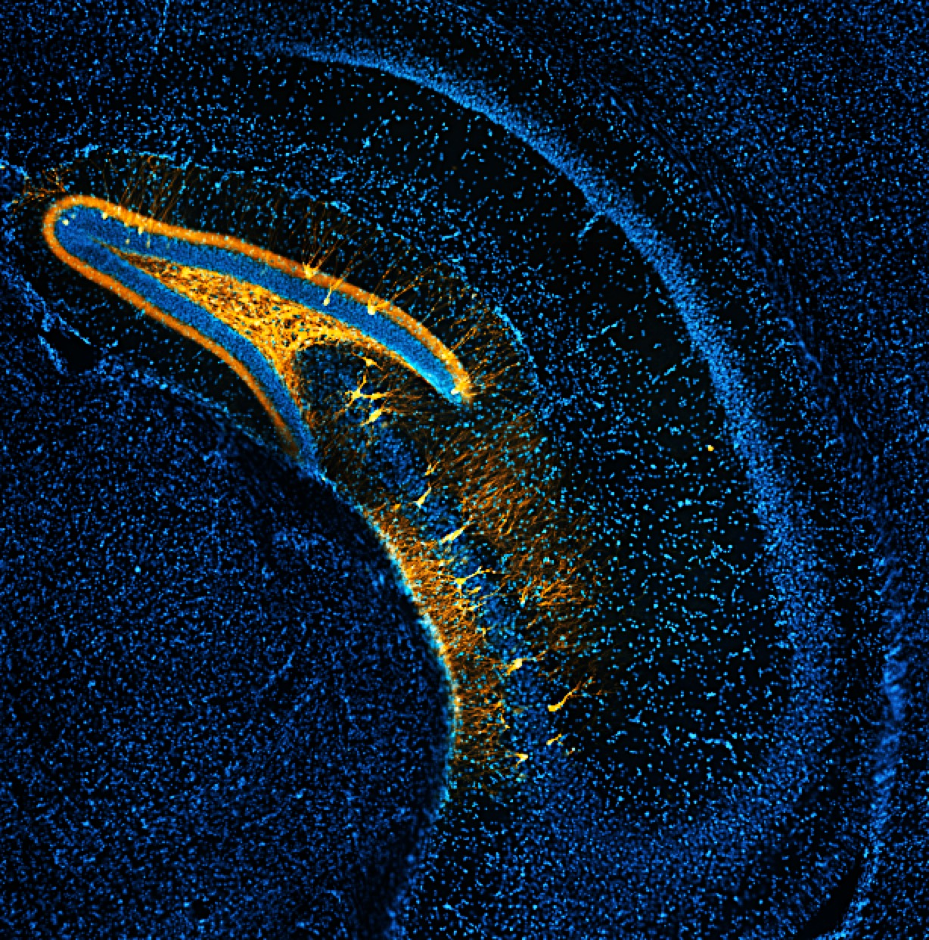
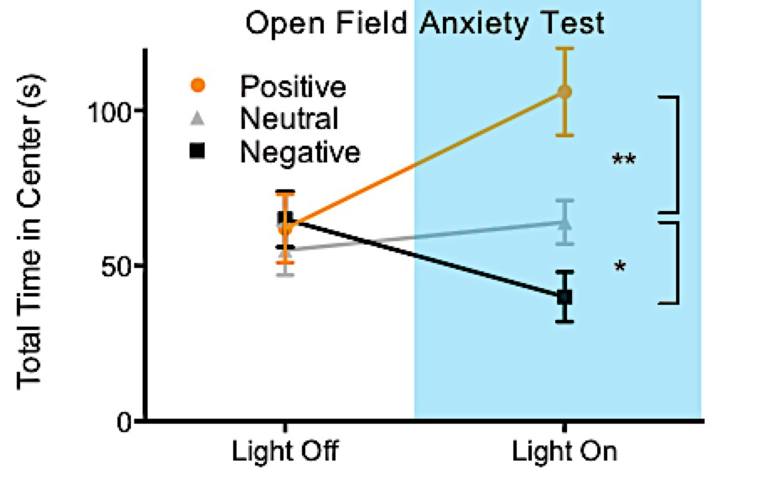
Identifying the contributions of dorsal and ventral HPC
in driving memories
No effect in anxiety-related assays
Interpretation:
Activating HPC cells that process positive or negative memories is sufficient to bi-directionally control avoidance behavior

Slide 17



Notes:
All acute effects

Slide 18
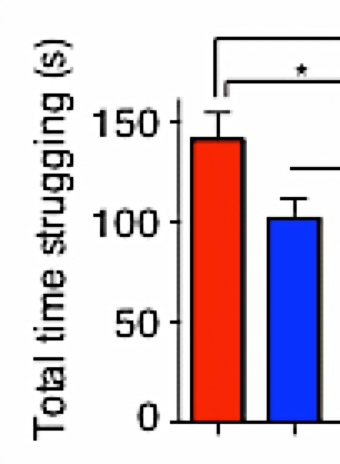
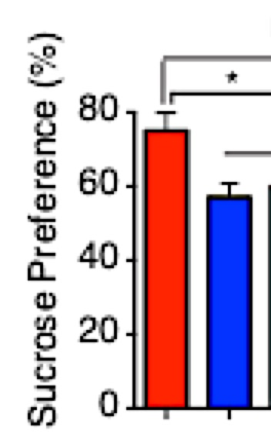
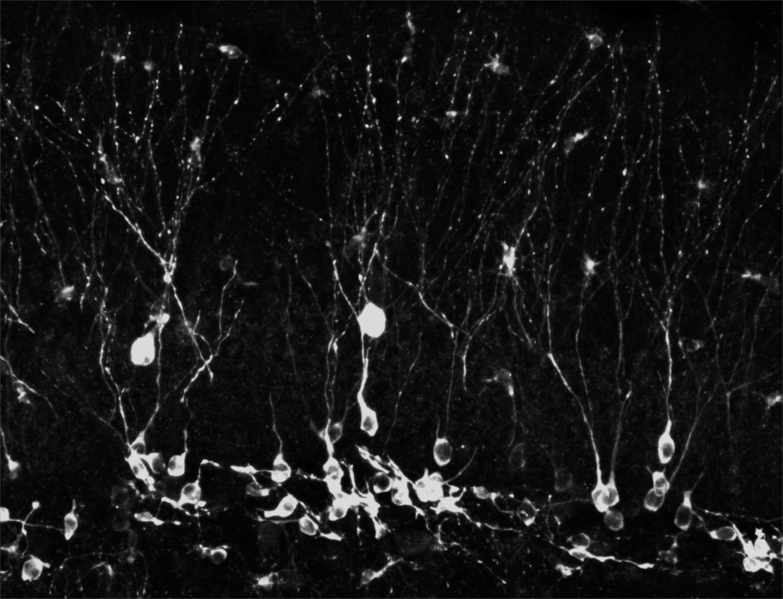
*
*
*
Total time struggling (s)
0 50 100 150
Sucrose preference (%)
0 20 40 60 80
Pos Neut
Notes:
REFERENCE HAN

Slide 19

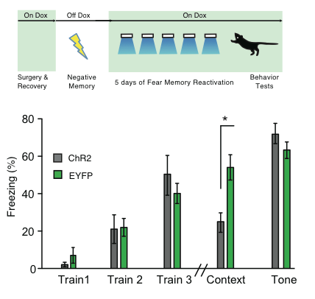
Dorsal hippocampus-mediated extinction?
Untagged
Context B
Tagged
Context A
Chronically reactivate
Context A cells in Context C
**
**
**
Untagged Context B
Tagged Context A
Notes:
STRONG FC protocol

Slide 20
Ventral hippocampus-mediated enhancement?
Untagged
Context B
Tagged
Context A
Chronically reactivate
Context A cells in Context C
**
**
Untagged Context B
Tagged Context A

Slide 21
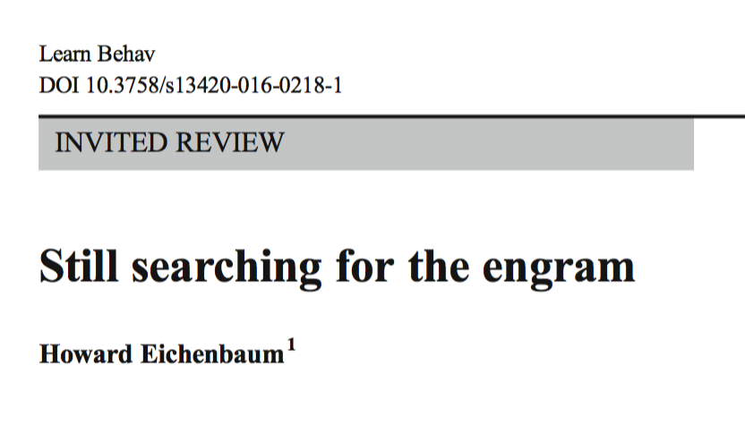
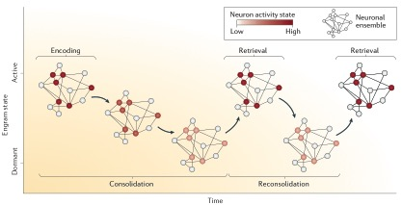
Engrams: triumphs and challenges

Slide 22
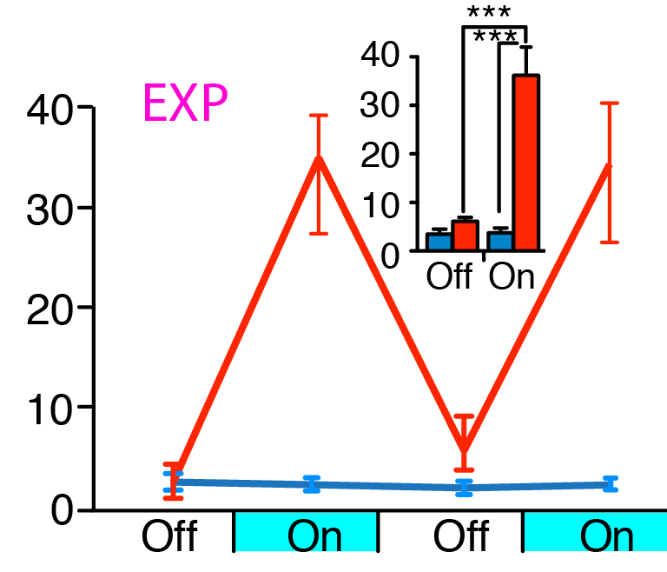
Necessity and sufficiency are not necessarily sufficient
Under which conditions are brain regions/circuit X
necessary and/or sufficient for output Y
(Liu et al. 2012; Kheirbek et al. 2013; Denny et al. 2014)

Slide 23

Artificially modulating >10,000 DG cells simultaneously at 20hz with 15ms pulse widths for 3 minutes is not how the DG naturally fires during memory recall.
And yet…
5hz; retrosplenial
20hz; DG
20hz; BLA
(Cowansage et al. 2014)
(Liu et al. 2012; Stefanelli et al. 2016)
(Gore et al. 2014; Yiu et al. 2014)
Notes:
These do not recapitulate endogenous firing patterns and yet have beh effects => drugs

Slide 24
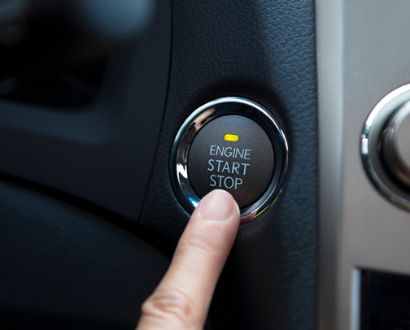
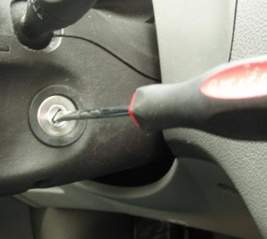
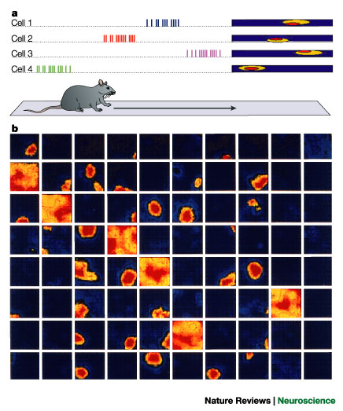
How does a car work How can a car work
How does memory work How can memory work

Slide 25
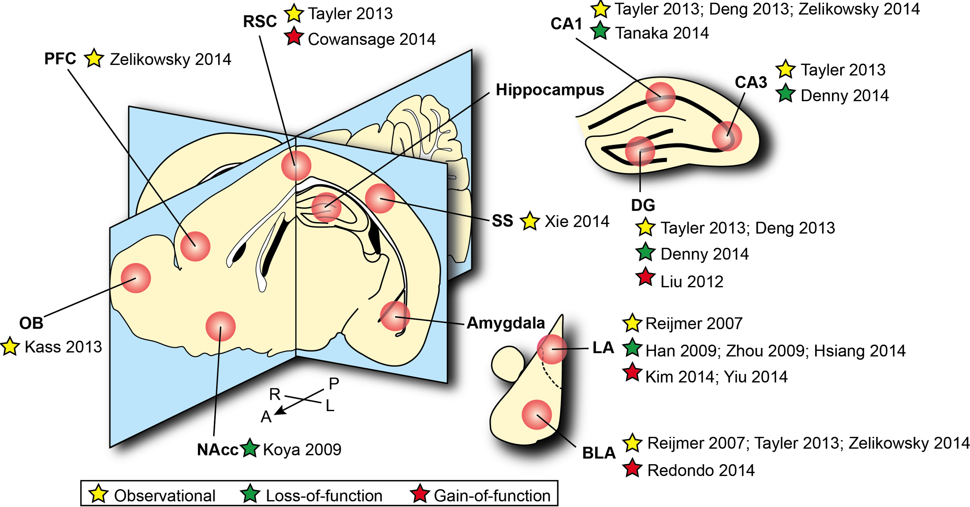
The many ways to induce the same behavior

Slide 26

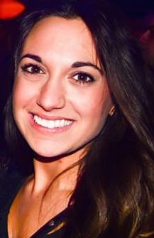



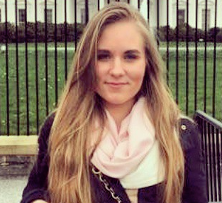





theramirezgroup.org

