Slide 1

Schizophrenia &
Multiple Personality Disorder
Tufts Ex College
March 11, 2014
http://skeptikai.com/

Slide 2

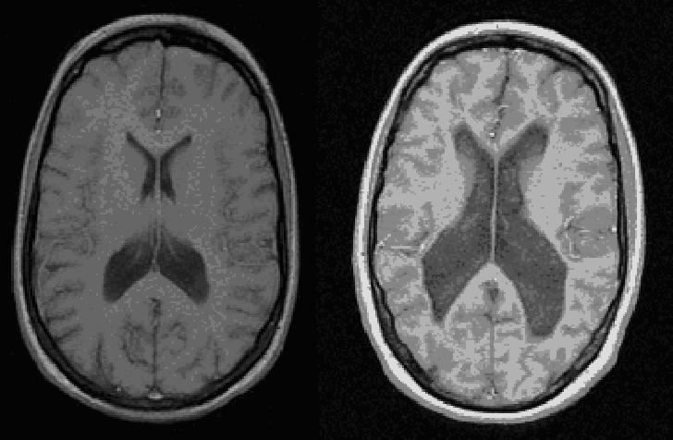

A pattern of broken thoughts:
Schizophrenia, A Beautiful Mind, and Fight Club

Slide 3
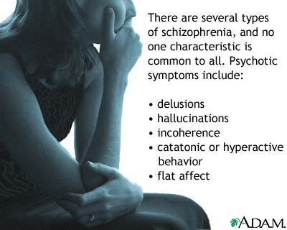
Schizophrenia is a disorder of the brain
^{Schizophrenia is a syndrome:}
A collection of signs and symptoms of unknown etiology
In its most common form, schizophrenia presents with paranoid delusions and auditory hallucinations
It usually manifests late in adolescence or in early adulthood (ages 18-25).

Slide 4
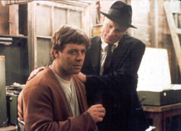
Schizophrenia is a disorder of the brain
Schizophrenia refers to “split-mind” in the sense that our mind is breaking up (NOT split personality).
This has lead to the misconception of split personality.
Symptoms: what is the most common symptom of schizophrenia?
http://www.youtube.com/watch?v=TA4N3K1oaEs
Thought Disorder.
A Portrayal of Thought Disorder

Slide 5
The real face of schizophrenia
http://www.youtube.com/watch?v=ZB28gfSmz1Y
What are some notable symptoms?

Slide 6
Schizophrenia has positive and negative symptoms
Positive symptoms are the presence of abnormalities
Negative symptoms are when something that should be there is not.
http://www.youtube.com/watch?v=O3qyC6Z3t5g
Positive or negative symptom?

Slide 7
Schizophrenia and A Beautiful Mind
Positive:
Psychosis—experiencing or believing things that have no basis in fact.
Hallucinations are sensory experiences for which there is no basis in fact.
Delusions are beliefs for which there is no basis in fact.
Negative:
The absence of a normally present trait: e.g., blunted affect (they do not show the proper emotion in response to a situation).
Withdrawal or staying away from social interaction is another negative symptom.
http://www.youtube.com/watch?v=BKV1SxfmeYQ
Positive or negative symptoms?

Slide 8
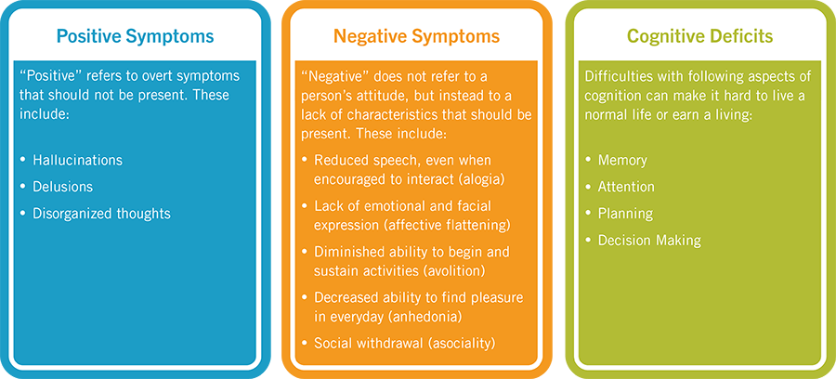

Slide 9

Donnie Dark and Schizophrenia
http://www.youtube.com/watch?v=DFmxDgNCGY8
http://www.youtube.com/watch?v=idFHPcv6sSs
Frank, hallucinations, and delusions

Slide 10
Fight Club and “Split-Mind Disorder”
http://www.youtube.com/watch?v=GZs0DPcF8A4
http://www.slate.com/blogs/browbeat/2014/01/21/fight_club_minus_tyler_durden_is_pretty_cool_video.html
A hallucination or second
personality?
http://www.youtube.com/watch?v=XEGDslQirug
The Changeover

Slide 11
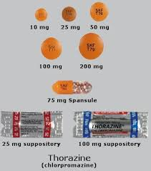
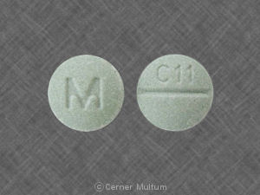
Schizophrenia is a disorder of the brain
In the 1950s, Thorazine started the drug revolution in psychiatry.
This is a “typical antipsychotic” and helps
with positive symptoms
Have many motor side-effects
But then in the 1990s, Clozapine came along.
It is an “atypical” antipsychotic and helps positive and negative symptoms
These have less motor side-effects

Slide 12
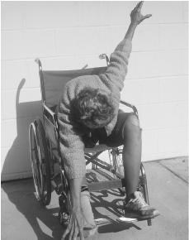
Schizophrenia is a disorder of the brain
Henri Labori wanted to use less general anesthetic, or a “pre-anesthetic” to make patients less nervous
Others adopted it for schizophrenia and found that it helped with positive symptoms.
A common side effect of Thorazine was a reduced ability to move, rigidity
What brain area could be affected?
Catatonic state

Slide 13
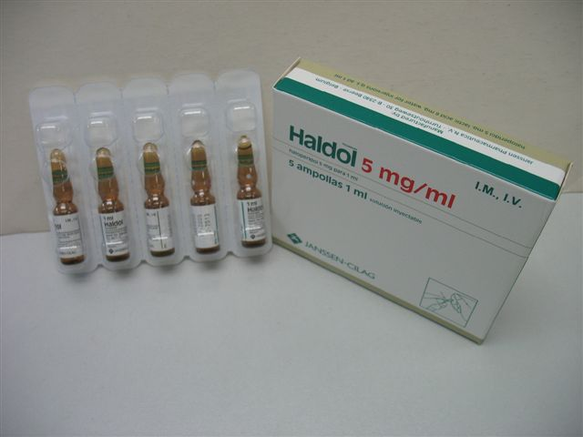
Schizophrenia is a disorder of the brain
Nearly every effective anti-schizophrenic drug blocks Dopamine D-2 receptors.
In other words, they are Dopamine antagonists.
Too much dopamine hypothesis?
Amphetamine abuse, which increases dopamine, can produce delusions and auditory hallucinations in healthy people
Haldol is the most widely prescribed typical antipsychotic drug in the world.
Motor side effects: tardive dyskenesia-- involuntary muscle movements

Slide 14
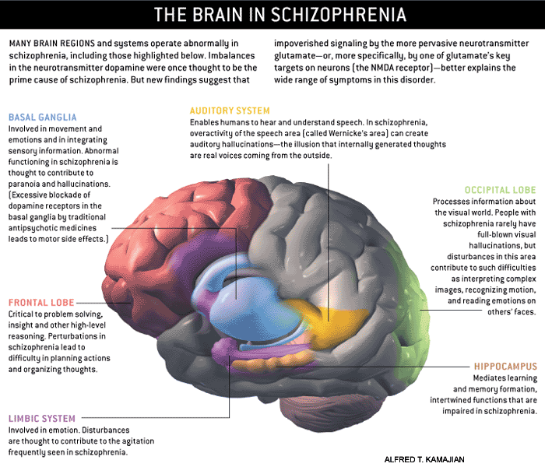

Slide 15
Multiple paths to Schizophrenia?
In schizophrenic patients, one subset of delusions is Grandiosity.
This means fantasy-like, grand, beyond what is reasonable.
A typical grandiose delusion is that they will be president of the United States.
http://www.youtube.com/watch?v=PMtkv1zgi8o
A Beautiful Mind
Two major hypothesis:
1) the too-much dopamine hypothesis
2) the too-little glutamate hypothesis
Too little glutamate hypothesis:
frontal cortex does not fire as normally as it should. There is less frontal cortex activity.
Animal models?
http://www.youtube.com/watch?v=TfDVLsBXYcM
Fight Club and dissociating

Slide 16
Schizophrenia and the PFC

Slide 17
The real face of schizophrenia revisited
http://www.youtube.com/watch?v=UTUMt05_nCI
What are some notable symptoms?

Slide 18
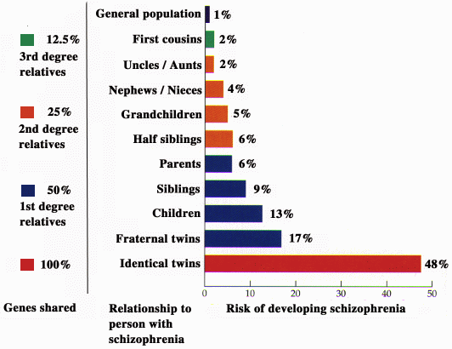
Schizophrenia has a genetic component
For monozygotic twins, there is a 50% “concordance rate” for schizophrenia.
But this is not 100%. Why?

Slide 20
Broken brain pieces lead to broken thoughts.
http://www.youtube.com/watch?v=1VJS8dIla2I

Slide 21
Schizophrenia is not
Multiple Personality Disorder
“Schizophrenia beats dining alone.” -Oscar Levant
“The idea of stardom was difficult to grasp. It was like being schizophrenic; there was her, the woman on television, and the real me.” -Jessica Savitch
http://skeptikai.com/

Slide 22
Dissociative Identity Disorder
(Multiple personality disorder)
http://www.youtube.com/watch?v=7TlYGivBGYE
Helen -> Adam at 1:05
Helen -> William at 4:12

Slide 23
Comparison of features
Schizophrenia
Dissociative Identity Disorder
1.1% of population 18 and older
Equal in men and women
Hallucinations
Delusions
Disorganized speech
Disorganized behavior or catatonia
Negative symptoms (flat affect, avolition, alogia)
Estimates vary: 0.1-1%
Frequently misdiagnosed
3-9X more common in women
Multiple distinct personalities
Often the consequence of abuse
Frequent amnesia
Rarely, auditory and visual hallucinations
Poorly described in DSM

Slide 24
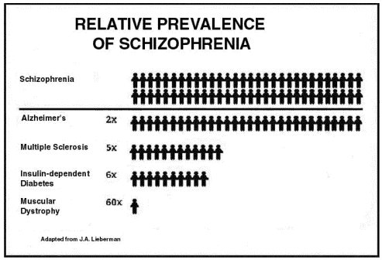

Slide 25
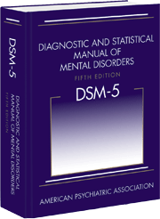
Diagnosing Schizophrenia
>2 symptoms for large part of 1 month
  Hallucinations
  Delusions
  Disorganized speech
  Disorganized behavior or catatonia
  Negative symptoms (flat affect, avolition, alogia)
Total duration of disturbance must be >6 months

Slide 26
Hallucinations and Delusions
Examples of Hallucinations
Examples of Delusions
Most commonly auditory, such as hearing voices
Seeing things such as crawling bugs
Feeling hands or fingers on one’s body
wears aluminum foil in the belief that it will stop one's thoughts from being broadcast and protect against malicious waves entering the brain
Belief that the radio is sending coded messages about an impending alien invation
Belief that the CIA has implanted microchips in one’s body to track their moves

Slide 27
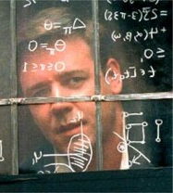
Hollywood’s John Nash
Social withdrawal
Loss of hygiene
Delusions - paranoid
Delusions - grandiose
Hallucinations (hearing or seeing things that aren't there)
The sense of being controlled by outside forces
Disorganized speech
Disorganized or erratic behavior
Smoking (90% of SCZ smoke)
Body rigidity and tremors

Slide 28
Common Symptoms of Schizophrenia
Positive symptoms: hallucinations, delusions
Negative (or deficit) symptoms: Reduced motivation, reduced attention, reduced response to pleasure, social withdrawal, difficulty in expressing emotions (flat affect), poor hygiene
Cognitive symptoms: Reduced attention, impaired working memory, difficulty remembering simple tasks
Affective (or mood) symptoms: depression, anxiety.
Notes:
Point out dopamine and glutamate symptoms

Slide 29
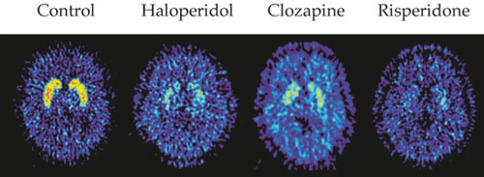
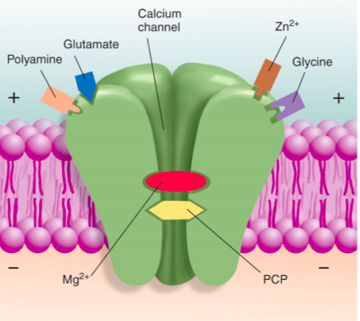
Hypotheses of Schizophrenia
Dopamine Hypothesis
Glutamate Hypothesis

Slide 30
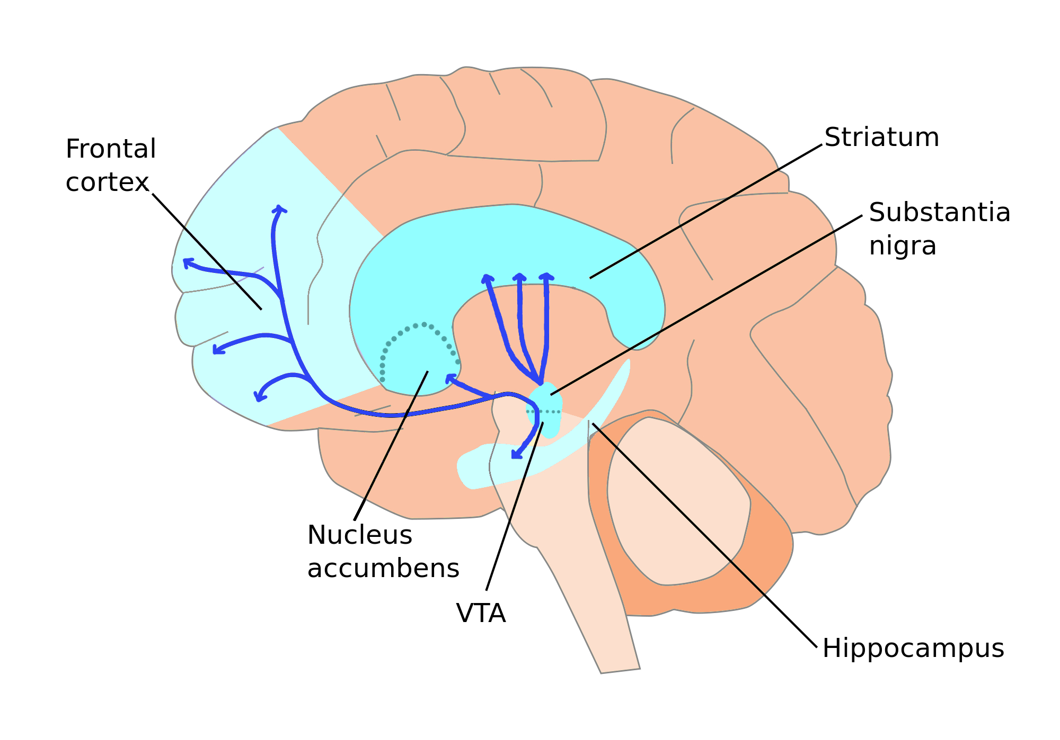
Dopamine pathways of the brain
Notes:
Human brain

Slide 31
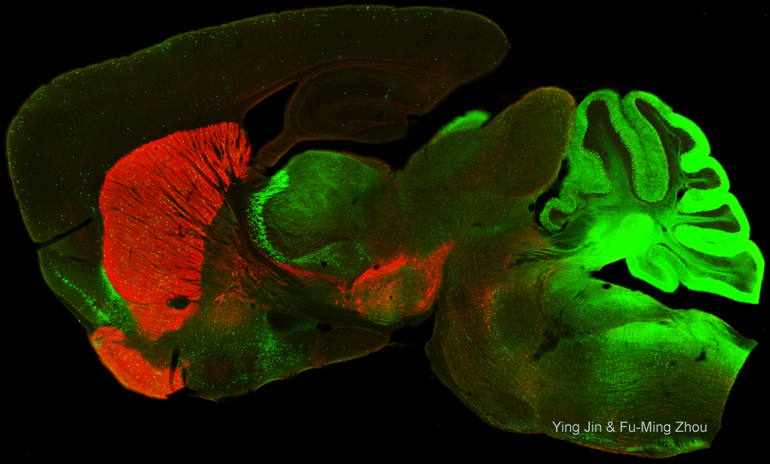
Dopamine pathways of the brain
Hippocampus
Frontal Cortex
Thalamus
Cerebellum
d. Striatum
VTA
SNc
v. Striatum
(Nucleus Accumbens)

Slide 32
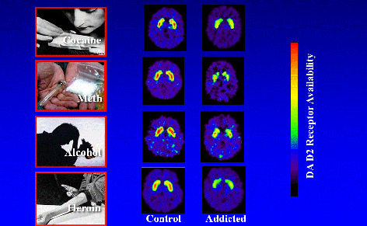
D2 receptors decreased by addiction

Slide 33
Antipsychotics
Compete with radiolabelled D2 receptor agonist

Slide 34
Glutamate Hypothesis
Evidence for Glutamate Hypothesis
ketamine and PCP induce hallucinations, delusions, reduced attention, and working memory
Risperidone reverses working memory deficit in mouse model lacking NMDARs receptors in cortex and hippocampus

Slide 35
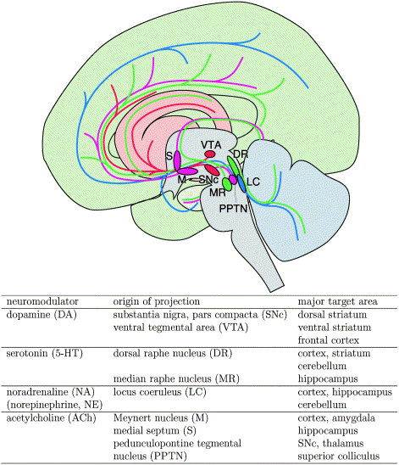
Six major neurotransmitters and where to find them
Glutamate producing neurons
Norepinephrine
Dopamine
Serotonin
Acetylcholine
GABA producing neurons
Neuromodulatory neurons and their axonal projections:

Slide 36
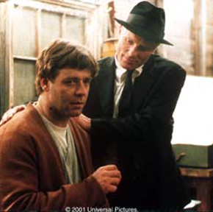
Group discussion
Recall the scene in A Beautiful Mind in which John Nash appears to attack his wife and baby, but believes he is protecting her from the attack of his hallucination (Ed Harris). If he had actually done harm and been taken to court, should he be considered culpable for his actions?
What if Helen’s aggressive personality “Brenda” had decided to sue her friend for libel over the documentary she made? Should she have a right to legal action?

Slide 37
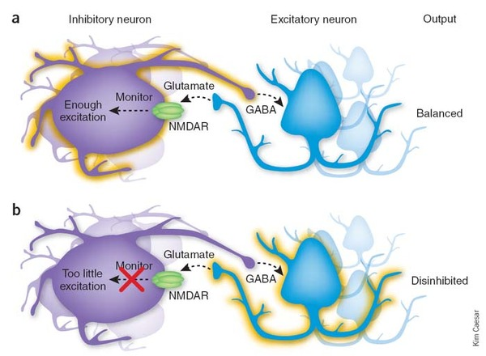
Glutamate Hypothesis:
NMDA Receptors on GABA neurons

