Slide 1


How to erase memories in humans and rodents
Notes:
1.5M lecture
Things they like / don’t like after each class

Slide 2
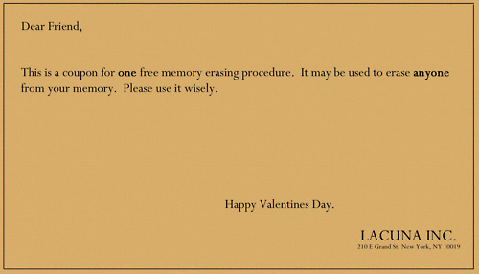
Lacuna Commercial
http://www.youtube.com/watch?v=UAlZ0SJzCcw

Slide 3
Allocating and manipulating memories
CREB
Active
Learning
Am.
Am.
Ablated
Memories can be artificially allocated to a subset of neurons and subsequently erased by killing these neurons
Fear memory
Am.
Notes:
Those studies all treat brain structures as a whole and don’t have much specificity. A more accurate approach to study memory involves isolating specific memory traces by analyzing the specific neurons active during memory formation. This has been most elegantly done by hijacking the molecules that are activated whenever a neuron is activated. These include TF’s and IEGs.

Slide 4
Today’s Forecast
Beginning
a: Student Presentations
Middle
a: Consolidation, Reconsolidation, and Extinction
3) End
a: Eternal Sunshine and Memory

Slide 6
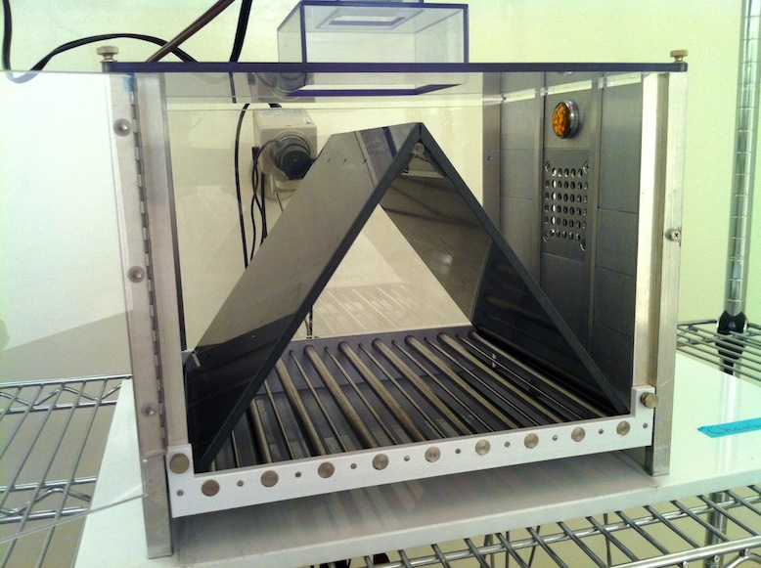


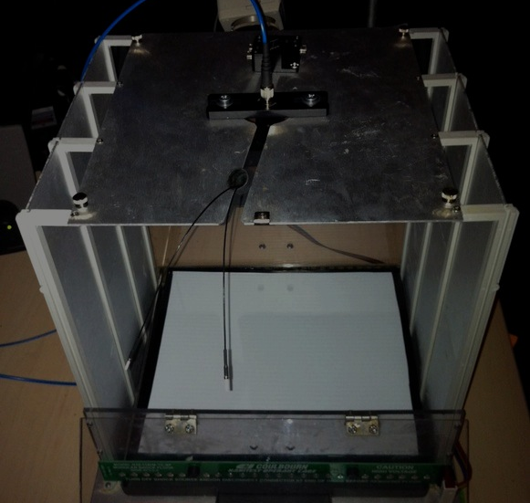
Behavioral Test: Fear Conditioning
Day 1 Day 2
Freezing
Context A
Context A
Context A
No
Freezing
Context B
Training
Testing
Context B

Slide 7
p.314
Memory Consolidation
Consolidation: The process by which memories become stabilized in our brains over time.
This stabilization process engages different brain regions depending on the age of the memory
Mapping memories
http://www.criticalcommons.org/Members/ccManager/clips/eternalSunshineMemoryErase.mp4/view
W. W. Norton

Slide 8
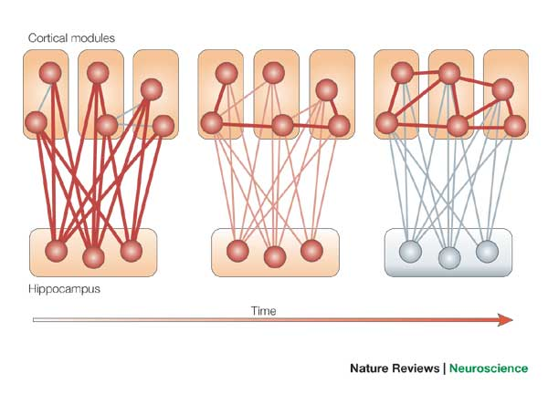
p.314
Propose an experiment that would test this hypothesis of consolidation
Eternal Sunshine Memory Clip
http://www.youtube.com/watch?v=Wz6Adofmjyc
Notes:
Draw on board

Slide 9
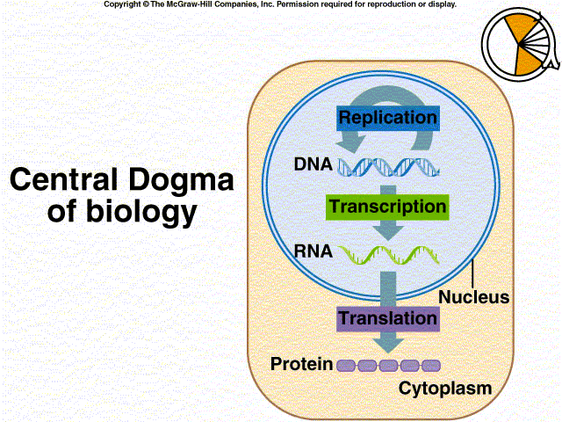
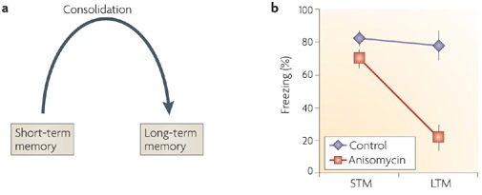
Consolidation and making new proteins
Anisomycin: A protein synthesis blocker
The formation of new memories requires the formation of new proteins to “strengthen” the connections between brain cells.
Hebb’s Rule: Neurons that fire together wire together.
It’s this “wiring” that requires protein synthesis

Slide 10
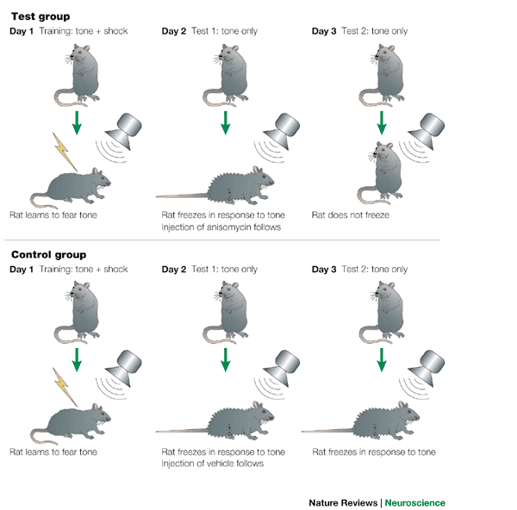
Reconsolidation
Reconsolidation: the process by which stored memories become “destabilized” or “labile” and susceptible to modification
Joe LeDoux on Reconsolidation
http://www.youtube.com/watch?v=zRuUQiIgyj4

Slide 11
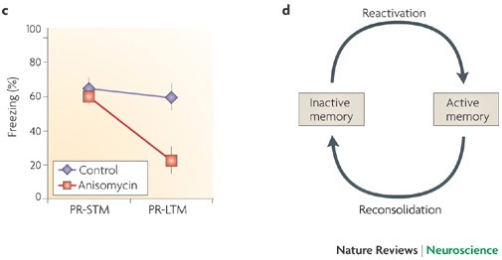
Reconsolidation depends on the
synthesis of new proteins
Pre-test
Test

Slide 12
Extinction is a way of learning to no longer fear a stimulus
Day 1 Day 2
Day 3… Day … 10
Context A
No
Freezing
Freezing

Slide 13
Extinction is a way of learning to no longer fear a stimulus
What are some examples of extinguished memories in your life?
Note that extinction does not erase the memory, it simply wipes away the negative emotional component
A brief explanation of extinction and therapy
http://www.youtube.com/watch?v=YVoyxZc0NrA

Slide 14
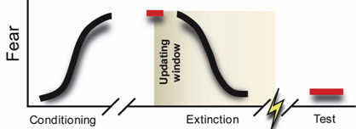
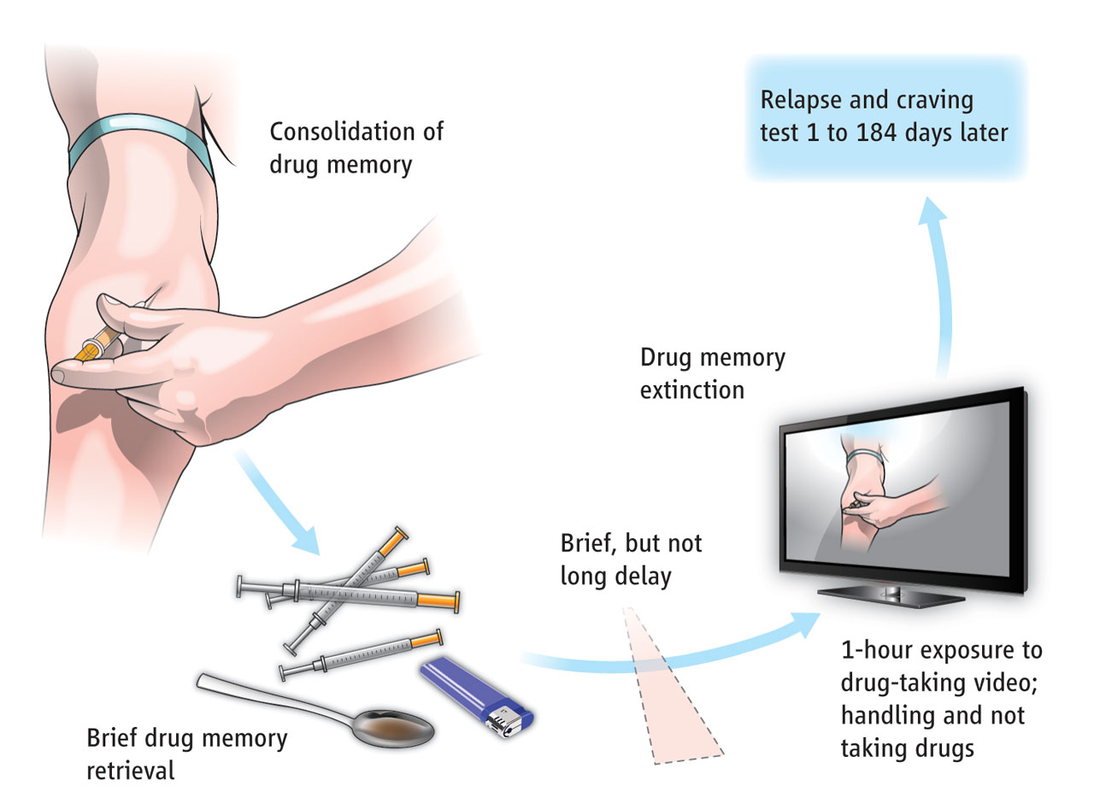
Combining Consolidation, Reconsolidation, and Extinction

Slide 15
Thing to never ever ever forget #2 and 3
Things to never ever (seriously NEVER PLEASE) forget after this course #forscience:
1) Recalling a memory is a reconstructive process not a perfect tape-recorded version of the past
2) Forming a memory requires the synthesis of new proteins.
3) Reconsolidation is the process of “updating” a memory with new information that was not present when the memory was initially formed

Slide 16
Memories we’d like to erase
What therapeutic purposes can you think of for “modifying” memories?
How would you implement this?
Think about what the amygdala and hippocampus do and what Eternal Sunshine gets right / wrong
Erasing Clementine
http://www.anyclip.com/movies/eternal-sunshine-of-the-spotless-mind/erasing-clementine/
Notes:
HARVARD experience

Slide 17
Memory Erasure and Eternal Sunshine
How is memory portrayed?
http://www.youtube.com/watch?v=3et9liRrywY
What aspects of the memory are
being erased?
http://www.youtube.com/watch?v=lFHLE24hDQY
Would you erase this kind of memory?
http://www.youtube.com/watch?v=fGxKi81F52w

Slide 18
Group Project
What are the benefits of erasing memories? What kind should be erased?
If I just recently got out of a break up and I wanted to erase the following, where and how would you begin tinkering around?
A recent memory of my ex-girlfriend
The emotional, heart-wrenching feeling of the break up
If I got out of the relationship 5 years ago, and I wanted to erase the memory, where would you begin to look?
Notes:
Tools: anisomycin, extinction, reconsolidation

Slide 19
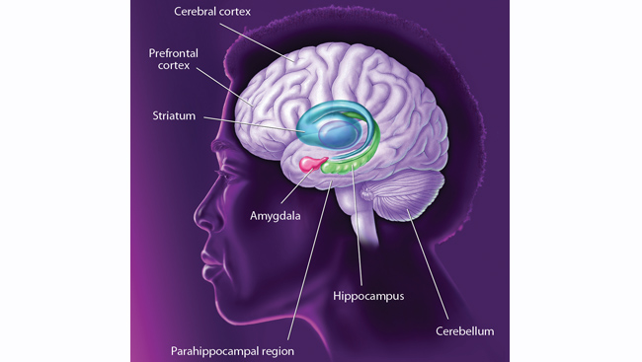
Name that brain area!

